Slide 1
Student Bios

Slide 2
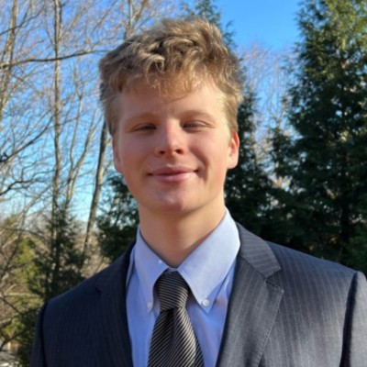
Nicholas firestine
Nick is a fourth-year undergraduate from Maryland, pursuing a Bachelor of Science with majors in Finance and Accounting. He is the president of the Accounting Honors Society, Beta Alpha Psi and a Sellinger Scholar. Upon graduation, Nick will be working as an Investment Banking Analyst on the M&A team at Oppenheimer & Co. in New York City. In his free time, Nick enjoys to fish, play poker, and surf.

Slide 3
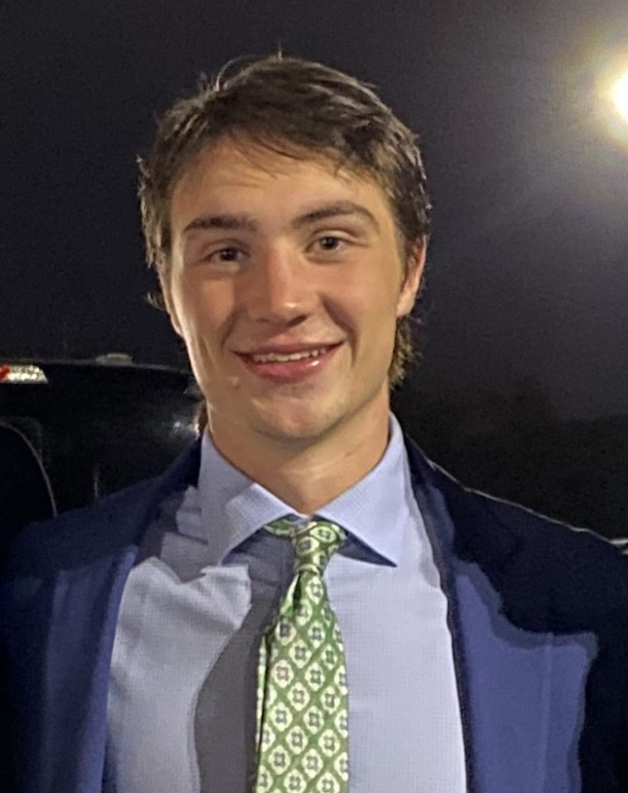
Max McGillicuddy
Max McGillicuddy is a fourth-year undergraduate from Connecticut, pursuing a Bachelor of Science with a concentration in Finance and a minor in Innovation and Entrepreneurship. He is also a member of the Loyola Men's Lacrosse team. Upon graduation, Max will be working as a financial analyst at IBM in New York. In his free time, Max loves to spend time with family and friends, as well as travel.
.

Slide 4
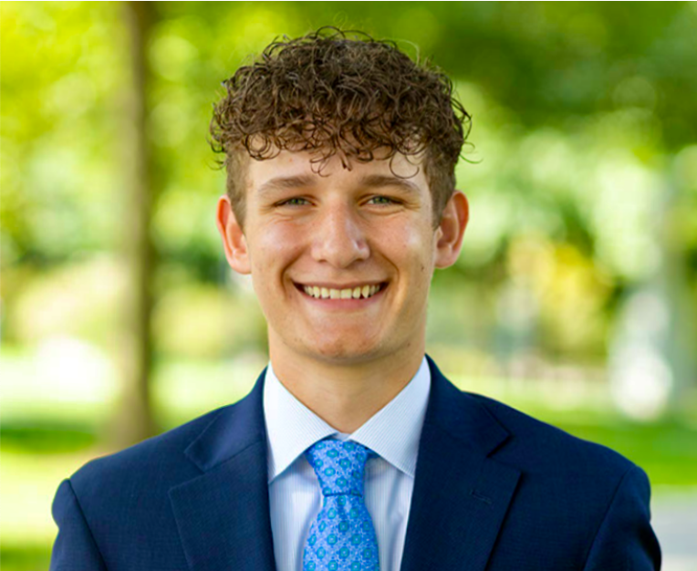

Joe Crema
Joe is a fourth-year undergraduate from Amityville, New York, pursuing a B.S. in Finance with a minor in Marketing. He is a member of Financial Management Association, Investment Club, and Advocates for Inclusion. Upon graduation, Joe will be joining JP Morgan Private Bank as an analyst. In his free time, Joe works closely with the special needs community, as he is the co-founder of Challenger Athletics Soccer, a 501c3 charity with the goal of providing learning and physically disabled children with the opportunity to play soccer.

Slide 5
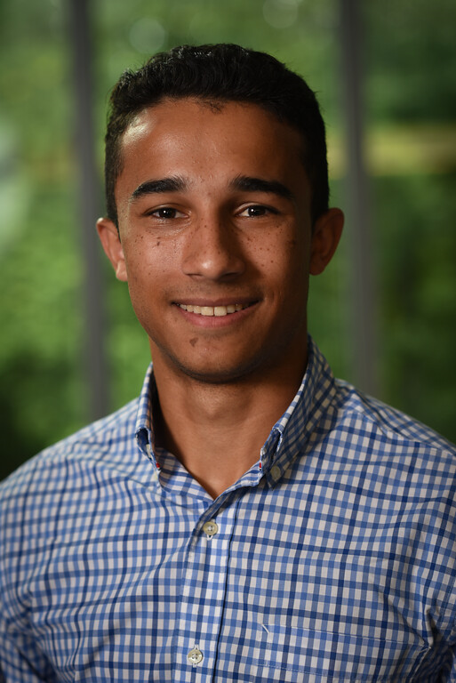
John Regan
John is a fourth-year undergraduate from New Jersey, pursing two bachelor’s degrees in Finance and Information Systems. He is a member of the Investment Banking club, Sellinger Scholars Board, and Club eSports . Upon graduation, John will be moving to Charlotte, NC and joining Wells Fargo as an analyst in their Supra Sovereign Agency debt origination team. In his free time, he enjoys poker, skiing, and cooking

Slide 6
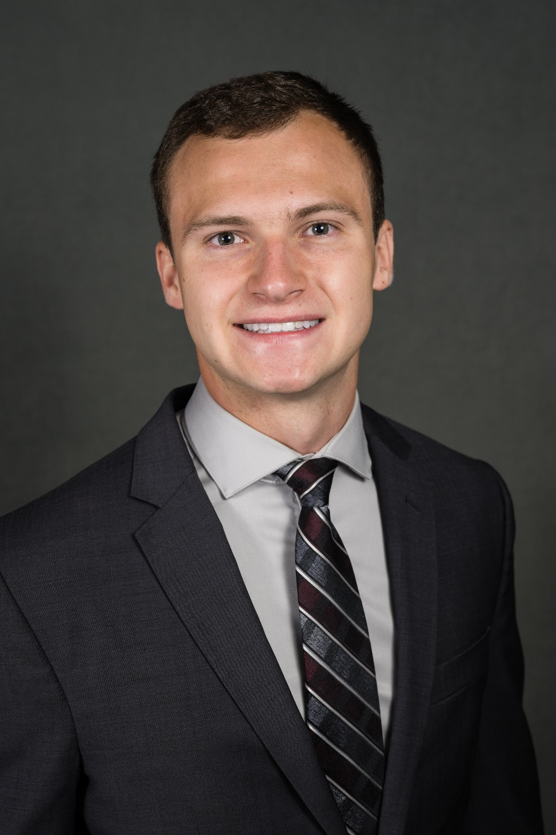
Alex Grahor
Alex is a fourth-year undergraduate from Pittsburgh, pursuing a Bachelor of Science in Finance and Information Systems and Data Analytics, and minoring in Mathematics. He has been a member of the Men’s Swim team for the past four years and is involved on campus as the treasurer of Loyola’s Knights of Columbus council and a volunteer at the campus chapel. Upon graduation from Loyola, Alex will be joining SMBC, where he previously interned. In his free time, Alex enjoys playing guitar, biking, and fishing.

Slide 7
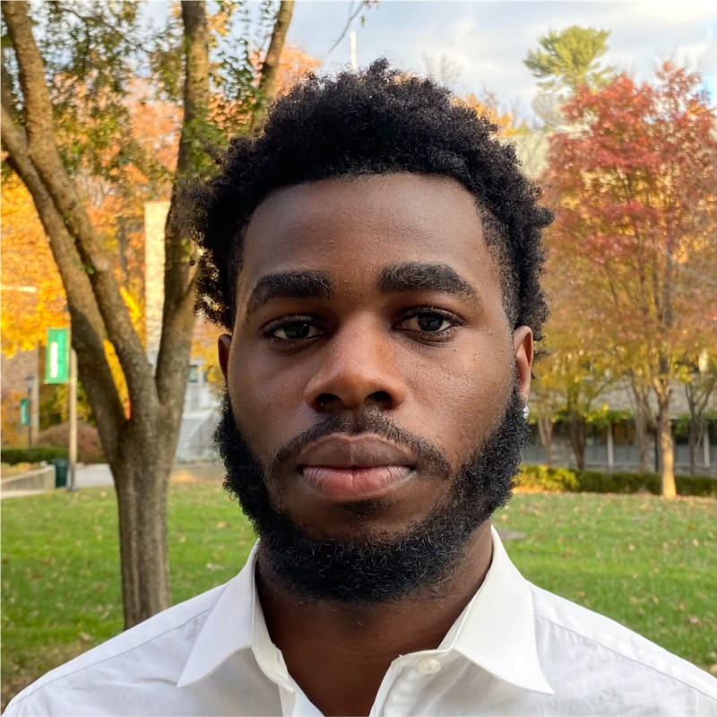
Adesina (Tjaay) Adetunji
Adetunji Adesina is a senior undergraduate student from Providence, Rhode Island, pursuing a Bachelor of Science with a Double Major in Finance and International Business. He is involved in Sellinger Scholars, Financial Management Association, and the Office of Loyola Residence Life. Upon graduation, Adetunji plans to join Bank of America in the Summer of 2024. In his free time, he enjoys watching crime documentaries, playing video games, and spending time with family.

Slide 8
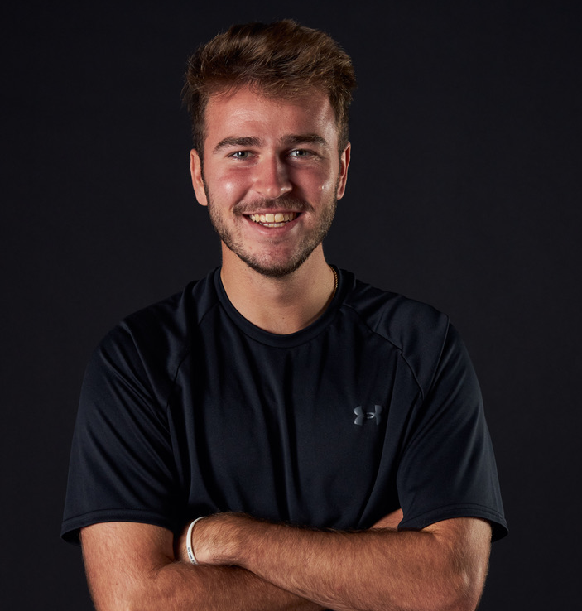
Cameron wallace
Cam is a fourth-year undergraduate from Wilmington, Delaware pursing a BS in Finance and Leadership & Organizational Effectiveness. At Loyola, he works Gameday Operations for the Athletics department, is a member of Financial Management Association, Club Soccer, and Male Practice Player for both the D1 Women’s Basketball and Soccer teams. Upon graduation, Cam will be returning to JPMorgan Chase & Co. In his free time, he enjoys spending time with friends, watching sports, and staying active.

Slide 9
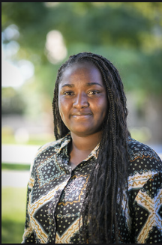
Zainab Oladejo
Zainab Oladejo is a fourth-year undergraduate from Harford Maryland, pursing a Bachelors with a concentration in Finance and a double minor in Accounting, Information System and Data Analytics. She is involved in FMA, ALANA, WIB and peer conduct board. Upon graduation, Zainab will be working at Morgan Stanley. In her free time, she likes to hike, travel, spend time with family, and explore new things.

Slide 10
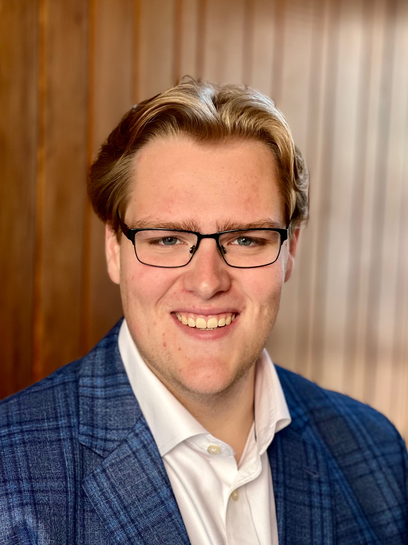
Andrew Schmutter
Andrew is a fourth-year undergraduate from Cranford, NJ, pursing a Bachelor of Science with a concentration in Finance and Information Systems. He is a Member of Student Government Association and has participated in the Investment Club and the Loyola Consulting Group. Upon graduation, Andrew will be working as a Venture Capital Analyst at StepStone Group. In his free time Andrew enjoys hiking and portrait photography

Slide 11
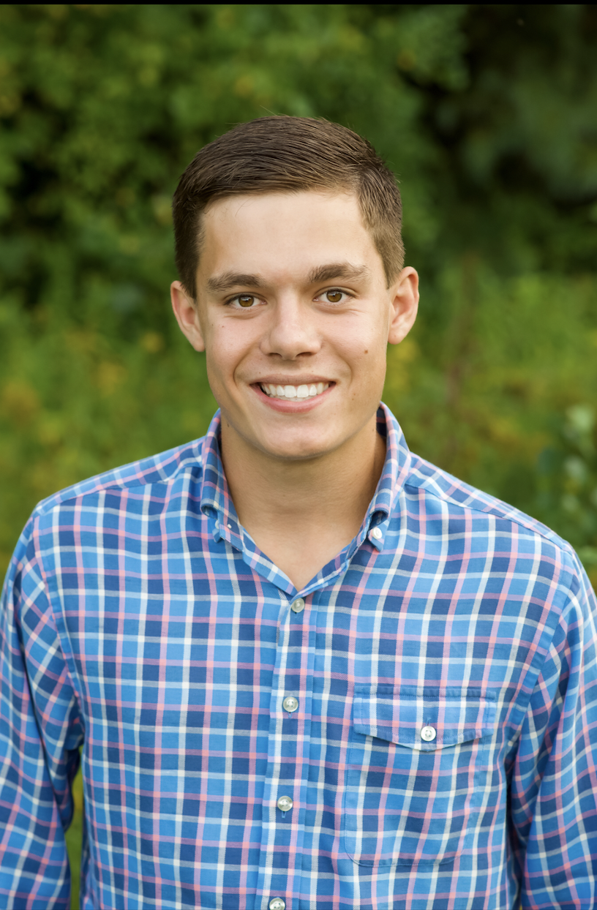
Oliver Davey
Oliver is a fourth-year undergraduate from Westford, MA, pursing a Bachelor of Science degree with a concentration in Finance and Business Sustainability. He is a member of the Men’s Tennis Team, Loyola’s Student-Athlete Advisory Council, and Loyola’s Chapter of the Financial Management Association. Upon graduation, Oliver will be an Analyst at Scotiabank on their Power & Utilities Investment Banking Team. In his free time Oliver enjoys playing golf.
Write to here*

Slide 12
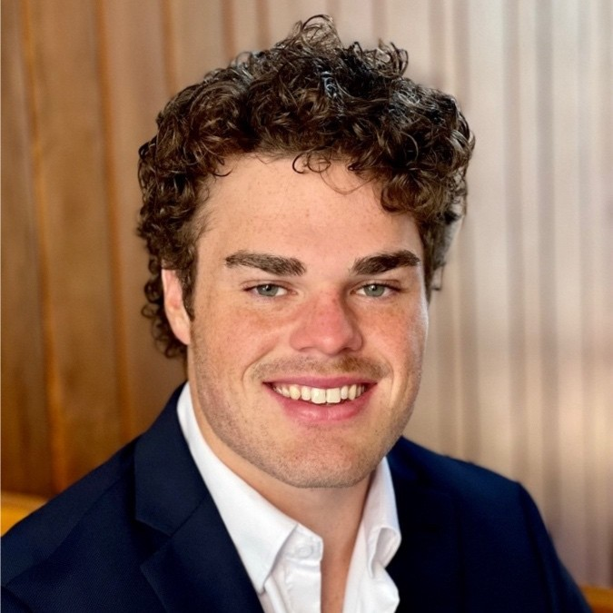
Declan Budnitz
Declan is a fourth-year undergraduate from Baltimore, MD, pursing a Bachelor of Science in Finance. He is a member of Club Lacrosse and sits on the Steering Committee of The Simon Center for Innovation & Entrepreneurship. Upon graduation, Declan will be working as an Analyst at StepStone Group. In his free time, he enjoys practicing Jiu-jitsu and reading.

Slide 13
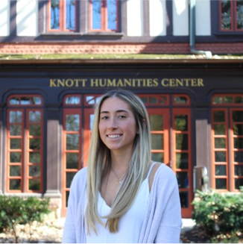
CAROLIne COTE
Caroline is a fourth-year undergraduate from Long Island, NY, pursing a Bachelor of Science in Finance with a minor in Entrepreneurship. She is a member of Women in Business and Letters to Elders​. In her free time, she enjoys real estate, travel, exercise, and baking​

Slide 14
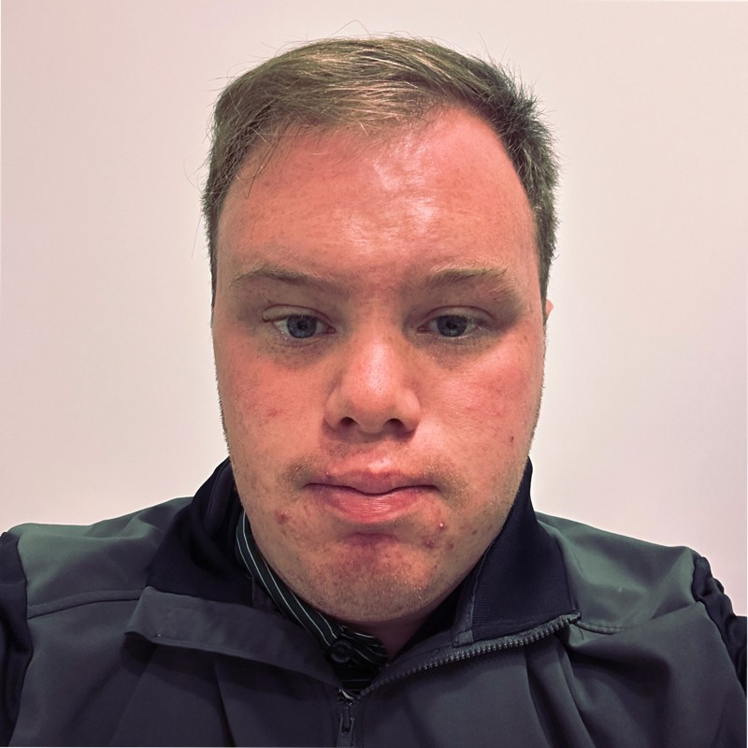
Richard Clow
Richard Clow is a fourth-year undergraduate from Walpole, MA, pursing a Business degree with a concentration in Finance & Information Systems. He is the President of Investment Club, Greyhound Writer, and Rugby Player. Upon graduation, Richard will be starting as a Financial Representative at Fidelity Investment. In his free time, he enjoys hiking, reading, and doing home improvement projects.

Slide 15
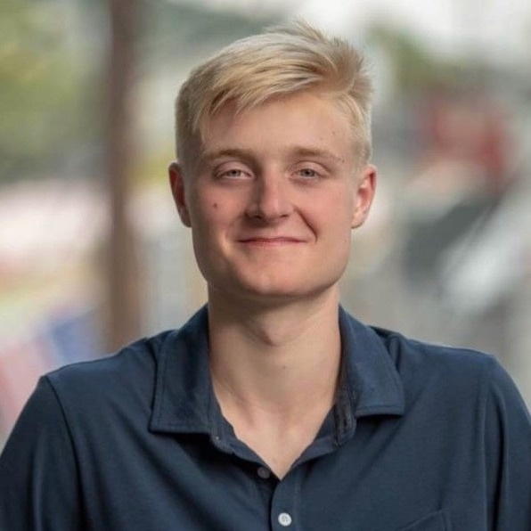
Nolan Walchko
Nolan Walchko is a fourth-year undergraduate from Ellicott City, MD, pursing a Bachelor of Science with a concentration in Finance. He is a Member of the Sellinger-Student Advisory Board. Upon graduation, Nolan plans to be working as a financial advisor and hopes to pass the Series 7 exam. In his free time, he enjoys watching sports and playing video games.

Slide 16
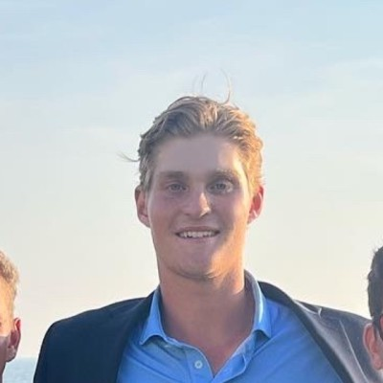
Aidan Harding
Aidan is a fourth-year undergraduate from Fairfield CT, pursing a B.S. with a concentration in Finance. Aidan is a member of the Club Basketball team as well as Chess Club. Upon graduation, Aidan will be pursuing a job in the financial field. In his free time, he enjoys to be on a golf course as well as being with his family.

Slide 17
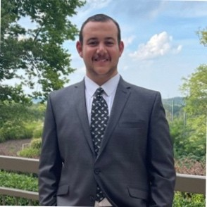
Christopher Sidrak
Chris Sidrak is a fourth-year undergraduate from Bel air MD, pursing a Bachelors Degree with a concentration in Finance & Information Systems. He is an officer of the Loyola Investment Club and won the 2020-2021 Loyola Intramural Table Tennis award. Upon graduation, Chris will pursue a Full-Time job as a Financial Advisor. In his free time, he enjoys traveling, trying different cuisines, playing table tennis, and spending time with family.

