Slide 1



Slide 2

SELLINGER APPLIED PORTFOLIO FUND
Summer 2024

Slide 3

Table of Contents
Investment Policy
Market Performance
Economic Conditions
Current Events
Sector Overviews
ETF Performance
Growth Strategy
Value Strategy
Dividend Strategy
Risk Analysis
Performance Review

Slide 4
Investment Policy

Slide 5
Overview of Sellinger Applied Portfolio Fund
Purpose: Provides students with hands-on portfolio management experience
Background:
Annual investment: up to $500,000 provided by the University. Follows a stated investment policy and all investments are liquidated annually at course end
Learning Objectives:
Dynamically apply principles learned from prior finance specialization courses (capital market principles, modern portfolio theory, linkages to international markets) to serve as portfolio/investment managers of the Sellinger Applied Portfolio Fund
Perform asset valuation, constraint setting asset allocation, asset selection, risk management, and performance evaluation in real-time.
Balance theory with pragmatic considerations of current market conditions
Evaluate all decisions within the context of current events
Collaborate with peers through consensus decision making
Develop written and oral communication
Employ reflective learning to strengthen decision making skills

Slide 6
INVESTMENT PHILOSOPHY
Ethical Considerations
Moral and social considerations grounded in the US Conference of Catholic Bishops’ principles of investments guide our investing decisions
Allowable Investments
U.S. exchange listed stocks, including ADRs
Unleveraged ETFs, including stock index and commodity ETFs
Investment grade securities only
Unallowable Investments
“sin” stocks:
  manufacturers of cigarettes
  alcohol
  firearms
  companies engaged in gambling activities
*Added emphasis on ESG/Sustainable Investments

Slide 7
INVESTMENT STRATEGIES
Primary Investment Philosophy:
Select stocks that are undervalued and will outperform both their industry and the S&P500 index over the course of the investment period
Diversification is integral to the portfolio, and the decision to under-weight or overweight certain sectors is judged on real-time market conditions.
Asset Allocation Targets:
<=10% invested in any one stock
<=25% invested in a single index
<=30% invested in a single sector
Weighting towards any one strategy depends on the existing economic conditions:
Growth Strategy: companies expected to grow at a faster rate than industry averages
Value Strategy: stocks trading at prices below their inherent value (identifying undervaluation)
Dividend Strategy: high dividend-yielding stocks

Slide 8
Research Sources & Process
Primary Research Databases:
Bloomberg
S&P Global Capital IQ
Morningstar Direct
Fundamental Analysis Tools:
Debt Ratios
Return on Assets Ratios
Return on Equity Ratios
Price to Earnings Ratios
Price to Earnings Growth Ratios
Current Ratios
Quick Ratios
Additional Research Sources:
Company Announcements
Global Market & Foreign Exchange
Inflation/Unemployment/Housing Statistics
Consumer Confidence
Interest Rates & Federal Reserve Announcements
Political News

Slide 9
Oversight & Process
Investment Committee of the Board of Trustees:
  Approve allocation of SAP Fund
  Monitor performance of SAP fund
Students:
  Conduct research and rebalancing within portfolio
  Prepare buy and sell requests for approval
Faculty:
  Provide oversight and direction to students
  Submit buy/sell requests to Associate VP Financial Services/Controller for approval, and to Investment and Treasury Associate for processing
  Submit semester-end reports detailing Fund performance to internal stakeholders
Office of Business & Finance:
  Associate VP Financial Services/Controller approves buy/sell requests
  Investment & Treasury Services enters buy and sell requests for trade execution
Investment Consultant:
  Provides quarterly Fund performance reporting within wider University endowment

Slide 10
Market Performance

Slide 11
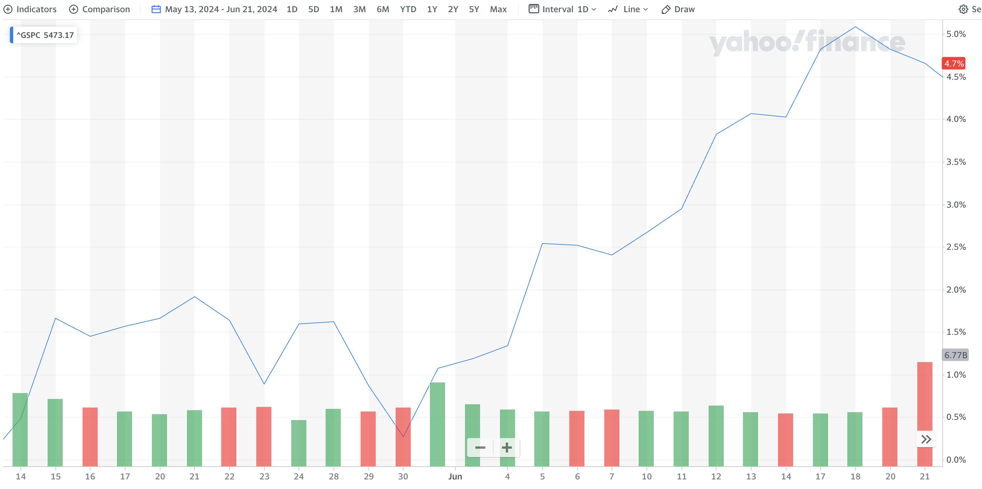
S&P 500 Performance
From market open on Monday May 13th, the week class began, to market close on June 21st, the week we sold out of our holdings, the S&P500 finished up 4.7%
The data below shows historical performance figures for the S&P500 as of June 21st, 2024
1 Mo | 3 Mo | YTD | 1 Yr. | 3 Yr. | 5 Yr. | 10 Yr.
3.8% | 4.4% | 14.7% | 25.7% | 31.2% | 85.2% | 178.4%

Slide 12
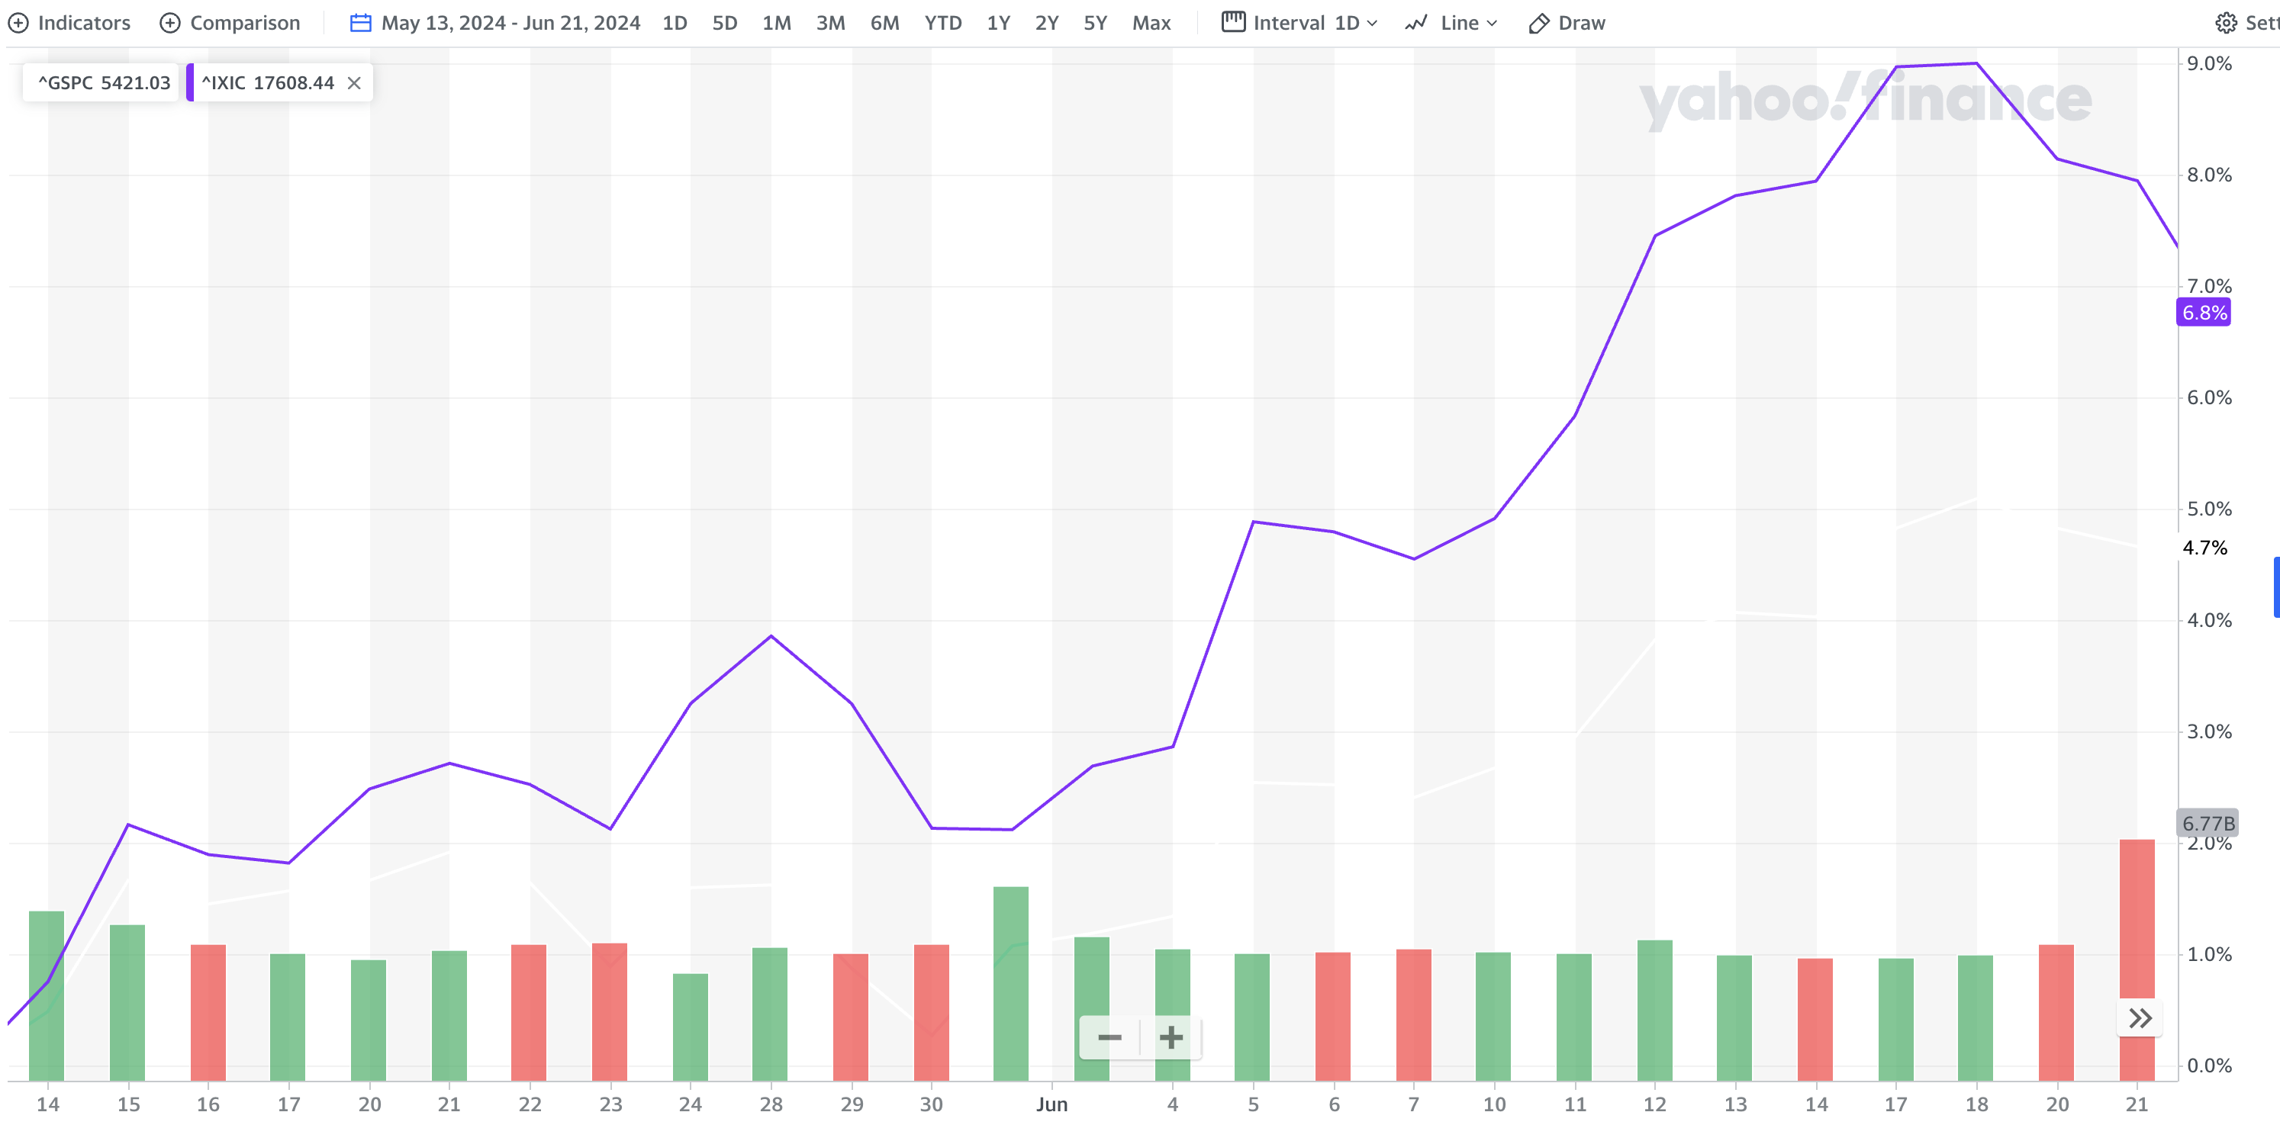
NASDAQ Performance
From market open on Monday May 13th, the week class began, to market close on June 21st, the week we sold out of our holdings, the Nasdaq finished up 6.8%
The data below shows historical performance figures for the Nasdaq as of June 21st, 2024
1 Mo | 3 Mo | YTD | 1 Yr. | 3 Yr. | 5 Yr. | 10 Yr.
5.9% | 7.9% | 18.6% | 32.0% | 26.9% | 122.4% | 303.9%

Slide 13
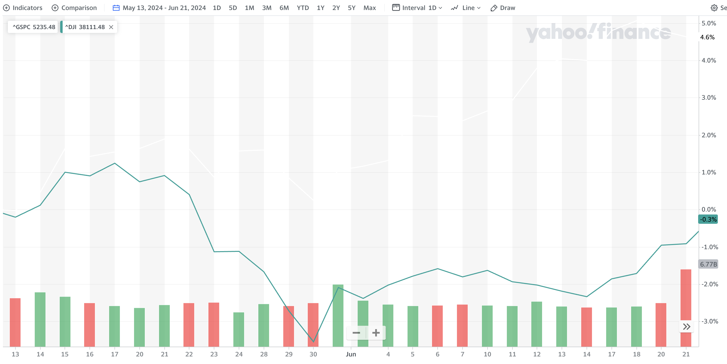
DOW Jones Performance
From market open on Monday May 13th, the week class began, to market close on June 21st, the week we sold out of our holdings, the Dow Jones finished down -0.3%
The data below shows historical performance figures for the Dow Jones as of June 21st, 2024
1 Mo | 3 Mo | YTD | 1 Yr. | 3 Yr. | 5 Yr. | 10 Yr.
0.1% | -1.6% | 3.8% | 16.0% | 17.6% | 47.1% | 132.6%

Slide 14


Economic Conditions

Slide 15
Monetary Policy
In response to rampant post-covid inflation, the Federal Reserve embarked on the most aggressive tightening cycle in the last 30 years from the perspectives of both speed and magnitude.
Source: Factset, Team Research

Slide 16
The Federal Reserve’s Dual Mandate
Inflation is stagnant above the Federal Reserve’s 2% target. However, unemployment has begun to edge higher which may motivate the Fed to begin easing monetary policy in late 2024 or early 2025.
Source: Factset,
Team Research

Slide 17
Labor Market
Aggressive monetary tightening has led to a significant decline in job openings. Despite the stable unemployment rate thus far, jobless claims data point to a rising unemployment rate in the near future.
Source: Factset,
Team Research

Slide 18
Equities look beyond delayed rate cuts
Rate cuts have been delayed due to stubborn inflation and a tight labor market. However, equity performance have become more focused on fundamentals as earnings estimates continue to march higher.
Source: Factset,
Team Research

Slide 19
Consumers have Begun to weaken
Moderating Retail Sales growth and an uptick in delinquencies show that consumers are starting to feel the lagged impact of tighter monetary policy and cumulative inflation.
Source: Factset,
Team Research

Slide 20
Household Net Worth
It’s hard to envision a severe downturn is imminent with Household Net Worth at ~7.6x disposable income. Strong equity returns driven by AI have stabilized Net Worth despite economic headwinds.
Source: Factset,
Team Research

Slide 21
Current
Events

Slide 22
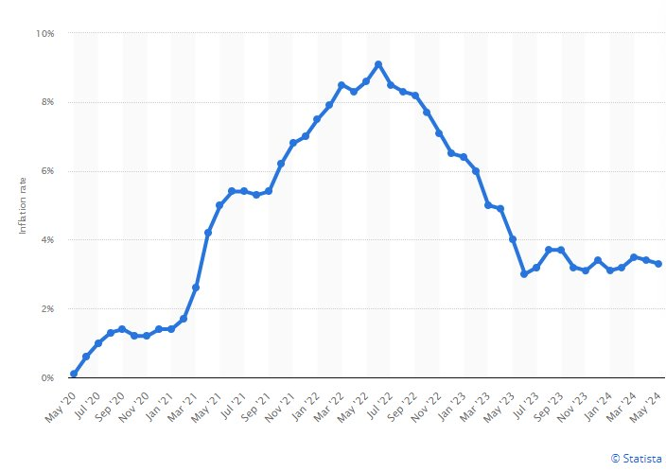
Improving Inflation Data Boosts S&P500 Index
Studies and recent economic data suggest that inflation is cooling at a steady pace without any serious forecasts of decline​
Inflation slowed in May even while +272,000 jobs were added to the US economy ​
Last month, the consumer price index (CPI) rose 3.3% year-over-year in May (down from a 3.4% gain in April). This latest reading proves that the Federal Reserve is making progress against inflation​
Interest rates remain steady but there are expectations of cutting rates before the end of the year (which is likely a cause of the positive momentum in the stock market)​
Wall Street analysts project that S&P 500 companies' second-quarter earnings will increase +9% YoY, which is the largest increase since Q1 2022​
For the year, the S&P 500 is up 14%; YTD the S&P 500 is up 12.6%
“That growth and inflation mix is pretty favorable, and the other leg of the stool is the AI investment surge, which is tremendous,” -David Lefkowitz, head of U.S. equities at UBS Global Wealth Management
As of 6/28: Inflation flat in May, for a YoY rate that dropped to 2.6% (using PCE Price Index), according to a report Friday from the Bureau of Economic Analysis
Sources: Wall Street Journal, Forbes, MarketWatch

Slide 23
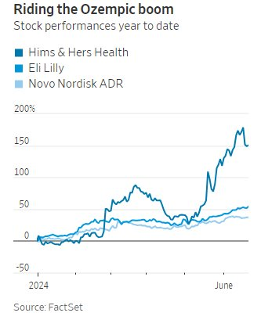
GLP-1 & Ozempic
  Huge demand in America for weight loss medications, some GLP-1s are on the FDA shortage list​.
  Last month, Hims & Hers announced an offering of compounded forms of injections that use the same active ingredients as Ozempic​.
  Hims & Hers' offering fills a void and comes at a bargain of a price compared to Eli Lilly and Novo Nordisk's products​.
  Both Novo and Lilly have tried to express the health concerns in using compounded drugs that are not FDA approved and have filed lawsuits to stop the sale of compounded versions of their drugs, but their attempts have failed thus far​.
  Once all GLP-1’s come off the FDA shortage list, the risks could be different for companies producing compounded forms on a large scale​.
  Due to the newer nature of the "Ozempic boom" companies are still not clear how this will play out and those investors should take caution around investing in this area ​
  Within the Wall Street Journal article, the title reads: "The War Over Cheaper Ozempic Won’t End Well for Some Investors"
Source: Wall Street Journal

Slide 24
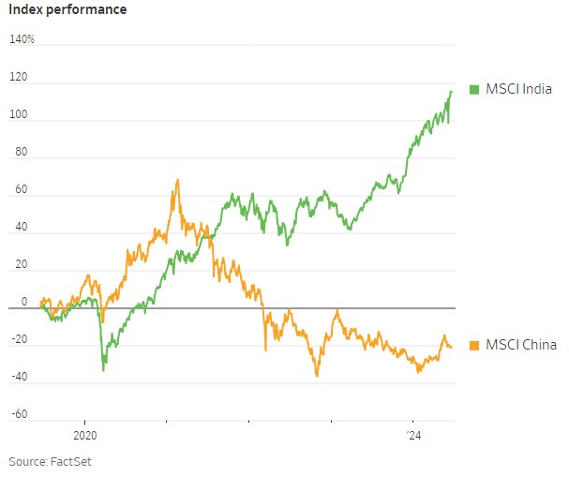
India vs. China – Contrasting Markets
From the end of 2019 through 6/17, the MSCI India Index surged 110% while the MSCI China index is down by 30% over the same period​
China's housing market is collapsing which is contributing to the downturn in the Chinese economy​
India's economy grew by 7.8% year over year in the first quarter and net profit for Indian companies rose 17% year over year (period ending in March)​
"India is increasingly a market that global investors cannot ignore"​
India has been pegged as the "next China" - it's younger population, reformations, and booming economy are contributors
Source: Wall Street Journal

Slide 25
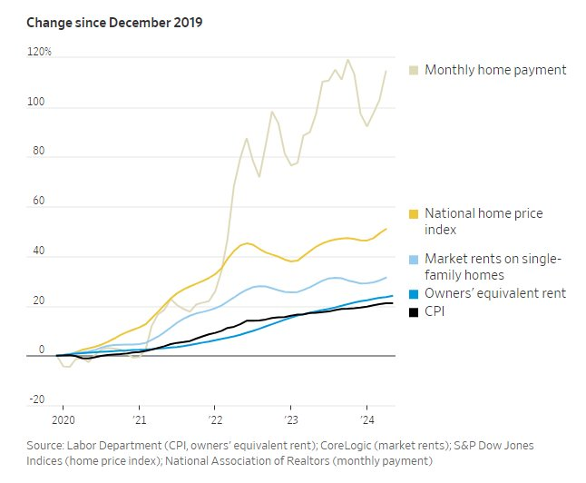
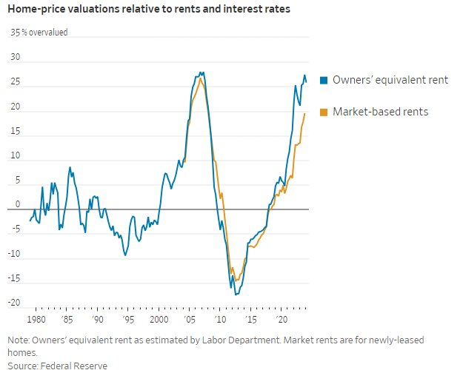
Top of the Housing Market
Homes are more costly than ever. Prices rose 1.2% from March-April and are up ~50% from the end of 2019​.
Warning to investors, homes are highly overvalued. Overvaluation tends to lead to either stagnant or negative returns in following years​.
Rent costs are up, but not as much as the rise in home prices. ​
A model in the Fed's semiannual financial stability report reflects that homes are now 25% overvalued and rent is 19% overvalued​
High demand and low supply is a contributor to the high prices. People don’t want to move from current homes because they have locked in a decent interest rate, immigration, and millennials reaching peak home buying years contribute to this shortage. ​
Not a good time to be buying homes from a landlord's perspective as the rental yields are low​.
Decline in prices is a regional risk​.
Source: Wall Street Journal
Notes:
Sources:
https://www.junglescout.com/wp-content/uploads/2024/03/Jungle-Scout-Consumer-Trends-Report-Q1-2024.pdf
https://www.fitchratings.com/research/us-public-finance/us-consumer-spending-likely-moderates-in-2024-labor-market-underpins-resilience-05-02-2024
https://institute.bankofamerica.com/content/dam/bank-of-america-institute/economic-insights/consumer-checkpoint-january-2024.pdf

Slide 26
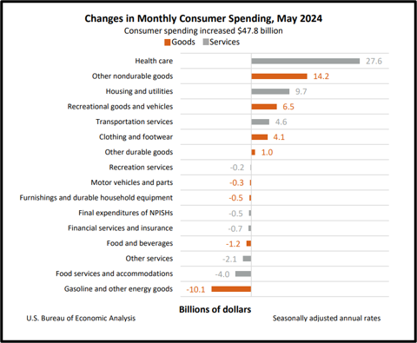
May Consumer Spending Data
Personal income increased $114.1 billion in May and disposable personal income (DPI) increased $94 billion.​
  Driven primarily by increases in compensation, personal income receipts on assets, and government social benefits.​
Consumer spending increased $47.8 billion in May.​
Largest contributors in services: Healthcare, housing & utilities, and transportation services​.
Largest contributors in goods: Other nondurable goods (led by prescription drugs), recreational goods and vehicles, and clothing and footwear​.
Gasoline and other energy goods saw the largest decrease in consumer spending.
Source: Wall Street Journal
Notes:
Sources:
https://www.junglescout.com/wp-content/uploads/2024/03/Jungle-Scout-Consumer-Trends-Report-Q1-2024.pdf
https://www.fitchratings.com/research/us-public-finance/us-consumer-spending-likely-moderates-in-2024-labor-market-underpins-resilience-05-02-2024
https://institute.bankofamerica.com/content/dam/bank-of-america-institute/economic-insights/consumer-checkpoint-january-2024.pdf

Slide 27
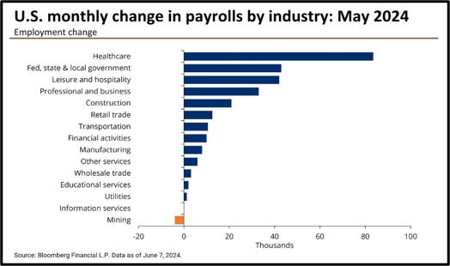
May Employment Data
May 2024:​
U.S. Economy has added +272,000 jobs​
Unemployment rate rose to 4%​
Industries Reporting Losses: Mining​
Industries Reporting Gains: Healthcare, government, hospitality, business, construction, retail trade, transportation, financial activities, manufacturing, other services wholesale trade, educational services, and utilities
Industries With No Change: Information services
Source: Wall Street Journal
Notes:
Sources:
https://www.junglescout.com/wp-content/uploads/2024/03/Jungle-Scout-Consumer-Trends-Report-Q1-2024.pdf
https://www.fitchratings.com/research/us-public-finance/us-consumer-spending-likely-moderates-in-2024-labor-market-underpins-resilience-05-02-2024
https://institute.bankofamerica.com/content/dam/bank-of-america-institute/economic-insights/consumer-checkpoint-january-2024.pdf

Slide 28
SECTOR OVERVIEW

Slide 29
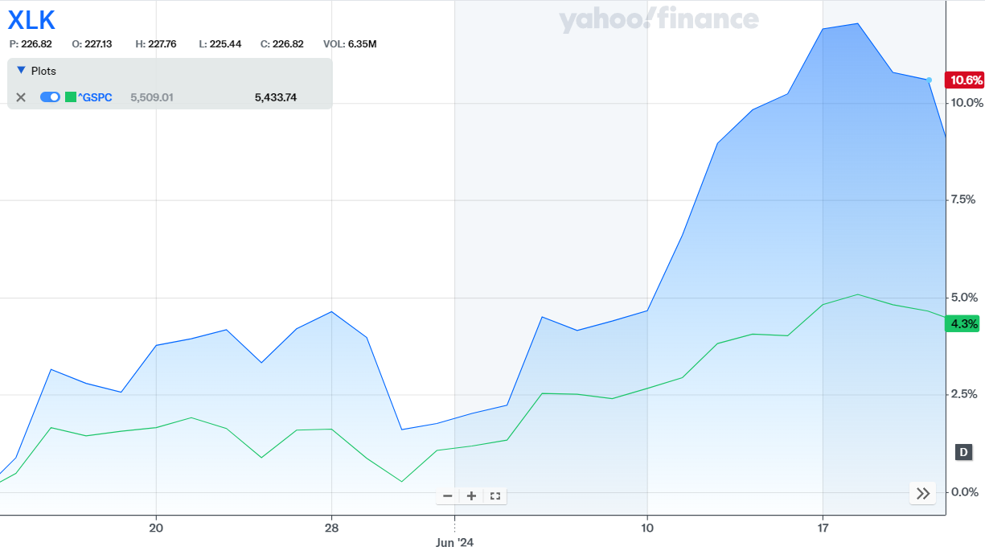
Technology
The Information Technology sector is made up of companies that are engaged with computer operating systems and applications in some form.​ Companies in this sector engage in the following activities: design, development, or support of computer equipment, data storage products, networking products, semiconductors, and various other components. This sector has the largest weight in the S&P 500.
Over the semester, the sector has performed similarly to the S&P 500 but is overperforming as of the end of June.
Position Strategy | Overweight
SAP Target | 34.00%
SAP Weight | 32.56%
S&P Market Weight | 29.20%

Slide 30
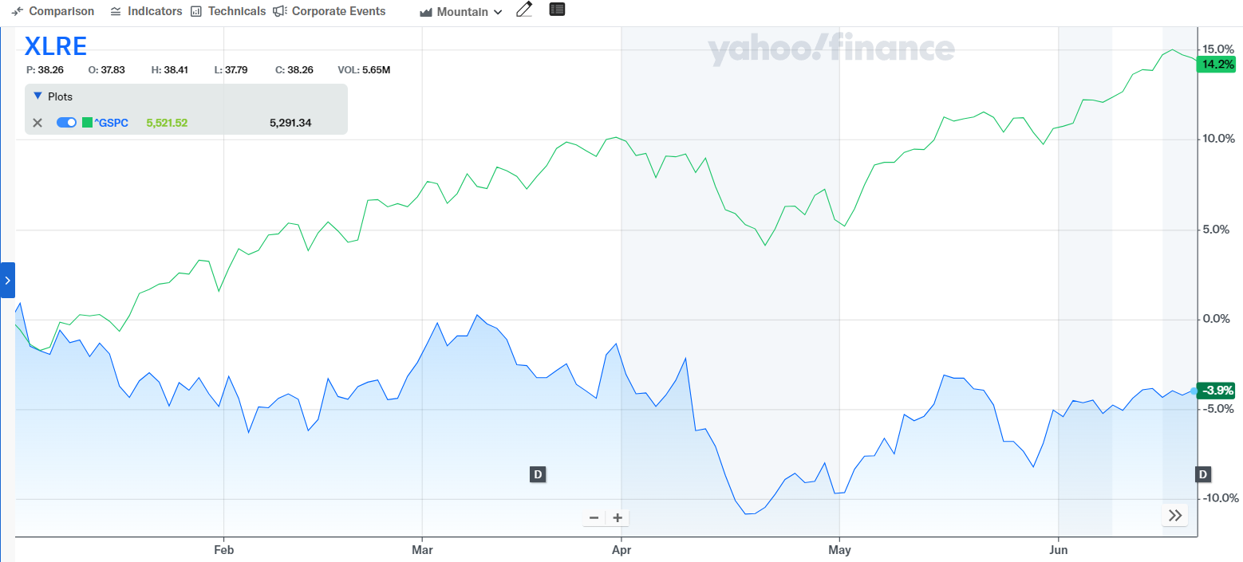
Real Estate
The Real Estate sector of the S&P 500 comprises companies such as Real Estate Investment Trusts (REITs), realtors and traditional real estate companies. It represents approximately 2.9% of the S&P 500. Some notable companies in this sector include American Tower Corp., Boston Properties, and Equinix.
The Real Estate sector has underperformed significantly against the S&P 500 over the course of the year. This is lead by high mortgage rates and high home prices along with a lack of housing supply. While the sector has underperformed significantly, our portfolio does not currently hold any stocks or ETFs in the sector.
Position Strategy | Underweight
SAP Target | 0%
SAP Weight | 0%
S&P Market Weight | 2.17%

Slide 31
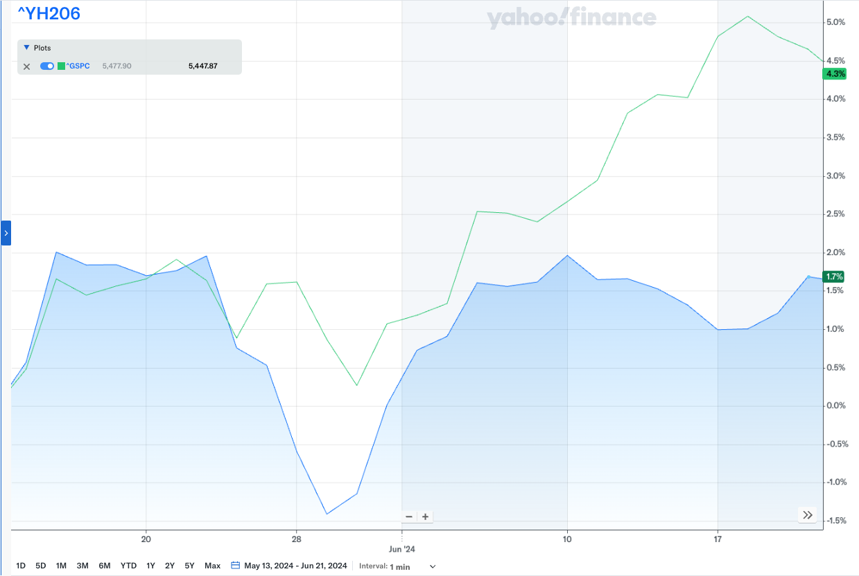
Healthcare
The Healthcare sector is made up of a wide variety of businesses that create products or provide services related to healthcare. The sector is divided into two main categories, Health Care Equipment & Services and Pharmaceuticals, Biotechnology, & Life Sciences, each encompassing various industries and sub-industries.
During our 8-week long course, the Healthcare sector underperformed compared to the S&P 500.
Position Strategy | Overweight
SAP Target | 8.00%
SAP Weight | 8.50%
S&P Market Weight | 10.86%

Slide 32
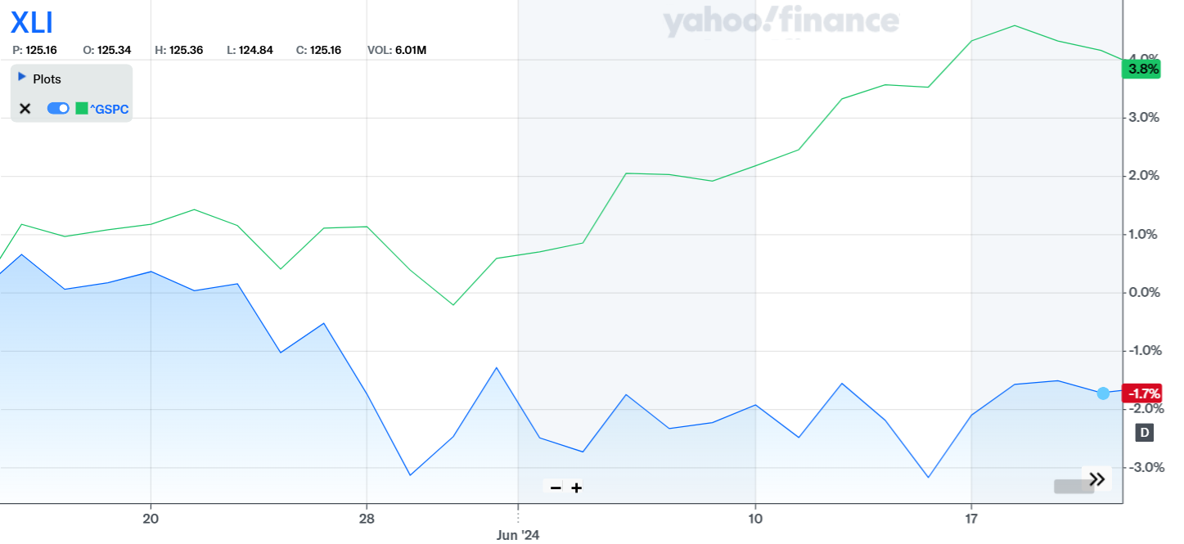
Industrials
The industrial sector encompasses a diverse range of companies involved in manufacturing, construction, engineering, transportation, and other industrial activities. These companies produce goods and provide services essential to infrastructure development, production processes, and logistics
The industrial Sector has underperformed the S&P 500 by slightly more than 5% over the course of the semester. Our portfolio took an underweight position strategy for this sector with a target of 5%, although our final contribution ended at 7.5%. The industrial sector is considered cyclical due to how stocks react to supply and demand. The sector generally performs well during the early phases of the business cycle and tends to drop during recessions.
Position Strategy | Underweight
SAP Target | 5.0%
SAP Weight | 8.3%
S&P Market Weight | 7.5%

Slide 33
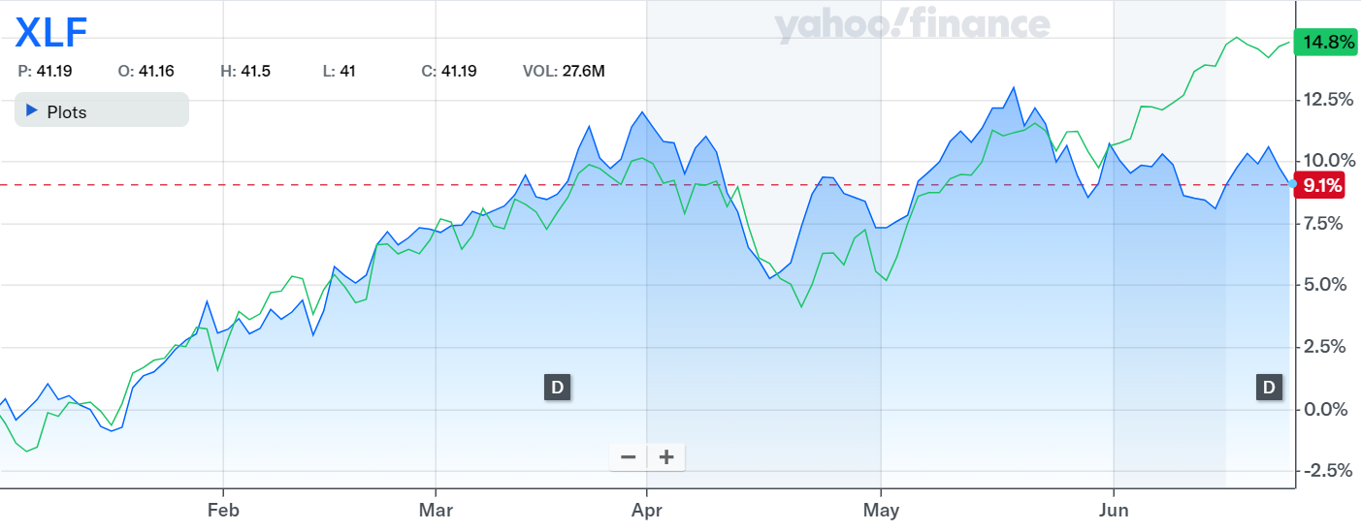
Financials
The Financials sector encompasses a broad range of companies involved in banking, investment, insurance, and real estate. This sector plays a crucial role in the economy by facilitating capital formation, investment, and risk management. Its performance is closely tied to economic conditions, interest rates, and regulatory changes.
The XLF ETF was performing on par with the S&P 500 until June. However, starting in June, concerns about a potential economic slowdown and the possibility of an impending recession led to increased caution among investors. Additionally, uncertainty around future interest rate hikes by the Federal Reserve created instability in the sector, contributing to its decline. As a result, the financial sector began to severely underperform the S&P 500.
Position Strategy | Underweight
SAP Target | 11.00%
SAP Weight | 12.40%
S&P Market Weight | 12.67%

Slide 34
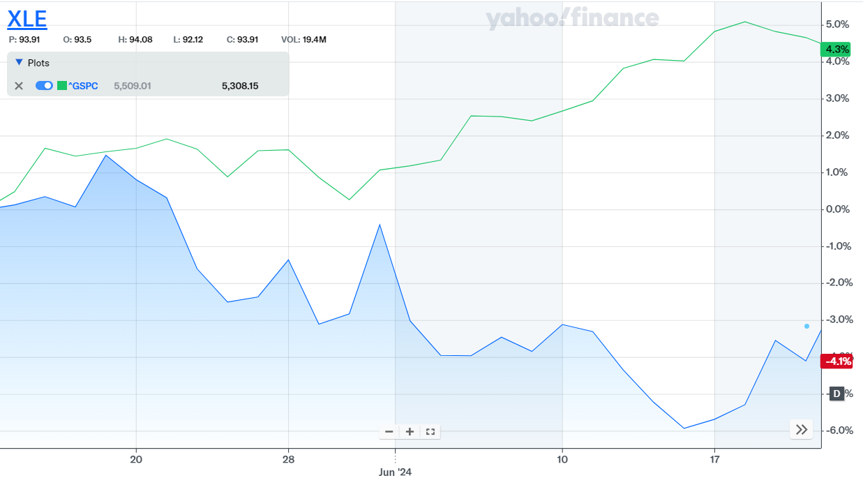
Energy
The Energy sector is comprised of stocks that relate to the production and supply of energy—both renewable and nonrenewable energy sources. Companies in this sector engage in the following activities: exploration and development of oil and gas reserves, providing power utilities, drilling, and refining.
In the beginning of the semester, the energy sector was outperforming the S&P 500, but it began to underperform at the end of May.
Position Strategy | Underweight
SAP Target | 0.00%
SAP Weight | 0.00%
S&P Market Weight | 4.10%

Slide 35
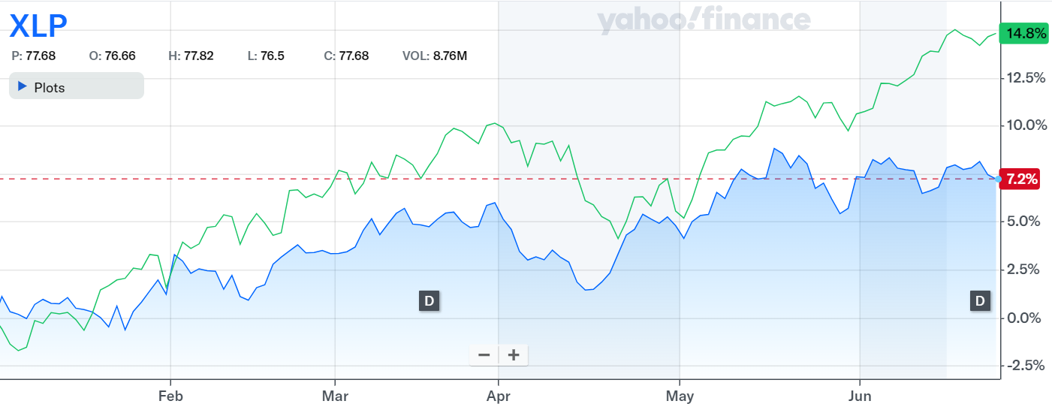
Consumer staples
The Consumer Staples sector includes companies that produce and sell essential products such as food, beverages, household goods, and personal care items. This sector is known for its stability and resilience, as demand for these necessities remains consistent regardless of economic fluctuations.
The XLP ETF has underperformed the S&P 500 so far this year, primarily due to lower overall consumer spending. While the ETF and the consumer staples sector have very low volatility, limiting potential highs, we have adopted an overweight position strategy for this year. This decision reflects our confidence in the sector's stability and resilience despite recent underperformance.
Position Strategy | Overweight
SAP Target | 4.35%
SAP Weight | 6.13%
S&P Market Weight | 5.82%

Slide 36
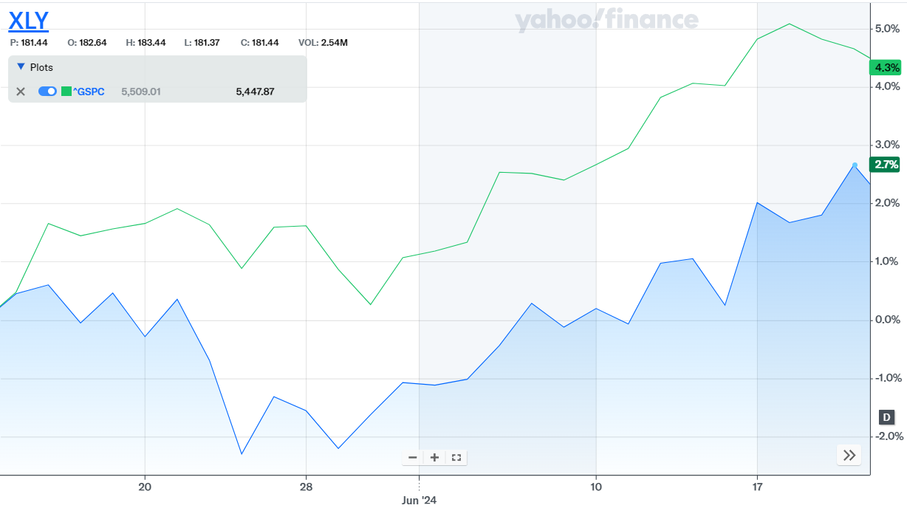
Consumer Discretionary
The consumer discretionary sector is a category of the economy that consists of businesses selling non-essential goods and services. These include companies in industries like retail, automotive, entertainment, and leisure. Consumers tend to buy these goods and services more when they have a higher disposable income, making this sector particularly sensitive to economic cycles. Therefore, the performance of this sector can be an indicator of the overall health of the economy.
The XLY ETF grew by 2.7% throughout the course which underperformed compared to the S&P 500 that grew 4.4%
Position Strategy | Overweight
SAP Target | 12.50%
SAP Weight | 20.54%
S&P Market Weight | 10.48%

Slide 37
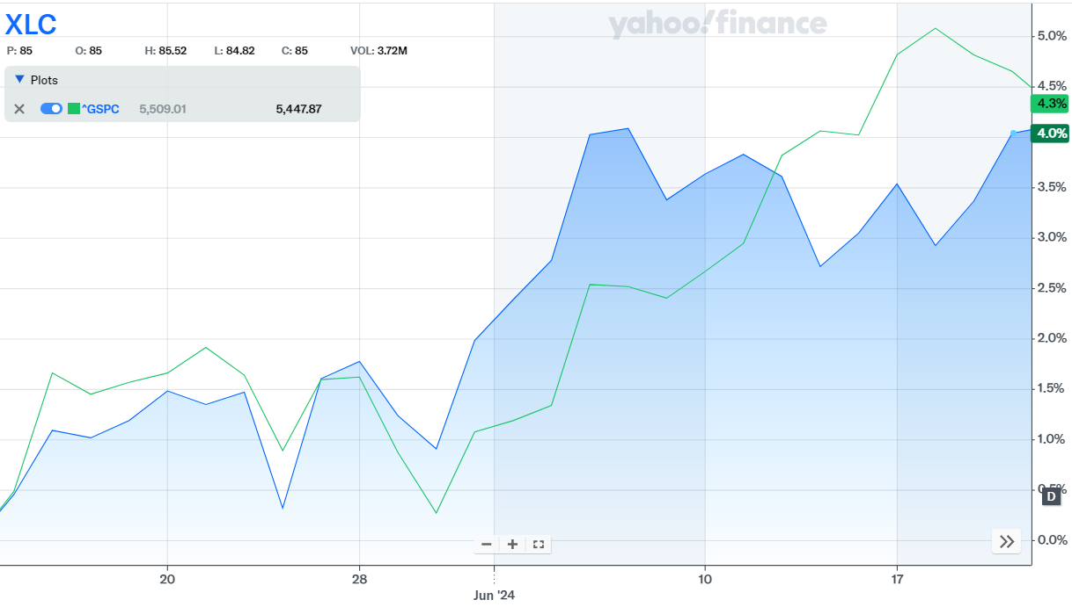
Communication Services
The communication services sector is a part of the economy that includes companies involved in telecommunication, media, and internet services. This includes businesses like wireless communication providers, cable companies, broadcasters, and internet service providers. These services are essential for modern life, enabling people to communicate, access information, and enjoy entertainment. The sector’s performance can reflect technological advancements, regulatory changes, and shifts in consumer behavior.
During the course, the XLC ETF grew 4% which underperformed the S&P 500’s growth of 4.3%
Position Strategy | Overweight
SAP Target | 11.00%
SAP Weight | 6.85%
S&P Market Weight | 9.14%

Slide 38
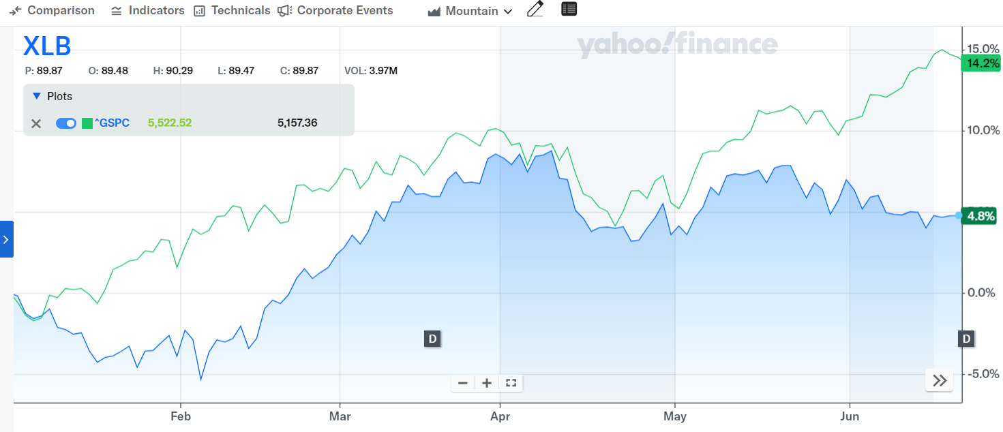
Materials
The Materials sector of the S&P 500 includes companies that make products such as chemicals, metals, and building supplies. These companies are important because they supply other companies need to make their products. Some major companies in this sector include Dow Inc. Newmont Corporation, Vulcan Materials Company, and International Paper Company.
The Materials sector has underperformed the S&P 500 significantly this year. Its YTD return is +4.8% compared to the index’s +14.2%.
Position Strategy | Underweight
SAP Target | 0%
SAP Weight | 0%
S&P Market Weight | 2.14%

Slide 39
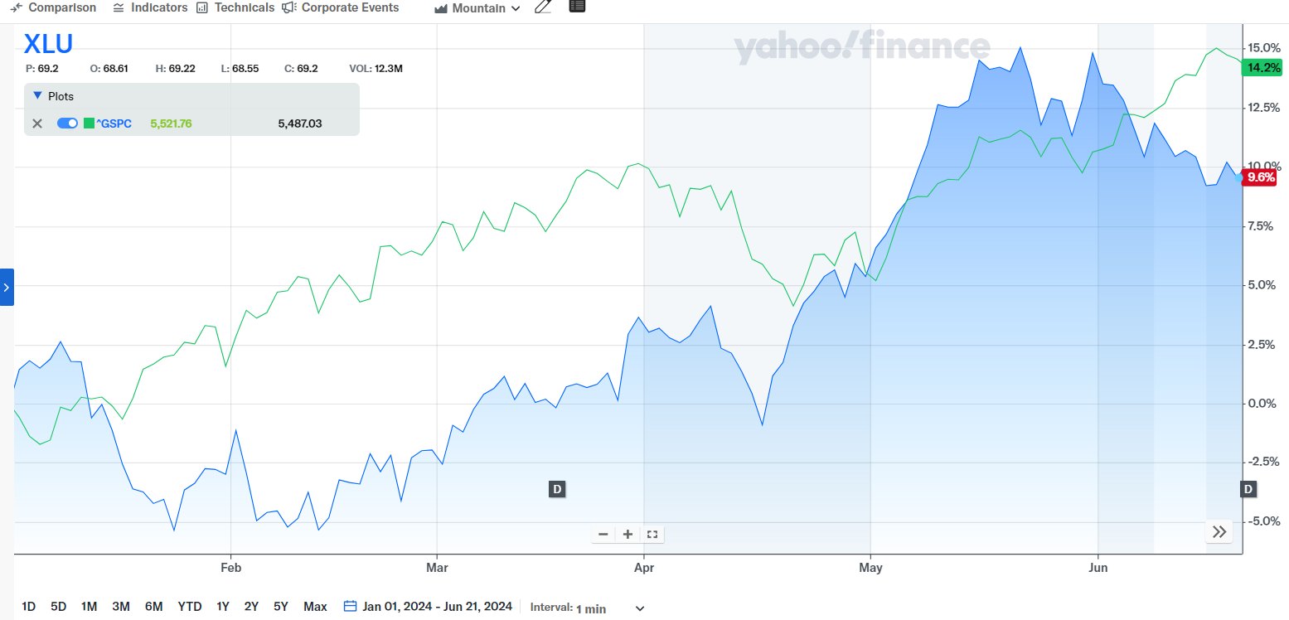
Utilities
The utilities sector encompasses companies that provide essential services such as electricity, natural gas, water, and sewage services. These services are critical for residential, commercial, and industrial operations, making the sector a fundamental part of the economy. Utilities often operate as regulated monopolies, ensuring stable revenues but subject to government oversight and regulation. Examples of companies in the utilities sector include NextEra Energy, Duke Energy, Dominion Energy, and American Electric Power.
The XLU was outperforming the S&P500 for the first half of our class but recently has underperformed. It finished up +9.6% YTD compared to the index at +14.2%. The outperformance time frame was largely attributed to increased attention on the sector related to potential demand of powering artificial intelligence technology.
Position Strategy | Overweight
SAP Target | 5.00%
SAP Weight | 6.85%
S&P Market Weight | 1.97%

Slide 40
ETF PERFORMANCE

Slide 41
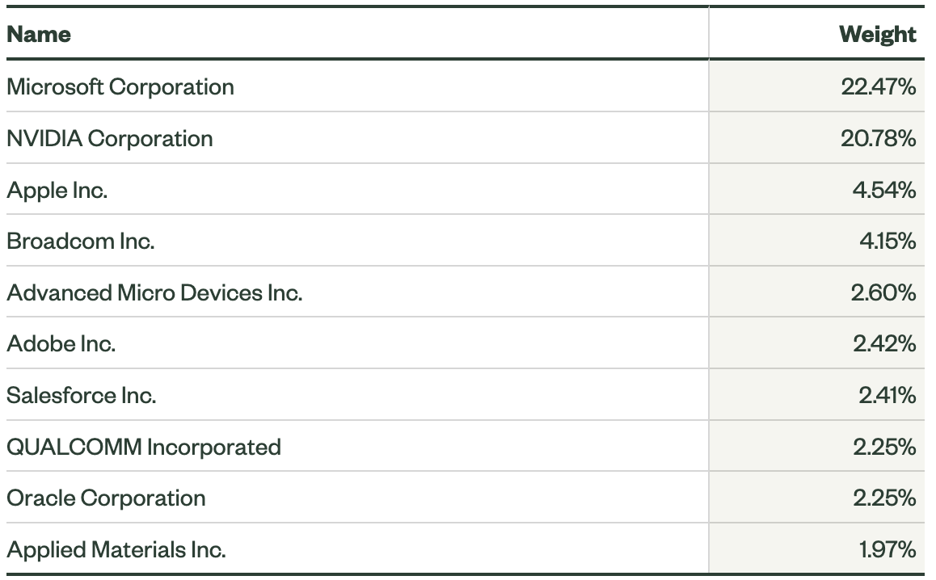
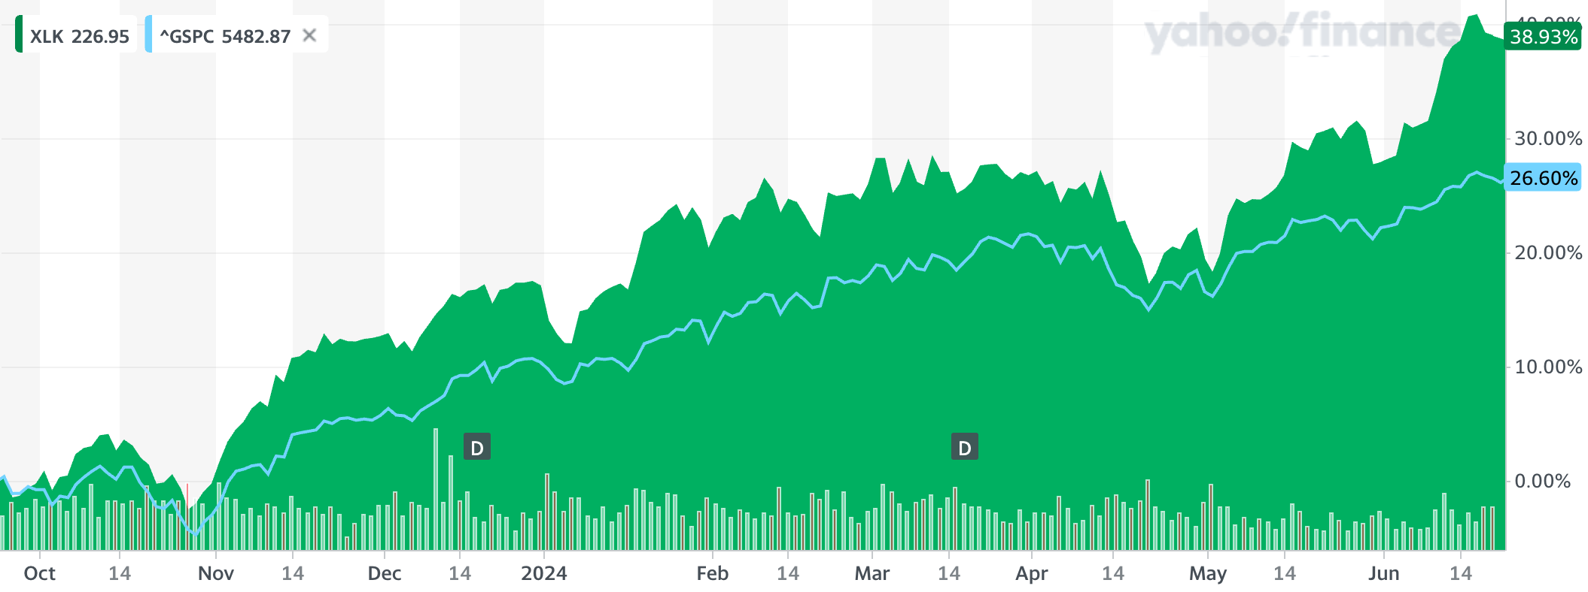
Technology SPDR (XLK)
Date Purchased | 09/20/2023
Number of Shares Held | 491.97
Acquisition Price | $168.75
Cost Basis | $83,017.48
Market Value (6/21/2024): $228.41 +$59.66 (+35.35%)

Slide 42
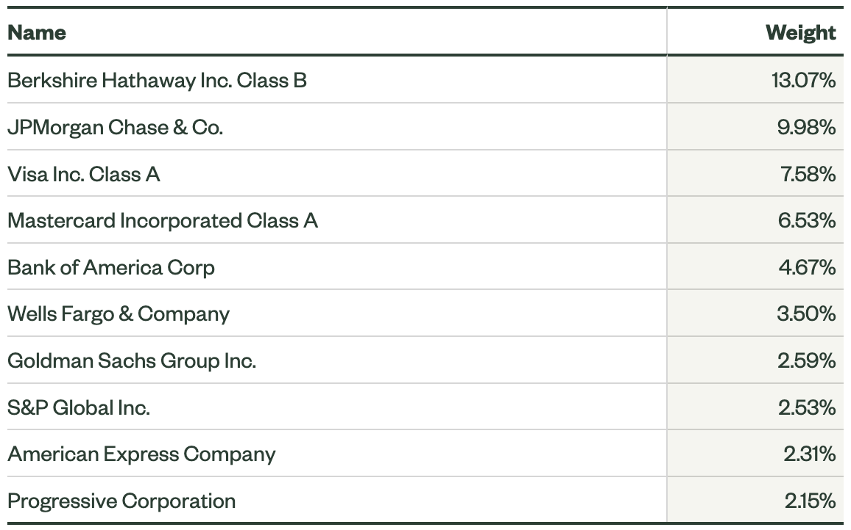
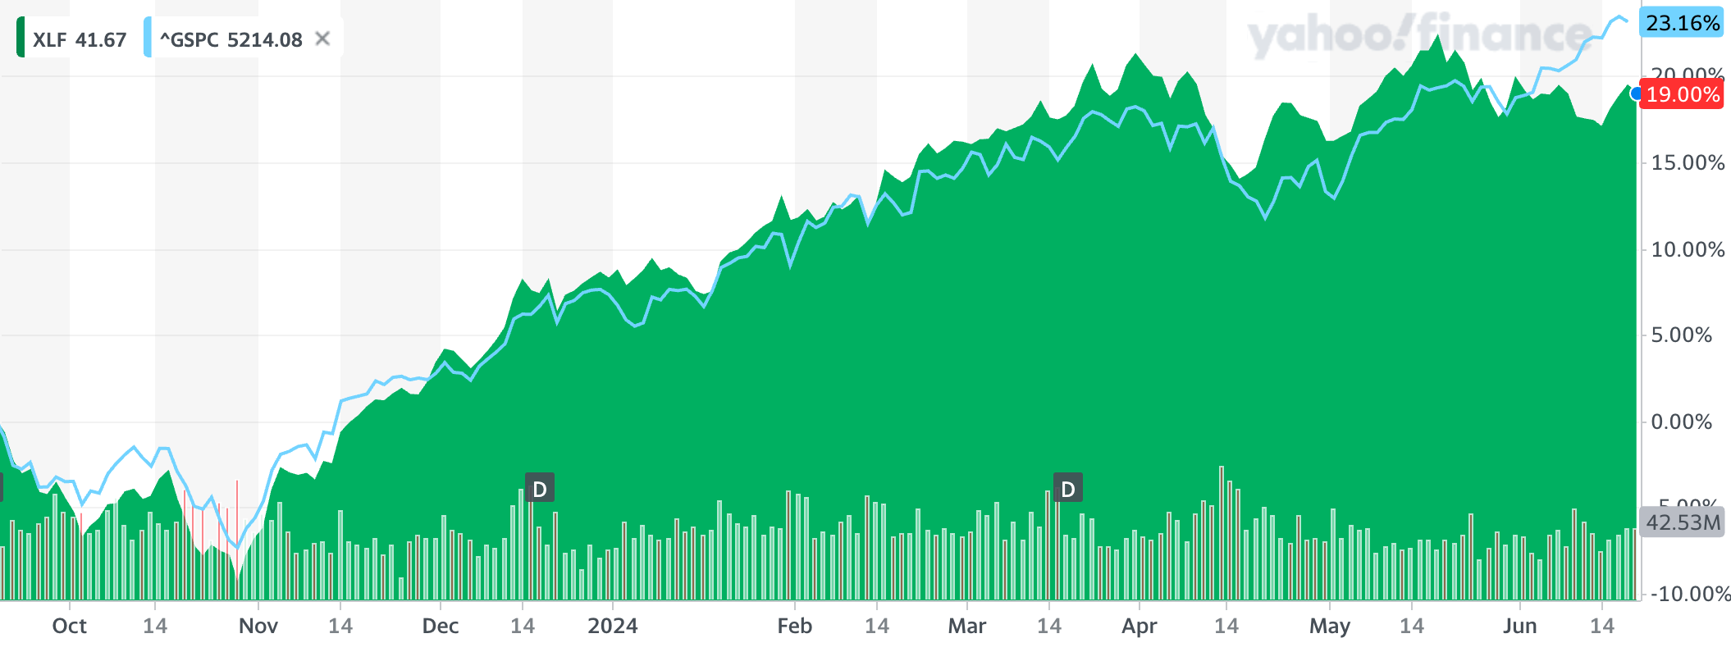
Financials SPDR (XLF)
Date Purchased | 09/20/2023
Number of Shares Held | 502.32
Acquisition Price | $34.77
Cost Basis | $17,535.03
Market Value (6/21/2024): $41.33 +$6.56 (+18.87%)

Slide 43
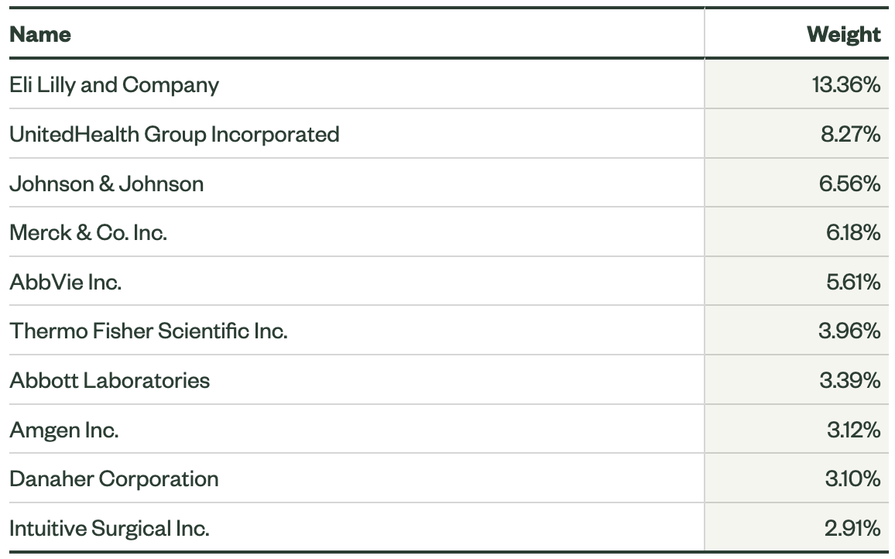
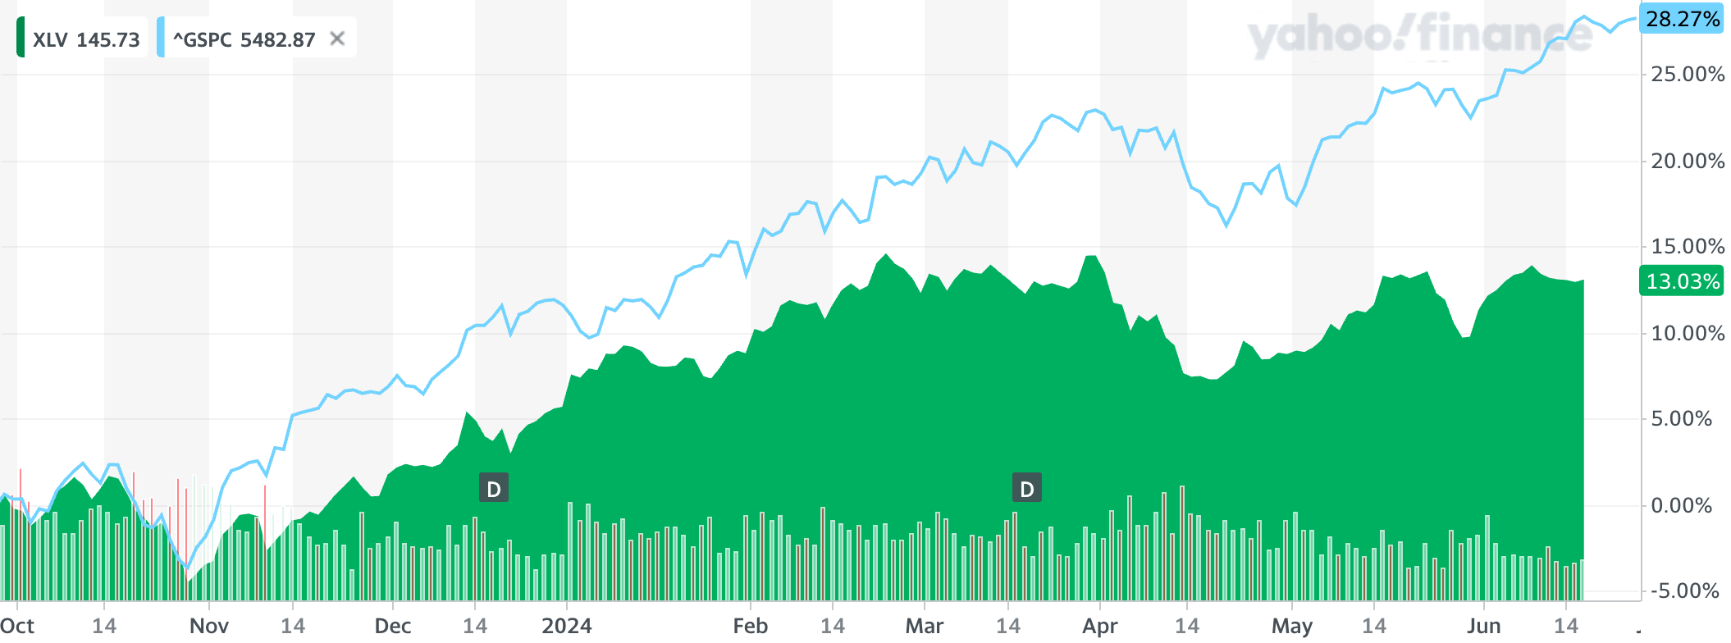
HEALTHCARE SPDR (XLV)
Date Purchased | 09/20/2023
Number of Shares Held | 36.35
Acquisition Price | $132.22
Cost Basis | $4,805.84
Market Value (6/21/2024): $146.81 +$14.59 (+11.03%)

Slide 44
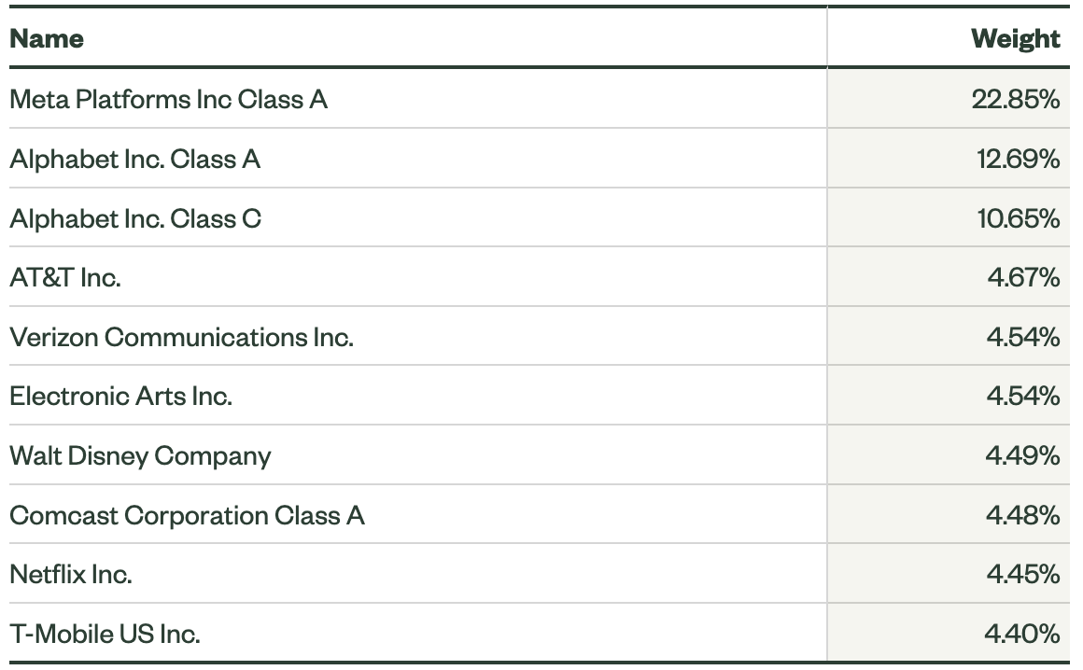
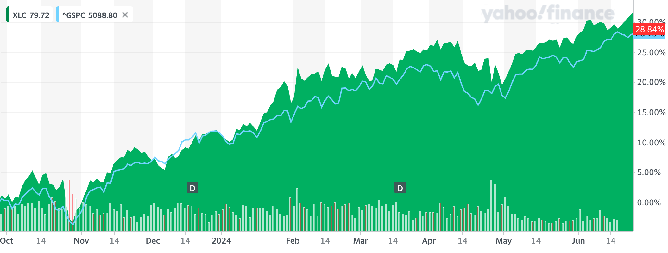
COMMUNICATIONS SERVICES SPDR (XLC)
Date Purchased | 09/20/2023
Number of Shares Held | 75.38
Acquisition Price | $67.08
Cost Basis | $5,056.51
Market Value (6/21/2024): $84.94 +$17.86 (+26.62%)

Slide 45
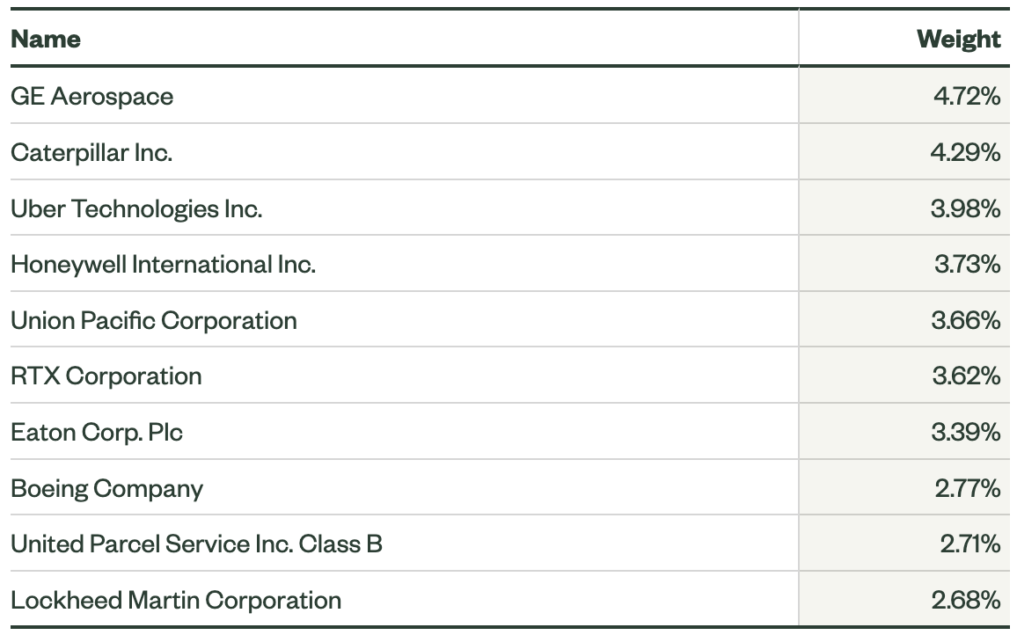
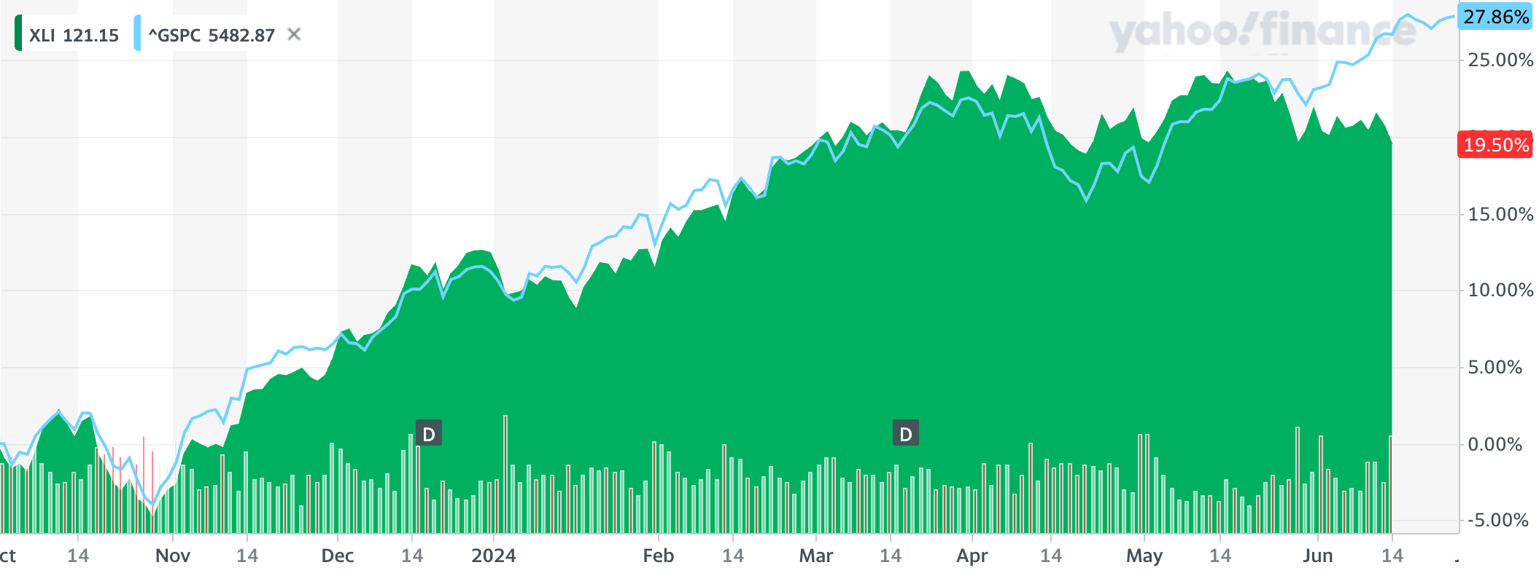
Industrials SPDR (XLI)
Date Purchased | 09/20/2023
Number of Shares Held | 171.45
Acquisition Price | $104.47
Cost Basis | $17,910.72
Market Value (6/21/2024): $122.97 +$18.50 (+17.71%)

Slide 46
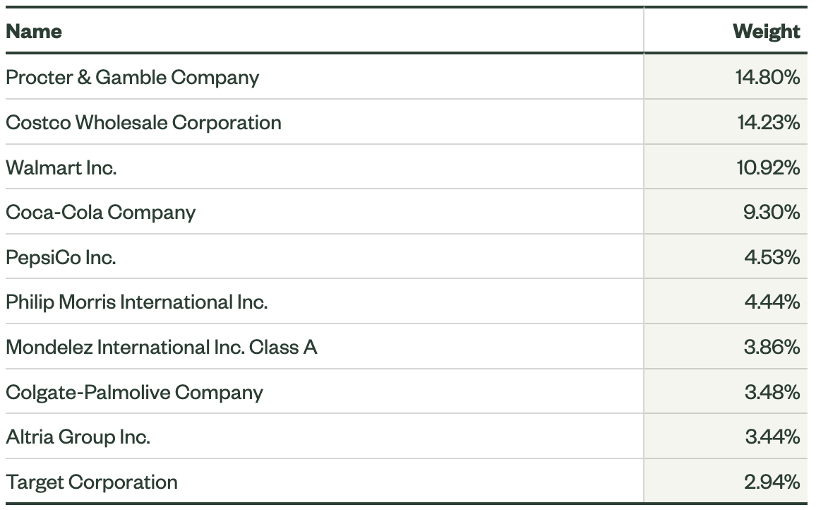
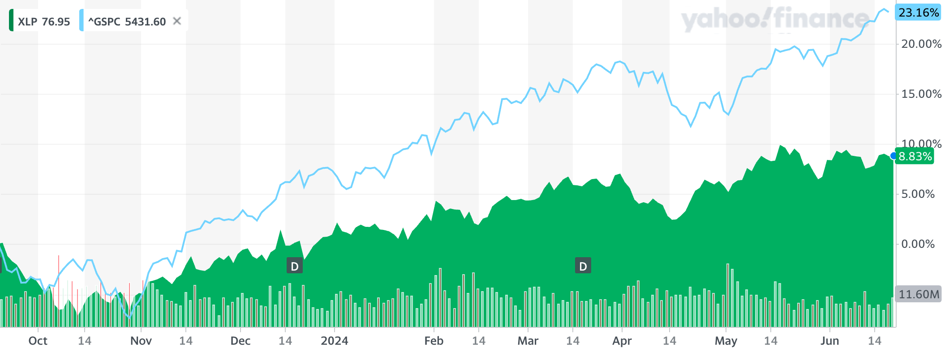
CONSUMER STAPLES SPDR (XLP)
Date Purchased | 09/20/2023
Number of Shares Held | 304.45
Acquisition Price | $71.64
Cost Basis | $21,809.27
Market Value (6/21/2024): $77.67 +$6.03 (+8.42%)

Slide 47
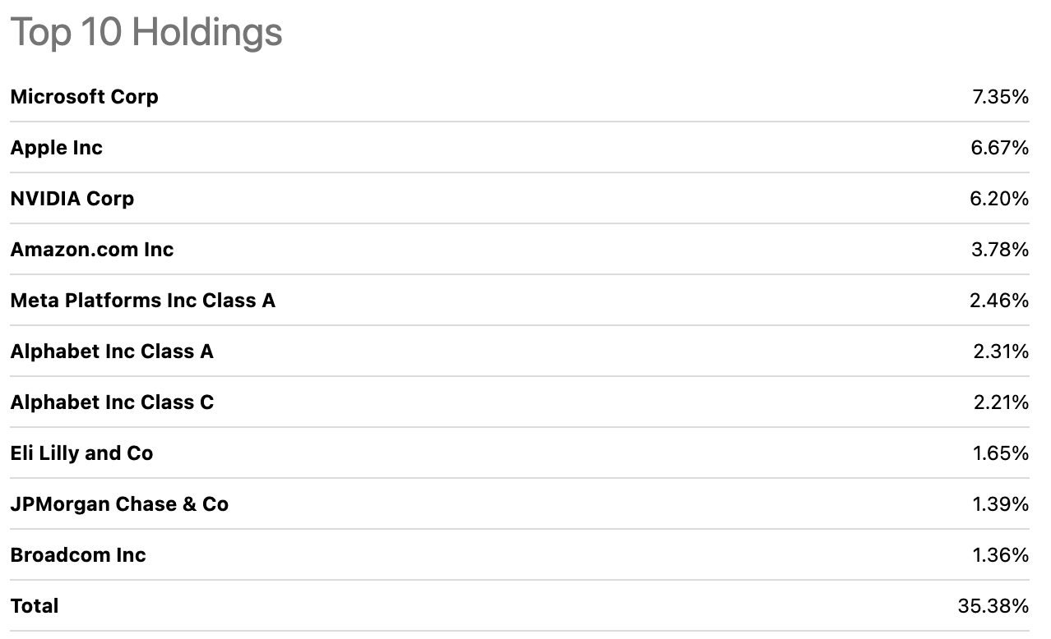
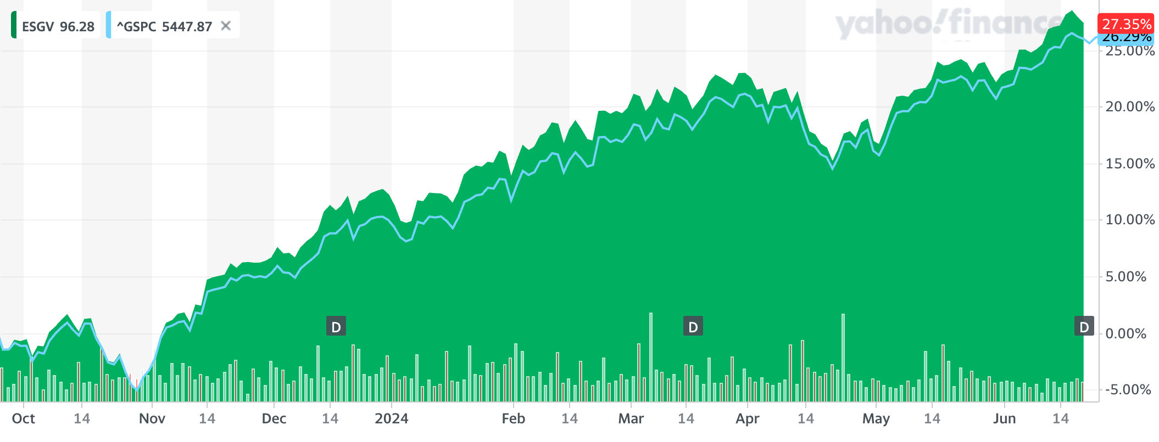
Vanguard esg us stock (esgv)
Date Purchased | 09/20/2023
Number of Shares Held | 376.44
Acquisition Price | $77.76
Cost Basis | $29,270.01
Market Value (6/21/2024): $96.53 +$18.77 (+24.14%)

Slide 48
Growth Strategy

Slide 49

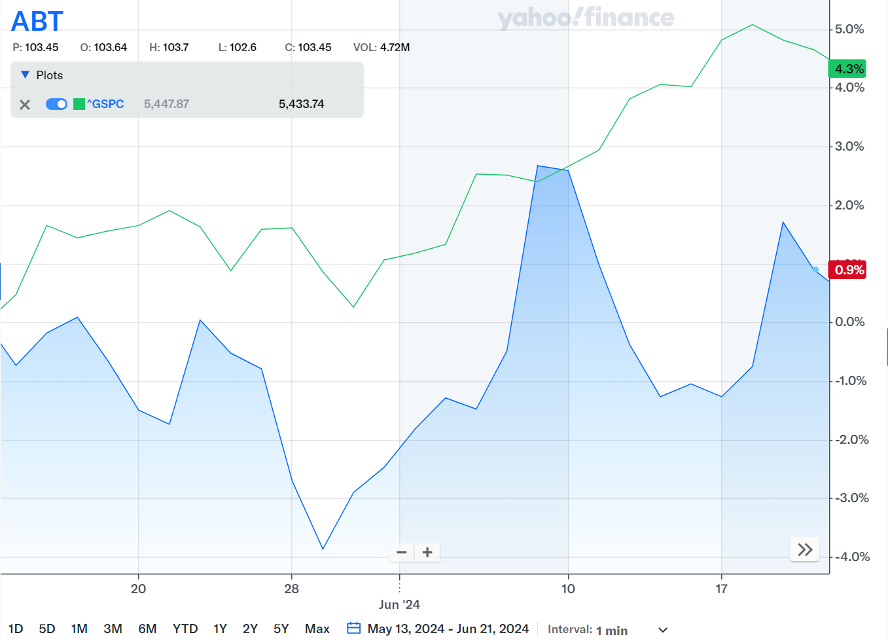
ABBOTT LABORATORIES: ABT
Healthcare
Abbott Laboratories is a global healthcare company that discovers, develops, manufactures, and sells a wide range of healthcare products across pharmaceuticals, diagnostics, nutrition, and medical devices.
Abbott Laboratories also specializes in nutritional products, cardiovascular and diabetes care devices, and neuromodulation devices, having been founded in 1888 and headquartered in North Chicago, Illinois.
Date Acquired | 5/29/2024
Number of Shares | 99.00
Acquisition PPS | $101.68
Cost Basis | $10,066.32
Market Cap | $183.83B
PE Ratio | 32.80
Beta | .74
EPS | 3.21
Market Value (6/21/2024): $105.72

Slide 50

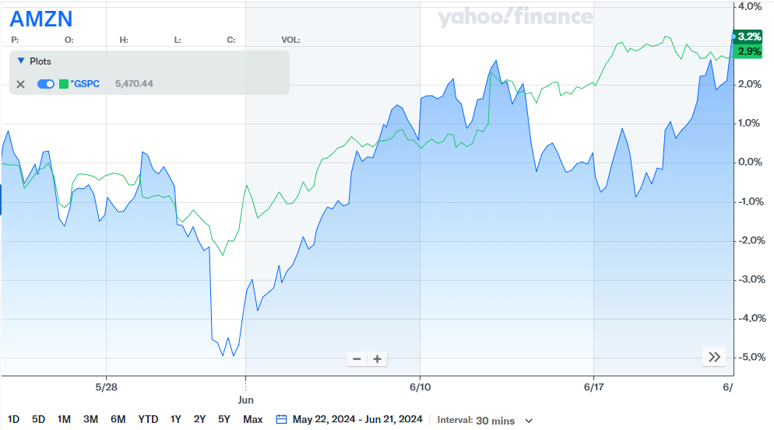
Amazon.com inc: amzn
Consumer Discretionary
Amazon, a global leader in e-commerce and cloud computing, continues to drive substantial revenue growth and diversify its business through strategic investments and innovations in digital advertising, media streaming, and physical retail (e.g. Whole Foods)
Amazon continues to demonstrate strong revenue growth, driven by its dominance in e-commerce and expanding presence in cloud computing through AWS.
Date Acquired | 5/22/2024
Number of Shares | 110
Acquisition PPS | $184.19
Cost Basis | $20,497.40
Market Cap | $1.94T
PE Ratio | 52.34
Beta | 1.14
EPS | 3.56
Market Value (6/21/2024): $189.08

Slide 51

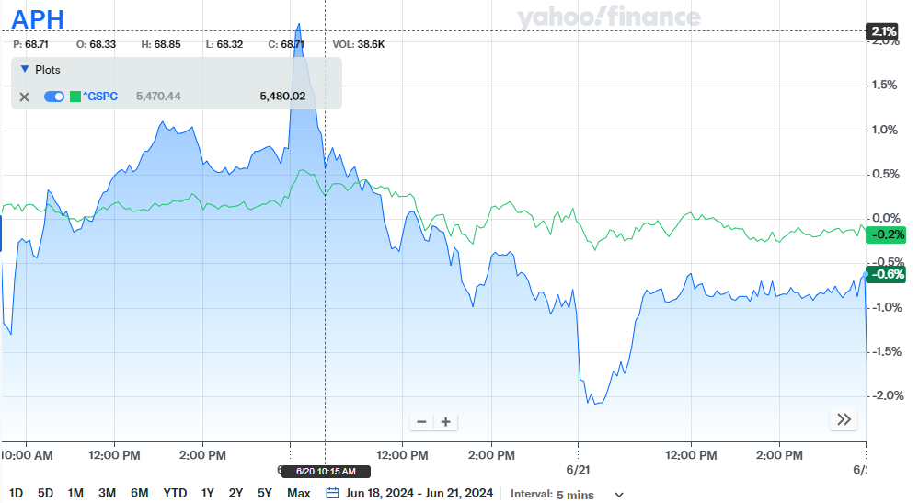
Amphenol corp class a: aph
Technology
Amphenol is a global company that designs, manufactures, and markets electrical, electronic, and fiber optic connectors, interconnect systems, antennas, sensors, and high-speed specialty cables.
APH has a strong global presence, diverse product portfolio across high-demand industries and consistent financial performance driven by their innovation and adaptability to market trends.
Date Acquired | 6/20/2024
Number of Shares | 71
Acquisition PPS | $70.24
Cost Basis | $4,987.37
Market Cap | $81.63B
PE Ratio | 41.69
Beta | 1.26
EPS | 1.63
Market Value (6/21/2024): $68.73

Slide 52

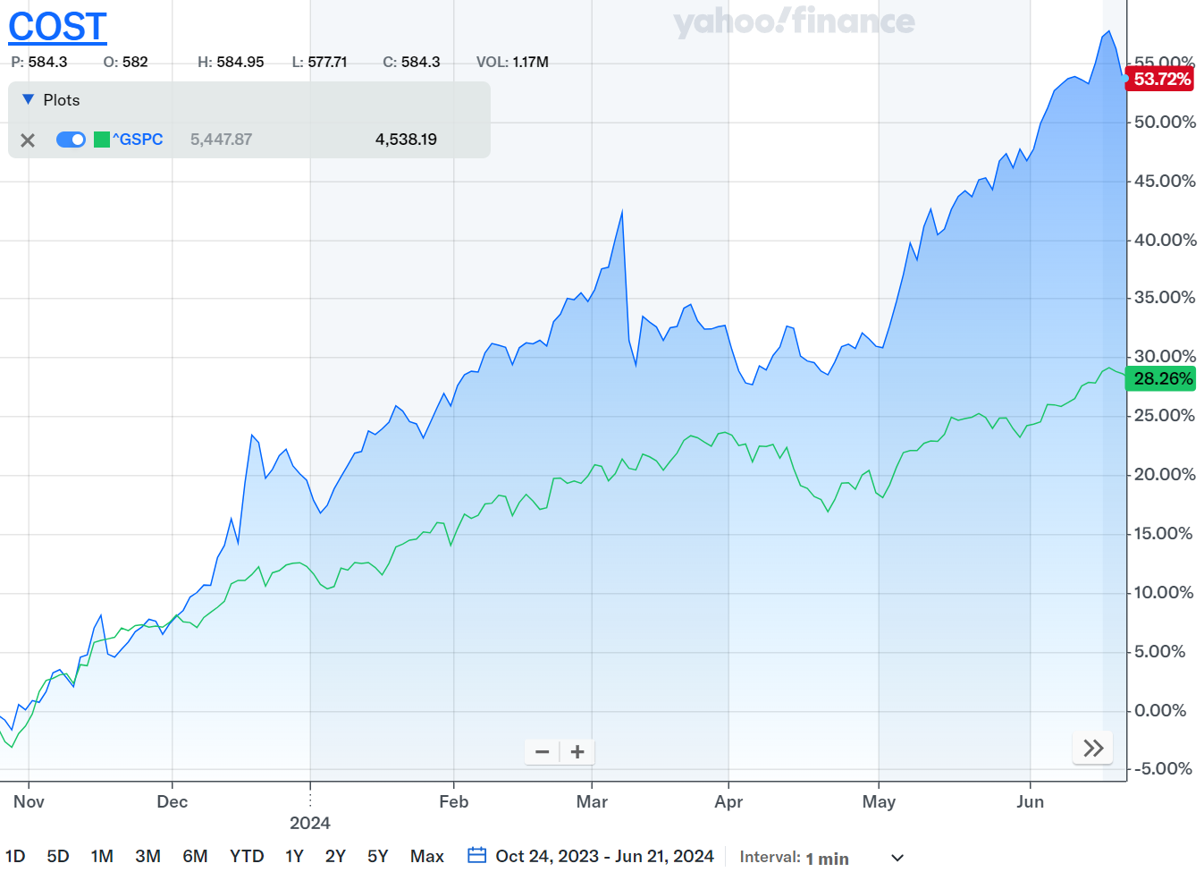
Costco wholesale CORP: cost
Consumer Discretionary
Costco Wholesale Corporation operates membership warehouses in multiple countries, offering a wide range of branded and private-label products, including groceries, electronics, apparel, and household items, along with services like gas stations, pharmacies, and tire centers.
Founded in 1976 and headquartered in Issaquah, Washington, Costco also provides various online services.
Date Acquired | 10/24/2023
Number of Shares | 35.89
Acquisition PPS | $551.46
Cost Basis | $19,790.80
Market Cap | $376.02B
PE Ratio | 52.65
Beta | .78
EPS | 16.11
Market Value (6/21/2024): $848.31

Slide 53

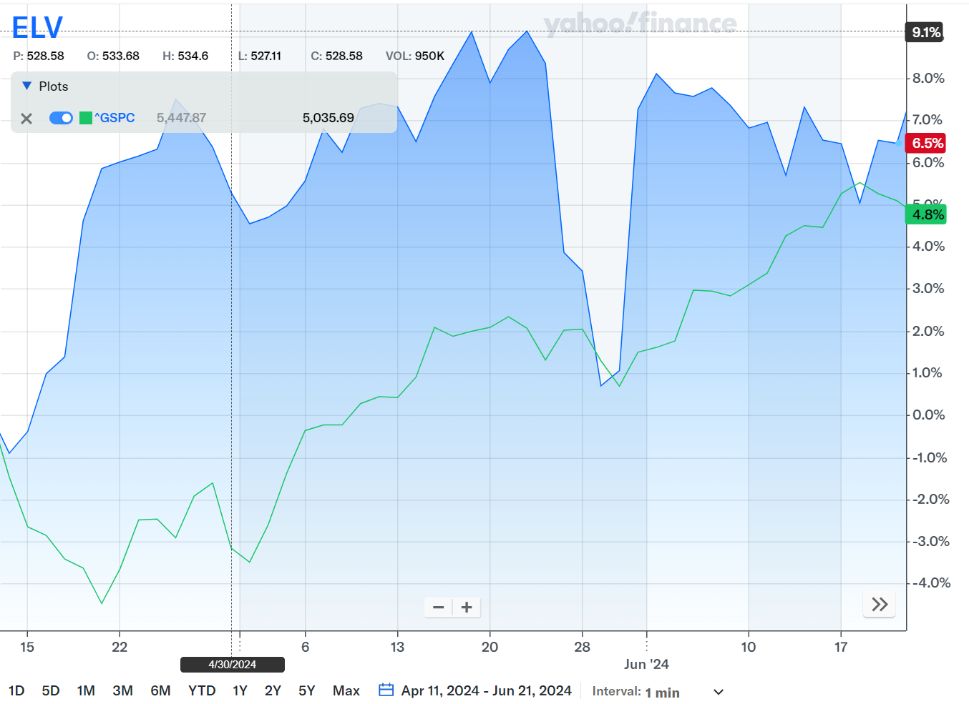
ELEVANCE HEALTH, INC: elv
Healthcare
Elevance Health is a leading health insurance provider in the U.S, offering a wide range of health plans and services to employers, individuals, and government programs. Their focus is improving health outcomes and reducing costs.
Elevance maintains consistent revenue growth, strong cash flow, and effective cost management which has led to robust financial performance.
Date Acquired | 4/11/2024 & 5/22/2024
Number of Shares | 29
Acquisition PPS | $495.62 & $548.26
Cost Basis | $14,846.70
Market Cap | $125.90B
PE Ratio | 20.43
Beta | .83
EPS | 26.51
Market Value (6/21/2024): $534.42

Slide 54

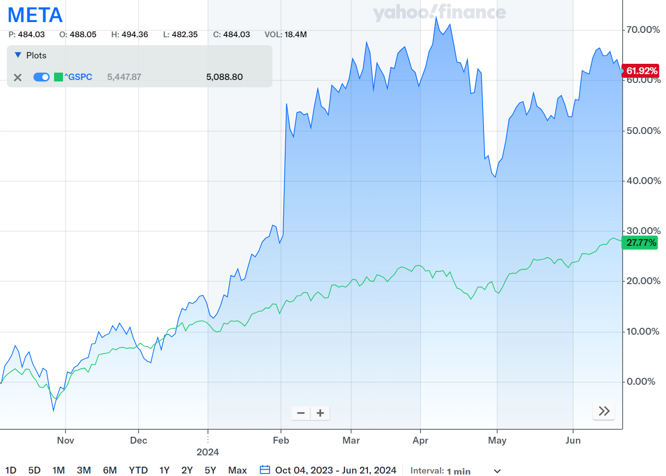
META PLATFORMS, INC: META
Communication Services
Meta is a leading technology company specializing in social media, virtual reality, and digital advertising, with a strategic focus on building the metaverse.
Meta has strong financial performance, extensive user base across its platforms, and significant investments in cutting-edge technologies which promise long-term growth and innovation.
Date Acquired | 10/4/2023
Number of Shares | 65.06
Acquisition PPS | $304.07
Cost Basis | $19,783.91
Market Cap | $1.27T
PE Ratio | 28.74
Beta | 1.21
EPS | 17.36
Market Value (6/21/2024): $494.78

Slide 55

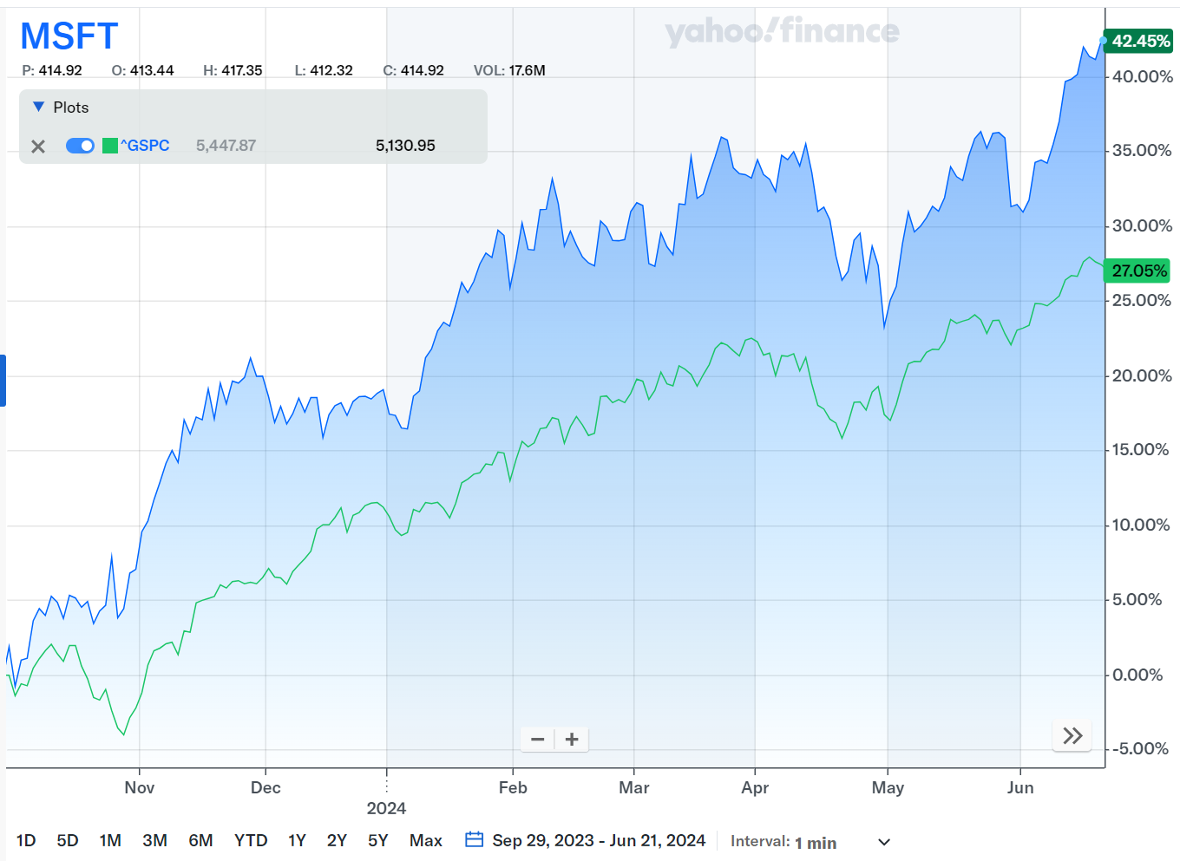
Microsoft corporation: MSFT
Technology
Microsoft is a global technology leader known for its software products, cloud services, and innovative advancements in AI, gaming and enterprise solutions, driving consistent growth and market influence.
MSFT has a strong commitment of sustainability and responsible corporate practices, which enhance long-term shareholder value and mitigate risks associated with environmental and social factors,
Date Acquired | 9/29/2023
Number of Shares | 35.13
Acquisition PPS | $317.30
Cost Basis | $11,147.67
Market Cap | $3.33T
PE Ratio | 38.73
Beta | .89
EPS | 11.56
Market Value (6/21/2024): $449.78

Slide 56

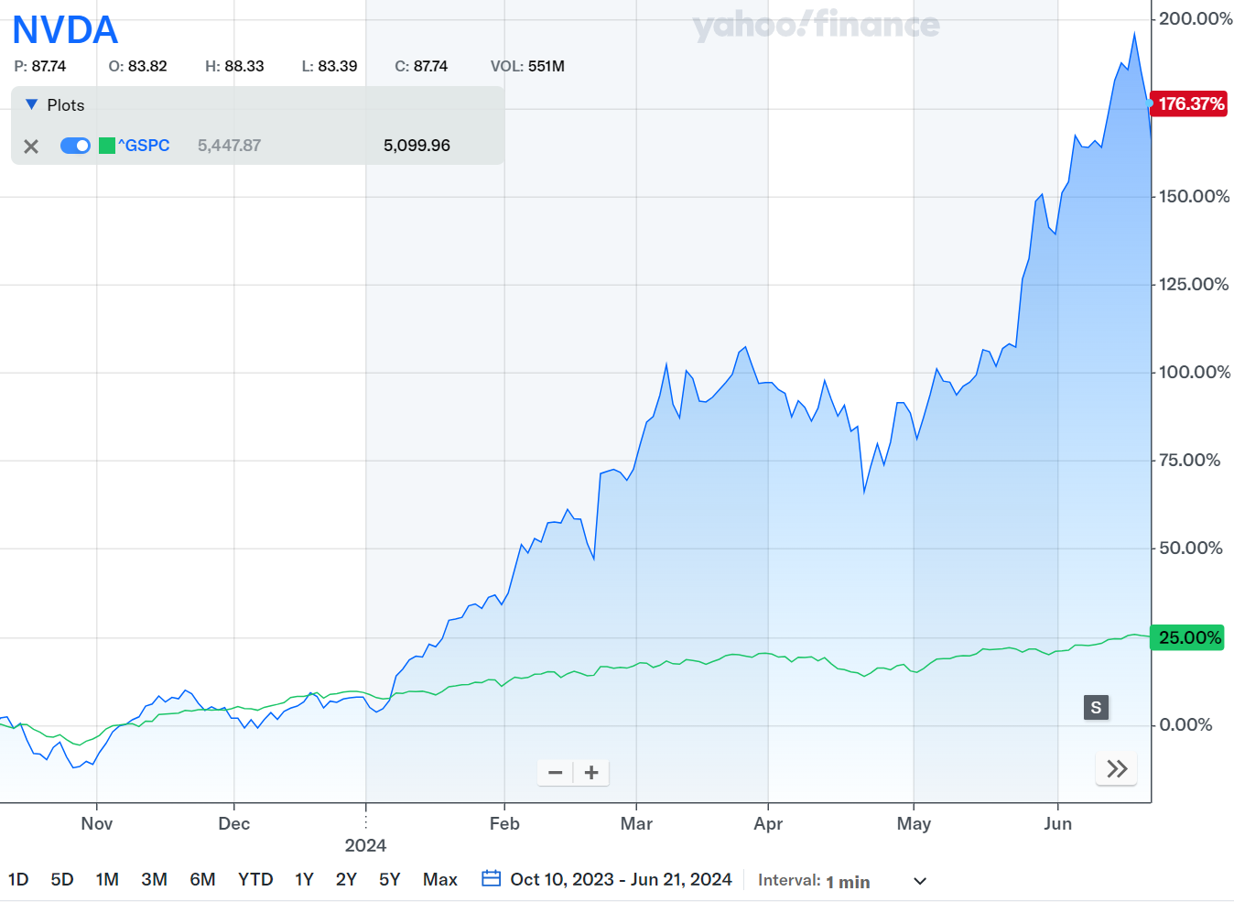
NVIDIA CORPORATION: NVDA
Technology
NVIDIA is a leading technology company renowned for it GPUs and AI-driven computing solutions, data centers, autonomous vehicles and other high-performance computing applications.
NVIDIA makes strategic acquisitions and partnerships that enhance its technological capabilities and market reach, which position the company well for long-term growth.
Date Acquired | 10/10/2023 & 1/20/2024
Number of Shares | 530
Acquisition PPS | $45.94 & $62.63
Cost Basis | $25,685.52
Market Cap | $2.91T
PE Ratio | 69.07
Beta | 1.69
EPS | 1.71
Market Value (6/21/2024): $126.57

Slide 57

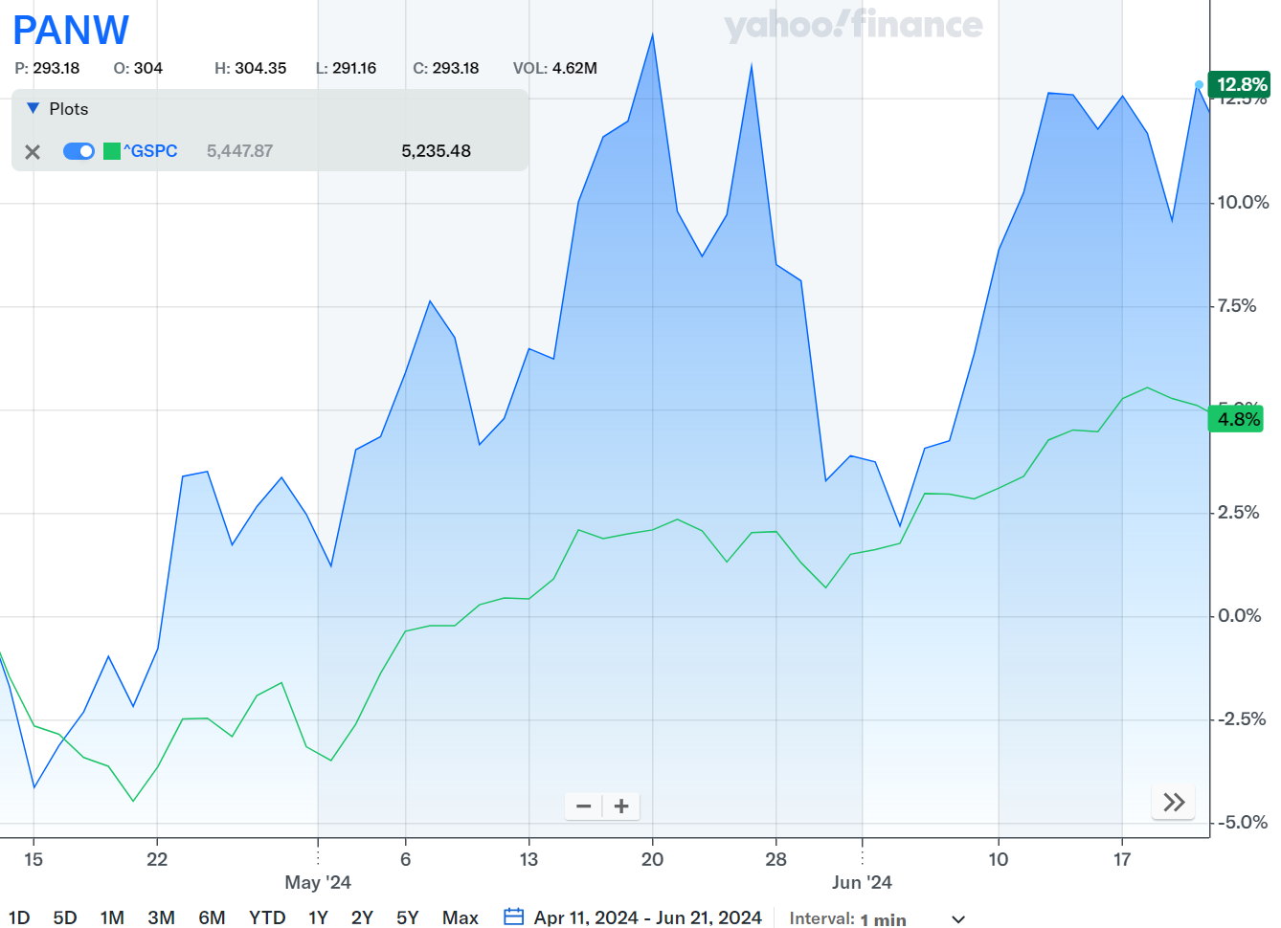
PALO ALTO NETWORKS, INC: PANW
Technology
Palo Alto Networks is a leading cybersecurity company known for its advanced cloud security solutions and firewall, helping organizations protect their data and networks from cyber threats.
Palo Alto has a strategic focus on cloud security and AI, which enhance its product offerings and positions the company for sustained growth in the ever evolving cybersecurity landscape.
Date Acquired | 4/11/2024
Number of Shares | 55
Acquisition PPS | $279
Cost Basis | $15,345
Market Cap | $102.54B
PE Ratio | 45.76
Beta | 1.11
EPS | 6.92
Market Value (6/21/2024): $320.33

Slide 58

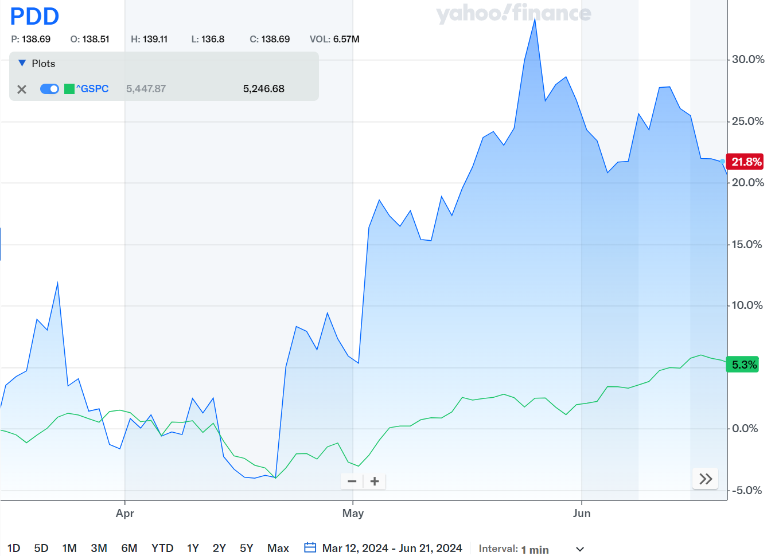
PDD HOLDINGS INC: PDD
Consumer Discretionary
Pinduoduo (PDD) Holdings Inc. is a Chinese e-commerce platform, much like Amazon, known for its innovative group-buying model, offering a wide range of products at competitive prices through social networking and mobile commerce.
PDD focuses on rural and lower-tier city markets in China, tapping into substantial demand and expanding its user base beyond cities, which enhances its growth prospects and market penetration.
Date Acquired | 3/12/2024
Number of Shares | 80
Acquisition PPS | $118.30
Cost Basis | $9,464
Market Cap | $196.55B
PE Ratio | 18.82
Beta | .63
EPS | 7.52
Market Value (6/21/2024): $143.86

Slide 59

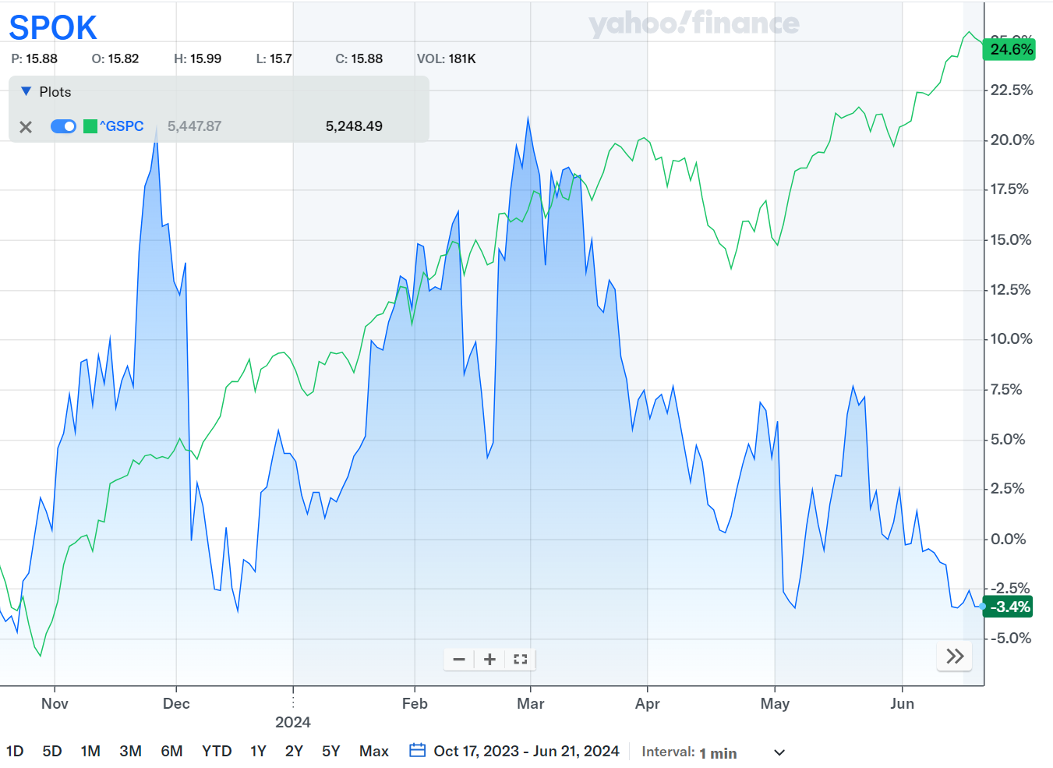
SPOK HOLDINGS, INC: SPOK
Healthcare
Spok Holdings Inc. is a healthcare communications company specializing in providing critical communications solutions for both hospitals and healthcare organizations to improve operational efficiency and patient care.
Spok has a strong commitment to innovation and enhancements to its product offerings to meet evolving needs of healthcare providers, which positions the company for long-term growth and market leadership.
Date Acquired | 10/17/2023
Number of Shares | 560.92
Acquisition PPS | $14.92
Cost Basis | $8.369.60
Market Cap | $291.34M
PE Ratio | 17.34
Beta | .31
EPS | .83
Market Value (6/21/2024): $14.34

Slide 60

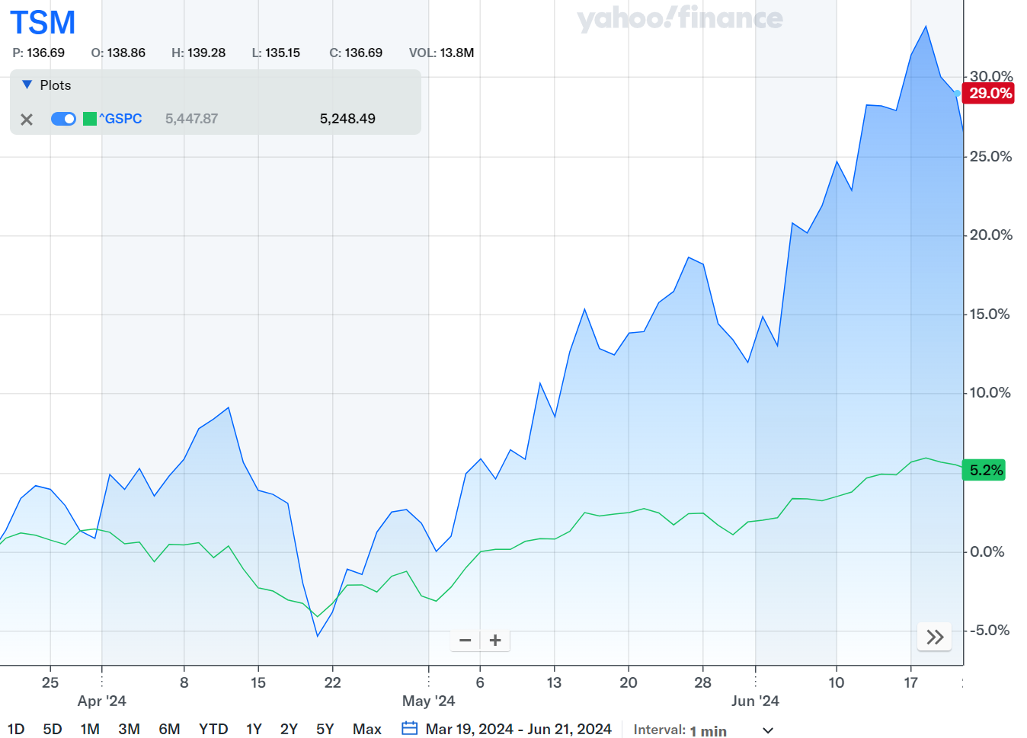
TAIWAN SEMICONDUCTOR MANUFACTURING CO, LTD: TSMc
Technology
TSMC is the world's largest semiconductor foundry, renowned for its advanced manufacturing processes and technological leadership in producing semiconductor chips for a wide range of global clients.
TSMC has robust financial performance, including consistent revenue growth, strong profit margins, prudent financial management and a track record of returning value to shareholders through dividends.
Date Acquired | 3/19/2024
Number of Shares | 80
Acquisition PPS | $135.42
Cost Basis | $10,833.60
Market Cap | $870.33B
PE Ratio | 32.40
Beta | 1.23
EPS | 5.18
Market Value (6/21/2024): $173.96

Slide 61

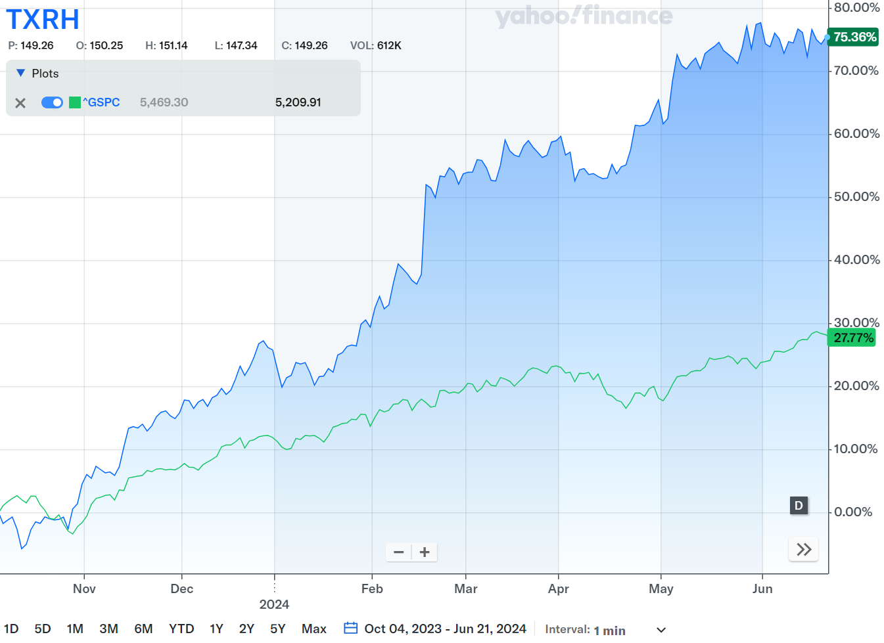
Texas roadhouse inc: txrh
Consumer Discretionary
Texas Roadhouse (TXRH) is a popular American restaurant chain known for its casual dining experience featuring hand-cut steaks, ribs, and other American classics, emphasizing quality food, friendly service, and a lively atmosphere.
TXRH has a resilient business model which has shown its adaptability and customer loyalty even during challenging economic conditions ensure steady revenue streams and profitability.
Date Acquired | 10/4/2023
Number of Shares | 201.712
Acquisition PPS | $96.40
Cost Basis | $19,445.04
Market Cap | $11.47B
PE Ratio | 34.61
Beta | 1.01
EPS | 4.96
Market Value (6/21/2024): $170.41

Slide 62

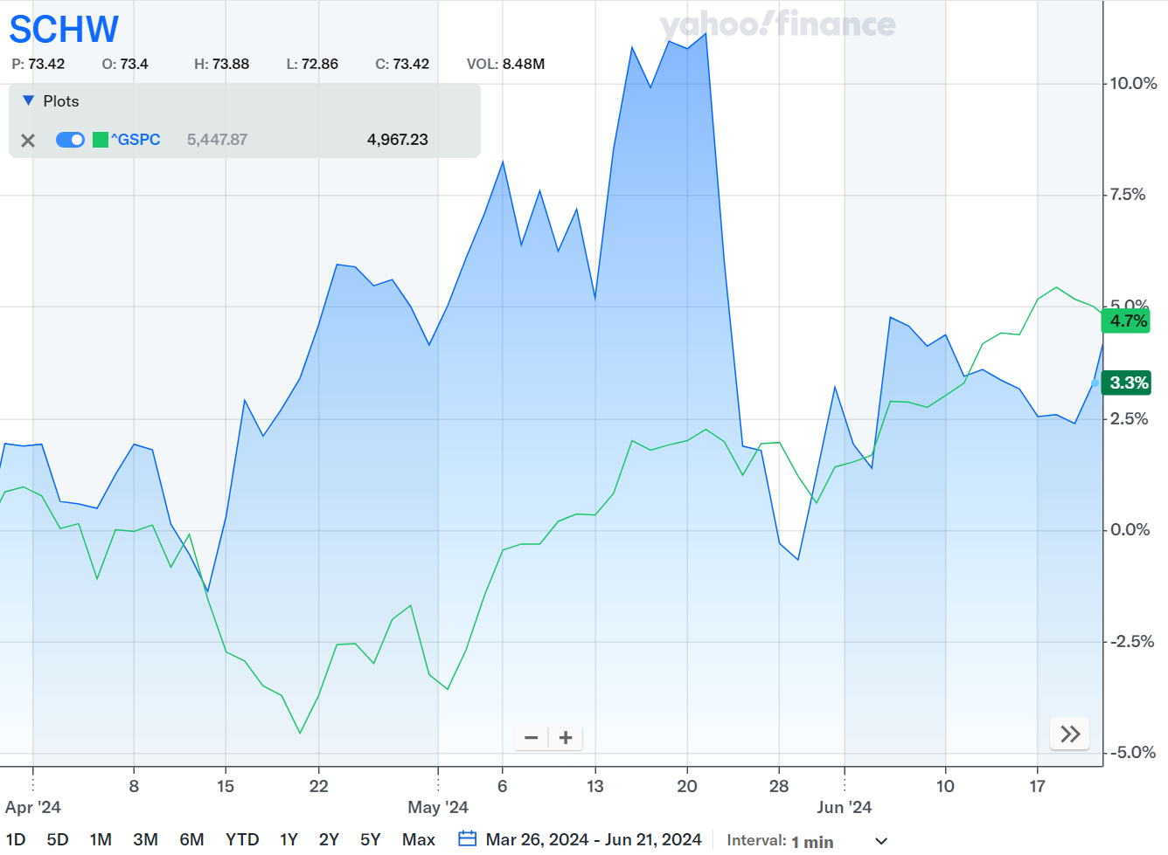
THE CHARLES SCHWAB
CORPORATION: SCHW
Financials
Schwab is a leading financial services firm known for it brokerage, banking and wealth management services, catering to institutional clients and individual investors with a focus on transparency, accessibility, and customer-centricity.
Schwab has a consistent focus on client education and empowerment, fostering long-term relationships and loyalty, which supports stable growth and enhances performance.
Date Acquired | 3/26/2024
Number of Shares | 70.48
Acquisition PPS | $71.30
Cost Basis | $5,025.34
Market Cap | $136.25B
PE Ratio | 31.18
Beta | .95
EPS | 2.39
Market Value (6/21/2024): $73.34

Slide 63

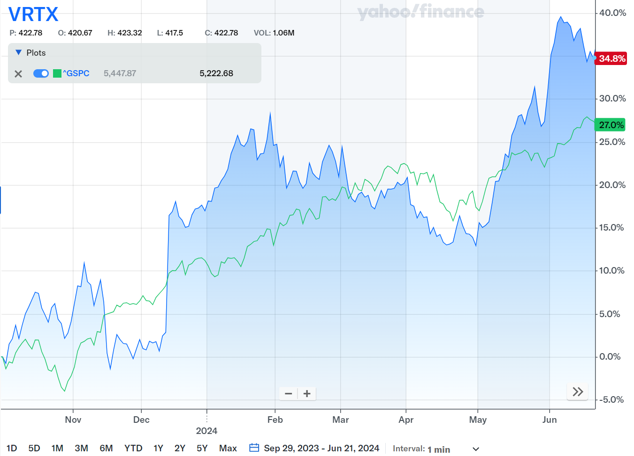
VERTEX PHARMACEUTICALS INCORPORATED: VRTX
Healthcare
Vertex Pharmaceuticals is a biotech company specializing in the development and commercialization of innovative therapies for serious diseases, particularly focusing on cystic fibrosis and other genetic disorders.
Vertex is a leader in cystic fibrosis therapies, strategic diversification into new therapeutic areas, global market expansion, commitment to R&D, and solid financial performance.
Date Acquired | 9/29/2023
Number of Shares | 23
Acquisition PPS | $349.66
Cost Basis | $8,042.24
Market Cap | $122.56B
PE Ratio | 30.86
Beta | .41
EPS | 15.39
Market Value (6/21/2024): $468.71

Slide 64
Value Strategy

Slide 65


Bank of America Corp: BAC
Financials
Bank of America Corporation, through its subsidiaries, provides banking and financial products and services for individual consumers, small and middle-market businesses, institutional investors, large corporations, and governments worldwide.
They operate in four segments: Consumer Banking, Global Wealth & Investment Management, Global Banking, and Global Markets.
Bank of America Corp plans to continue improving processes to generate savings that can be reinvested in growth.
Date Acquired | 4/4/2024
Number of Shares | 400
Acquisition PPS | 37.11
Cost Basis | 14,844
Market Cap | 307.97B
PE Ratio | 13.60
Beta | 1.21
EPS | 2.90
Market Value (6/21/2024): $39.49

Slide 66


GE Aerospace: GE
Industrials
GE Aerospace is a world-leading provider of jet and turboprop engines, components, and integrated systems for various aircrafts.
They aim to be a net-zero company by 2050 for emissions associated with their products and are actively developing next-generation technologies for increased fuel efficiency and reduced CO2 emissions.
GE plans to invest over $650 million in upgrading their supply chain and manufacturing facilities.
Date Acquired | 06/20/2024
Number of Shares | 41
Acquisition PPS | 165.13
Cost Basis | 6,770.33
Market Cap | 175.84B
PE Ratio | 52.64
Beta | 0.81
EPS | 3.04
Market Value (6/21/2024): $164.24

Slide 67


Citigroup Inc: C
Financials
Citigroup Inc. is a diversified financial service holding company, provides various financial product and services to consumers, corporations, governments, and institutions worldwide.
Citigroup operates through five segments: The Services segment, The Market segment, The Banking segment, The U.S. Personal banking segment, and The Wealth segment.
Date Acquired | 6/5/2024
Number of Shares | 85
Acquisition PPS | 61.28
Cost Basis | 5,208.38
Market Cap | 117.46B
PE Ratio | 18.23
Beta | 1.33
EPS | 1.58
Market Value (6/21/2024): $59.99

Slide 68


JPMorgan Chase & Co: JPM
Financials
JPMorgan Chase is a major player in the global financial services industry, offering a comprehensive suite of financial products and services to clients around the world.
Operates through four segments: Consumer & Community Banking, Corporate & Investment Bank, Commercial Banking, and Asset & Wealth Management.
Date Acquired | 10/10/2023
Number of Shares | 136.61
Acquisition PPS | 145.76
Cost Basis | 19,912.46
Market Cap | 568.79B
PE Ratio | 11.96
Beta | 1.11
EPS | 4.44
Market Value (6/21/2024): $196.30

Slide 69


Nextera energy inc: nee
Utilities
NextEra Energy through its subsidiaries, generates, transmits, distributes, and sells electric power to retail and wholesale customers in North America.
The company was founded in 1925 formerly known as FPL group and changed its name to NextEra Energy Inc.
NextEra expects to remain on track for their overall renewable development expectations of roughly 33 gigawatts to 42 gigawatts from 2023 through 2026.
Date Acquired | 03/19/2024
Number of Shares | 160
Acquisition PPS | 62.06
Cost Basis | 9,930.24
Market Cap | 149.94B
PE Ratio | 19.89
Beta | 0.81
EPS | 1.1
Market Value (6/21/2024): $72.81

Slide 70


QUALCOMM INCORPORATED: QCOM
Technology
Engages in the development and commercialization of foundational technologies for the wireless industry worldwide.
Qualcomm is a vital player in the mobile communication industry. Their technology is all around us, and their research is helping to pave the way for even faster and more powerful wireless connections in the future.
They continue to see high single-digit to low double-digit percentage growth in 5G headsets.
Date Acquired | 11/14/2023
Number of Shares | 121.25
Acquisition PPS | $126.82
Cost Basis | $15,377.18
Market Cap | $224.14B
PE Ratio | 26.78
Beta | 1.30
EPS | 7.50
Market Value (6/21/2024): $212.53

Slide 71


T-Mobile us Inc: TMUS
Communication Services
T-Mobile offers voice, messaging, and data services to customers in the postpaid, prepaid, and wholesale and other services.
They offer unlimited data plans with features like scam protection and 5G access at no additional cost. They also sell mobile devices and accessories, along with providing options to finance them.
Date Acquired | 02/06/2024
Number of Shares | 60.24
Acquisition PPS | 160.79
Cost Basis | 9,685.83
Market Cap | 208.16B
PE Ratio | 24.17
Beta | 0.76
EPS | 2
Market Value (6/21/2024): 176.73

Slide 72


Toll brothers Inc: tol
Consumer Discretionary
Toll Brothers together with its subsidiaries, designs, builds, markets, sells, and arranges finance for a range of detached and attached homes in luxury residential communities in the United States.
Offers a variety of services beyond constructions such as mortgage, title, land development, and even smart home technology.
Toll Brothers plans to expand price and increase the supply of spec homes, which are pre-built houses.
Date Acquired | 11/21/2023
Number of Shares | 230.96
Acquisition PPS | 85.42
Cost Basis | 19,728.60
Market Cap | 11.87B
PE Ratio | 7.90
Beta | 1.65
EPS | 4.55
Market Value (6/21/2024): 117.12

Slide 73


TOYOTA MOTOR CORP ADR: TM
Consumer Discretionary
Toyota Motors designs, manufactures, assembles, and sells passenger vehicles, minivans, and commercial vehicles, and relates parts and accessories.
The company provides financial services, such as retail financing and leasing, wholesale financing, insurance, and credit cards.
Date Acquired | 06/05/2024
Number of Shares | 35
Acquisition PPS | 207.65
Cost Basis | 7,267.75
Market Cap | 322.70B
PE Ratio | 8.99
Beta | 0.46
EPS | 74.02
Market Value (6/21/2024): 193.58

Slide 74
Dividend Strategy

Slide 75


Coca-Cola Company: KO
Consumer Staples
The Coca-Cola Company, a beverage company, manufactures, markets, and sells various nonalcoholic beverages worldwide.
The company provides sparkling soft drinks, sparkling flavors; water, sports, coffee, and tea; juice, value-added dairy, and plant-based beverages; and other beverages. It also offers beverage concentrates and syrups, as well as fountain drink supplies.
Date Acquired | 005/29/2024
Number of Shares | 123
Acquisition PPS | 61.42
Cost Basis | 7,554.05
Market Cap | 272.61B
PE Ratio | 25.36
Beta | 0.59
EPS | 2.49
Market Value (6/21/2024): 62.77

Slide 76
RISK ANALYSIS

Slide 77
Portfolio Risk analysis: Beta
Beta measures the systematic risk of a portfolio relative to a market benchmark (in this case, the S&P 500).
Over the course this semester’s holding period (05/13/24 – 06/21/24), SAP maintained a Beta of 1.09. This figure was generally in line with SAP’s Beta over the course of prior semesters.
A Beta > 1.0 suggests that SAP is more sensitive to volatility risk than the S&P 500.
How does SAP’s Beta compare to the most popular large-cap blend active funds?

Slide 78

Portfolio Risk Analysis: Beta
Over the course of this semester’s holding period, a positive yet weak relationship existed between the returns of SAP’s holdings and their systematic risk.
NVDA greatly contributed to this relationship. The holding had the highest Beta (1.69) in the portfolio and by far the largest holding period return (40%).

Slide 79
Portfolio Risk analysis: Sharpe Ratio
The Sharpe Ratio measures how much excess return was generated for each unit of portfolio volatility.
Sharpe Ratio = (Portfolio Return – Risk-free rate) / Portfolio Standard Deviation
Over this semester’s holding period, SAP’s Sharpe ratio significantly outperformed its peers:

Slide 80
Portfolio Risk analysis: Treynor Ratio
Despite a relatively high portfolio Beta, SAP’s superior excess returns allowed it to outperform its competition.
The Treynor Ratio measures how much excess return was generated for each unit of systematic risk (Beta).
Treynor Ratio = (Portfolio Return – Risk-free rate) / Portfolio Beta
Note: 10-year Treasury yields have been used to approximate the Risk-free rate.

Slide 81

Efficient frontier and capital allocation line
When given the option to either invest in SAP, invest in its benchmark (SPY), or invest in each – the optimal portfolio (i.e., the one that produces the highest Sharpe ratio) is one allocated 90% to SAP and 10% to SPY. Allocation to the Risk-free rate can be made to adjust volatility.

Slide 82
Information Ratio
The Information Ratio (IR) measures the excess return of a portfolio above its benchmark, and then compares this excess return to overall portfolio volatility. The benchmark in this case is the S&P 500.
IR = (Portfolio Return – Benchmark Return) / Standard Deviation of difference between portfolio and benchmark returns.
Over this past semester, SAP’s IR was an incredibly high 3.60; a value that is likely unsustainable over the long-run.

Slide 83
Correlation Matrix
Dark blue cells represent SAP securities that had strong positive correlation in daily price changes over the course of this semester’s holding period. While dark red cells show securities that had strong negative correlations.

Slide 84
Covariance Matrix
A covariance matrix represents values between pairs of security returns in a random vector. Blue represents strong positive correlation while red represents strong negative correlation.

Slide 85
Performance Review

Slide 86
SAP FUND vs. S&P 500
GB 828 (24/SU) | Sellinger Applied Portfolio | S&P 500
Market Value (5/13/2024) | $630,797.95 | $5,233.08 (Open)
Market Value (6/21/2024) | $673,851.23 | $5,464.62 (Close)
Return (5/13/2024 – 6/21/2024) | 6.39% | 4.24%
SAP Starting Market Value: $630,797.95
Comparison Timeframe: Market Open May 13th, 2024 – Market Close June 21st, 2024
When the SAP Portfolio was liquidated on June 21, 2024, we achieved a net-positive return of +6.39%

Slide 87
SAP FUND vs. S&P 500 (cont.)

Slide 88






Overperformers in SAP Portfolio
Amount and percentages reflect the price increase from 5/13/2024 to 6/21/2024
META: +$27.23 (5.50%)
TMUS: +$14.00 (7.92%)
VRTX: +$38.78 (8.27%)
QCOM: +$29.07 (13.68%)
TSM: +$28.01 (16.10%)
NVDA: +$36.18 (28.58%)

Slide 89




Underperformers in SAP Portfolio
Amount and percentages reflect the price increase from 5/13/2024 to 6/21/2024
TM: -$22.06 (-11.40%)
TOL: -$9.03 (-7.71%)
NEE: -$1.29 (-1.77%)
SCHW: -$1.36 (-1.85%)

