Slide 1
Keeping Up With the Courts
October 30, 2024
Title IX Case Law Review

Slide 2
Session Facilitators
Kim Pacelli, M.Ed, J.D.
Dan Fotoples, J.D., M.A
Partner, TNG Consulting
ATIXA Advisory Board
Director of Content Development, TNG Consulting

Slide 3
Setting the Table
We will be discussing cases that have not gone all the way to trial
Since pre-trial settlements are common, the real legal battles are in pre-trial motions
In pre-trial motions, the court assumes the allegations are true
Motion to Dismiss (MTD) v. Motion for Summary Judgement (MSJ)
For the purposes of this session, we assume the allegations are true
Facts discussed have not been proven to be true

Slide 4
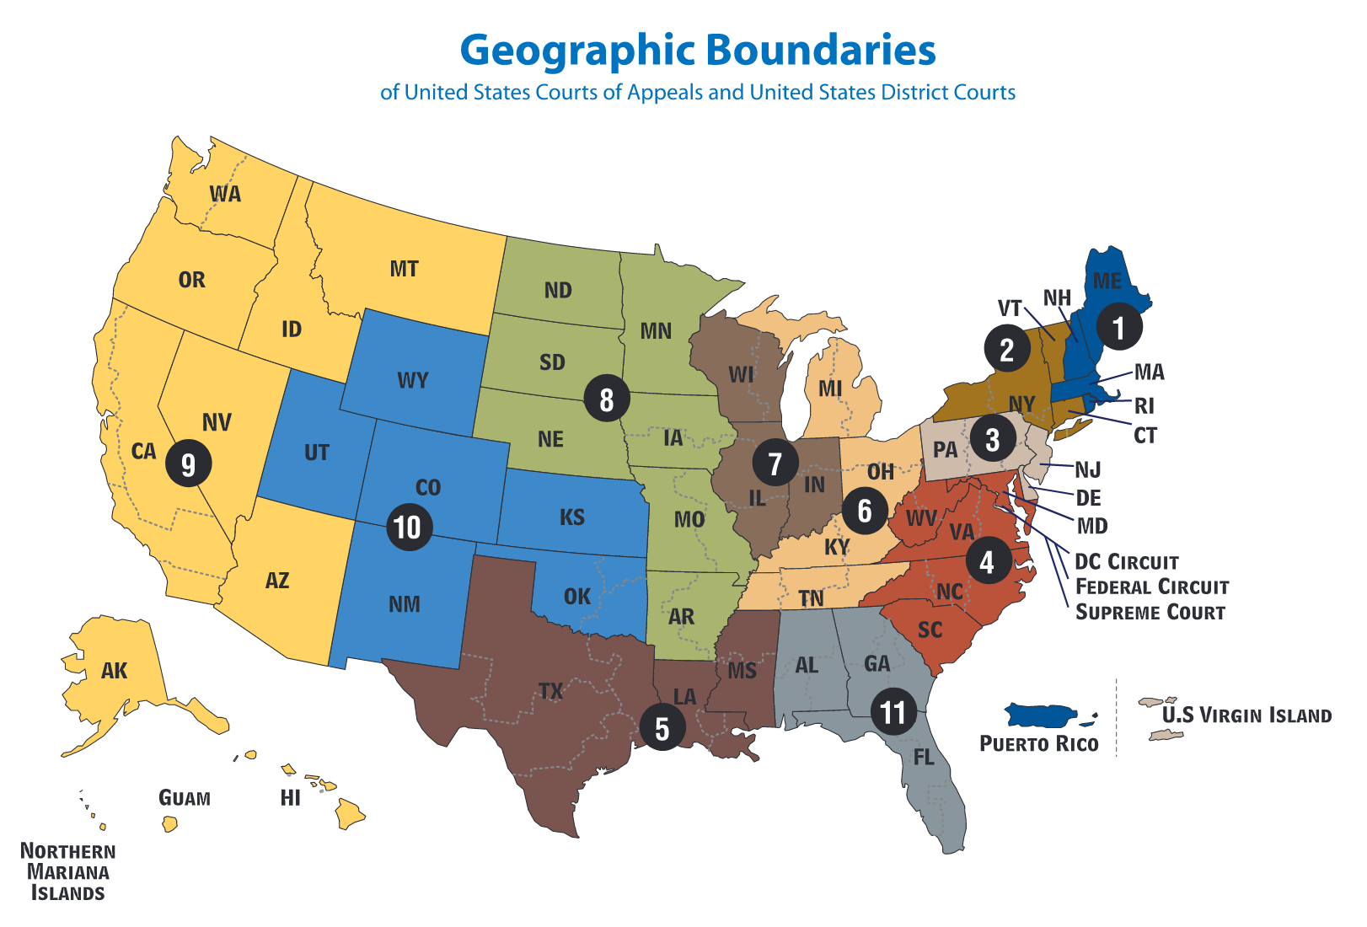
Map of Circuit Courts of Appeal
Source: https://www.uscourts.gov/sites/default/files/u.s._federal_courts_circuit_map_1.pdf
Notes:
DF

Slide 5
“Heightened Risk” Theory
An institution maintains a “policy” of deliberate indifference to reports of sexual misconduct
Creates a heightened risk of harassment that was known or obvious
In a context subject to the institution’s control
That was so severe, pervasive and objectively offensive that it can be said to deprive plaintiff of access to the educational opportunities or benefits.
Karasek, Ninth Circuit, 2020

Slide 6
Ware v. University of Vermont
Heightened Risk Pre-Assault Liability
Title IX Deliberate Indifference and Retaliation

Slide 7
Ware v. UVM
Facts & Allegations
Four Plaintiffs alleged that UVM is deliberately indifferent to the risk of sexual violence on campus in several specific contexts
Alcohol abuse and sexually-motivated drugging incidents in fraternities and by student athletes
Plaintiffs alleged Title IX policies are deficient and that UVM knew of the deficiency
Notes:
Plaintiffs had individual claims that connected back to their heightened risk claims
Plaintiffs alleged Title IX policies are deficient, too
Investigated by several regulatory agencies or task forces
Clery noncompliance
Audit by external consultants

Slide 8
Ware v. UVM
Decision
Adopts Karasek theory of liability
Plaintiffs plausibly stated that UVM maintained an official policy supporting a heightened risk of sexual assault on campus
Investigations by federal agencies re: underreporting and mishandling complaints
Failure to update policies after participating in a state-wide task force
Failure to proactively and transparently publicize policy changes
Failure to regulate, monitor, or increase oversight of campus parties
Indifference to risk of sexual misconduct due to alcohol abuse at social events
Plaintiffs were able to connect their own assaults to unsafe conditions on campus

Slide 9
Ware v. UVM
Decision
Regarding athletics, Plaintiffs were unable to demonstrate that UVM had actual notice of alleged misconduct by student athletes
Regarding fraternities, the court held:
Policy of de-recognizing fraternities, but permitting them to operate elsewhere, could be deliberately indifferent
Suspension often did not include oversight or enforcement
Website list of fraternities in good standing was often not updated
UVM did not leverage its control to stop, prevent, and remedy
Notes:
Merely pushing troublesome fraternities off-campus enables further poor behavior

Slide 10
Ware v. UVM
Decision
Two Plaintiffs brought post-assault deliberate indifference claims
UVM could have exercised “substantial control” over off-campus locations
“Team” house organized by athletics staff
UVM could have exercised disciplinary authority over behaviors off-campus
Two Plaintiffs brought retaliation claims
UVM plausibly retaliated in how it ran its grievance process
Alleged “smear campaign” by athletics staff
Institution plausibly could have retaliated even after the complainant withdrew
Notes:
Merely pushing troublesome fraternities off-campus enables further poor behavior

Slide 11
Ware v. UVM
Takeaways
Institutions are required to proactively reduce known risks of sexual assault that accrue to culture/climate
When presented with information that students do not know how to engage with Title IX procedures, institutions must attempt to remedy
Practices and policies in areas like fraternity/sorority life or athletics may impact Title IX compliance and liability
Don’t ignore off-campus behaviors entirely
Avoid interference with Title IX grievance process/procedures
Retaliation protection extends even if an individual withdraws

Slide 12
A.C., next friend of S.T.C, v. Jefferson County R-1 Sch. Dist.
Heightened Risk in K-12 context

Slide 13
A.C. v. Jefferson County
Facts
S.T.C., the Plaintiff’s middle school daughter, alleged that two students had sexually assaulted and harassed S.T.C. multiple times, grabbing her breasts and putting their hands down her pants
Mother alleged that the assaults occurred as a part of a pervasive culture of sexual assault and harassment at the middle school
“Titty Touch Tuesday” (TTT)
“Slap Ass Friday” (SAF)
TTT and SAF had been confirmed by other students as occurring for many years prior to daughter’s assaults

Slide 14
A.C. v. Jefferson County
Facts
Students did not report TTT and SAF because:
They did not think they had to report
They did not know how to report
They did not think they could report
They assumed administrators knew about it because it was so normalized
District denied that culture was widespread; however, administration did undertake efforts to improve monitoring, issuing warnings, and asking students to report

Slide 15
A.C. v. Jefferson County
Facts
Also, when S.T.C. notified the school of her sexual assaults, the school and police had significant communication gaps which unreasonably delayed the resolution process
Students had admitted to some of the allegations
School did not switch Respondents’ schedules or act without a restraining order
Changed Plaintiff’s schedule, implemented pathways restrictions
Plaintiff went from advanced courses into remedial courses because of pathways restrictions
She experienced subsequent harassment from Respondents’ friends

Slide 16
A.C. v. Jefferson County
Facts
Nearly six months after the report, police arrested the students who assaulted Plaintiff
The same day as arrest, the school sent their Title IX determination to Respondent
Decision
Heightened risk “before theory,” but applying the deliberate indifference standard
Did the school’s actual knowledge of the school culture issues constitute “notice” of the risk of harassment to S.T.C.?
Widespread rumors could constitute prior reports providing actual notice of the risk

Slide 17
A.C. v. Jefferson County
Takeaways
Obligation to respond regarding “knowledge,” even if there is no report
Knowledge/notice of a specific risk to some students can suffice to serve as “notice” of harassment of other students, when there is a substantial risk of abuse to students
Train staff but also educate students (in a developmentally suitable way) about Title IX
MOU and/or collaborative relationships with local law enforcement

Slide 18
Doe v. Kentucky
Retaliation
Due Process

Slide 19
Doe v. Kentucky
Facts
Jane Doe reported that she was raped in her residence hall on campus
The institution implemented its Title IX resolution process
The process yielded four hearings, in total
The first three found Respondent responsible but were overturned
The fourth found Respondent not responsible; Plaintiff’s appeal was denied
Between the third and fourth hearing, Doe had sued UK under Title IX
After the fourth hearing, Doe expanded her lawsuit claims to include retaliation
Notes:
First hearing: Scheduled within a week of the reported rape, Respondent could not attend and submitted a written statement
Respondent found responsible, expelled
Appeal panel ordered a new hearing because the Respondent was not present for the hearing
Second hearing: Held two weeks after the reversal, Doe did not attend out of concerns for re-traumatization
Panel used Doe’s recorded statements from first hearing
Same outcome as first hearing
Appeal panel ordered a new hearing because the panel used Doe’s statements from first hearing and Doe’s absence denied Respondent ability to cross examine
Third hearing: Held in March 2015, six months after incident occurred, Doe attended by phone
Panel found Respondent responsible, suspended for five years
Appeal panel ordered a new hearing because two officers were permitted to testify in each other’s presence

Slide 20
Doe v. Kentucky
June 2015
UK reaches out to schedule fourth hearing
October 2015
Doe files lawsuit
January 2016
Doe discloses that no fourth hearing was scheduled
September 2016
Court criticized UK for not holding a fourth hearing
October 2016
Fourth hearing cancelled day-of
January 2017
Fourth hearing occurs
March-April 2015
Third hearing and appeal

Slide 21
Doe v. Kentucky
Retaliation allegations
Delay scheduling fourth hearing
Key issues from fourth hearing
Recorded testimony from 3rd hearing
University police officer unavailable
Previous testimony from 1st hearing used for impeachment
Questions about lawsuit against UK
Decision-maker decision and rationale
Police Chief allegations
University response to appeal
Notes:
Respondent found not responsible in fourth hearing
Rested on credibility and minor inconsistencies in Doe’s testimony
No analysis of whether the sexual activity was consensual
Doe argued on appeal:
The panel permitted irrelevant questions
The officer should have been called as a witness
Respondent permitted to ask leading questions
Respondent’s police officer witness permitted to submit a statement without cross
The panel failed to decide whether non-consensual sex occurred
UK responded to appeal, criticizing the panel for not determining whether sexual activity was consensual and for resting its credibility analysis on irrelevant details
Labeled Doe’s other arguments as without merit and advocating that the appeal be denied
Anonymous information that Police Chief had interfered
TIXC made no effort to contact officer, did not inform appeals board
Appeal denied
Doe dismissed her initial lawsuit and brought a retaliation lawsuit instead
Retaliation claims require:
Doe engaged in a protected activity
The institution knew of the protected activity
Doe suffered an adverse institution-related action
A casual connection exists between the protected activity and the adverse action

Slide 22
Doe v. Kentucky
Takeaways
Neutrality is key; do not take sides!
Always follow your policy and do not be distracted by collateral processes like a lawsuit being filed/OCR investigation
Do not assume a party will “get back to you” unless you have clearly stated that expectation in your communication
Train your DMs, ADMs to cure due process deficiencies, assess relevant evidence, and write rationales

Slide 23
Doe v. Sacks
Anonymous Reports
Jurisdiction over Online Harassment

Slide 24
Doe v. Sacks
Facts
An anonymous group of NYU students published a Google spreadsheet called the “Blacklist”
Posted around campus with a QR code
Plaintiff listed three times and creators refused to remove his name
Plaintiff reported the spreadsheet to NYU faculty and staff, including campus safety

Slide 25
Doe v. Sacks
Facts
NYU took the following action:
NYU campus safety inquired about their ability to take down the document and/or identify the source, but were unable to
Advised students against using the spreadsheet as a means of reporting via statement sent to the entire student body
Communicated to Plaintiff that NYU had no intention of pursuing disciplinary action against the creators
Eventually, the spreadsheet was taken down

Slide 26
Doe v. Sacks
Facts
Plaintiff alleged the following harm as a result of the spreadsheet:
Removal for classmate’s film project
Having trouble booking other professional gigs
Bullying, harassment, and social ostracism
Fell behind on classroom assignments, unable to attend certain classes
Mental and emotional distress
Institution provided Plaintiff with some academic accommodations
Referred Plaintiff to mental health resources
Provided a letter stating Plaintiff had never been the subject of a TIX investigation

Slide 27
Doe v. Sacks
Allegations & Decision
Plaintiff argued that NYU discriminated against him on the basis of sex by failing to address his complaints of harassment
Deliberate indifference to peer harassment and subjected to hostile environment
The court held that NYU had no substantial control over the alleged harassment
No evidence the spreadsheet was created using institutional networks
No location-based information suggesting campus origination

Slide 28
Doe v. Sacks
Takeaways
Assessing control in digital environments
Documenting efforts to determine control
Remedies for downstream effects
Take the action that you can, including communication to key stakeholders or to campus at large

Slide 29
Grace v. Board of Trustees, Brook East Boston
K-12 Title IX Jurisdictional Assessment
Bullying

Slide 30
Grace v. Board of Trustees
Facts
At the start of fourth grade, other students starting pushing plaintiff
School characterized it as “peer-to-peer conflict” under conduct code, not bullying
During fifth and sixth grades:
Continued with name-calling that included homophobic and transphobic slurs and taunts, disparaging events, and more physical altercations
Characterized as “peer-to-peer conflict”
A teacher left a book about a transgender child on Plaintiff’s desk
Parent notified administration, but there was no evidence of investigation
Plaintiff’s mental health deteriorated, diagnosed with major depressive disorder, anxiety, and PTSD

Slide 31
Grace v. Board of Trustees
Facts
Also, during sixth grade, received nearly 100 reprimands for defiant classroom behavior after receiving fewer than 10 during fourth and fifth grade combined
Poor relationship with teacher, school refused to move Plaintiff
Evidence existed that teachers were talking about Plaintiff, but no investigation into comments made to Plaintiff by other teachers
Possible incident of teacher throwing stack of post-it notes at Plaintiff, not investigated

Slide 32
Grace v. Board of Trustees
Decision
Court ruled that school had actual knowledge that there were students who were discriminating against Plaintiff because they thought he was gay
School remained on notice as additional teasing, rumors, and physical alterations continued
Incidents with teachers, in context, could support a finding that teachers exacerbated the hostile environment
School did not take suitable remedial measures to stop, prevent, and remedy
Characterized bullying and harassment/discrimination as “peer-to-peer conflict”
Did not transfer Plaintiff out of the classroom after parent request

Slide 33
Grace v. Board of Trustees
Takeaways
Label behavior accurately
Avoid diminishing behavior as “conflict” if it meets the standard of bullying, discrimination, or harassment under your policy
Take early and timely action
Address bullying before it becomes harassment or discrimination
Documentation is critical to demonstrating efforts to stop, prevent, and remedy
Address professionalism concerns about staff

Slide 34
Parents Defending Education v. Olentangy Local School District
First Amendment

Slide 35
Parents Defending Education v. Olentangy Local School District
Facts
School District’s Anti-Harassment Policy prohibited discriminatory harassment on the basis of gender identity
Parents Defending Education (PDE) sued and sought a pre-enforcement preliminary injunction, arguing the policy would violate students’ free speech rights, unconstitutionally compel speech, and require viewpoint-based discrimination

Slide 36
Parents Defending Education v. Olentangy Local School District
Decision
Disruptive speech
A school may regulate on-campus speech that materially disrupts classwork or invades the rights of others
PDE recognized that use of the wrong pronouns could be dehumanizing, derogatory and may cause trauma or humiliation
Academic studies confirm the “measurable psychological and physiological harms” that could occur from misgendering
Together, evidence suggests that the policy regulates speech that could cause a substantial disruption

Slide 37
Parents Defending Education v. Olentangy Local School District
Decision
Compelled Speech
Policy does not compel speech because students have other options, including use of first names
PDE argues this would result in “stilted speech”
Court ruled it may not be the students’ preference, but it is a reasonable compromise
These types of rules are commonly imposed to protect the basic educational mission of public schools
Dissent argues that “the speech at issue here concerns the existence of gender transition” and therefore the court’s proposed solution is compelled speech and viewpoint discrimination

Slide 38
Parents Defending Education v. Olentangy Local School District
Decision
Viewpoint Discrimination
A school may engage in content discrimination to prevent disruption but not viewpoint discrimination
Blanket bans are content discrimination; tailored bans are not
The pronoun policy is not viewpoint-based
The policy proscribes harassment, misconduct, and other disruptive speech
It does not prevent discussion about sex and gender identity
Speech about specific students’ identities is particularly harmful and likely to disrupt the educational experience
Dissent argues that “the speech at issue here concerns the existence of gender transition”, so the court’s proposed solution is compelled speech and viewpoint discrimination

Slide 39
Parents Defending Education v. Olentangy Local School District
Takeaways
Non-discrimination/conduct policies that are used to address the effect of harassing speech (misgendering) directed towards individuals are upheld even against First Amendment concerns
But some courts may view it as a very thin line between maintaining the Tinker standard and compelling a particular viewpoint
Can regulate how potentially offensive viewpoints are expressed, but cannot silence them entirely

Slide 40
Questions?

