Slide 1

Portugal Study Tour
Laurie Magnino
&
OIP
MORE THAN READY.
LOYOLA READY.

Slide 2

Our partner
Since 1967, WorldStrides has coordinated international travel for over 9 million students.
Will you be next to travel on a
WorldStrides program???

Slide 3

Loyola
Winter session program
WHO: Students taking MG419/IB370
WHAT: International Study Tour
WHERE: Lisbon, Portugal
WHEN: January 1-10, 2026
WHY: This is an intensive one-week module in Portugal, where students explore the real-world relevance of cutting-edge technologies—Artificial Intelligence (AI), Data Analytics, Cloud Computing, the Internet of Things through industry visits, expert-led sessions, and collaborative projects in a global context.
HOW: Apply online before 11:59pm on 8 October

Slide 4
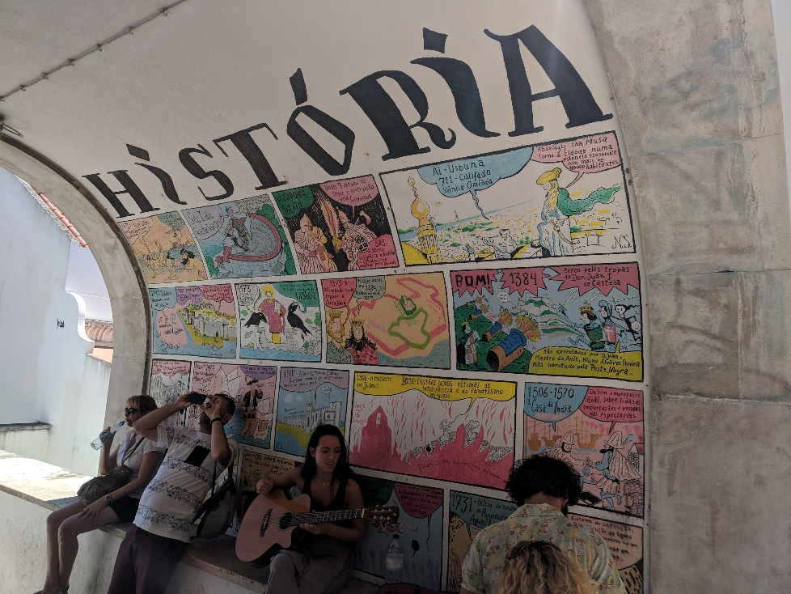
Why Lisbon Portugal?
Five-hour time difference from the east coast in January
Opportunity to learn about a new culture and language while studying technologies and AI
Various excursions around Portugal
Warmer temperature compared to Baltimore in January - Lisbon Average 53 degrees (Baltimore 36 degrees)

Slide 5

The Study Tour includes:
Breakfast included nearly all days, some lunches and some dinners
In country transportation
Local guides in Portugal
Double occupancy 3- hotel room in Lisbon (breakfast included)
  *solo room request incur additional fees
Welcome Dinner
Entrance fees to scheduled cultural excursions and Activities
One full day trip and a half day trip to Sintra and Evora

Slide 6

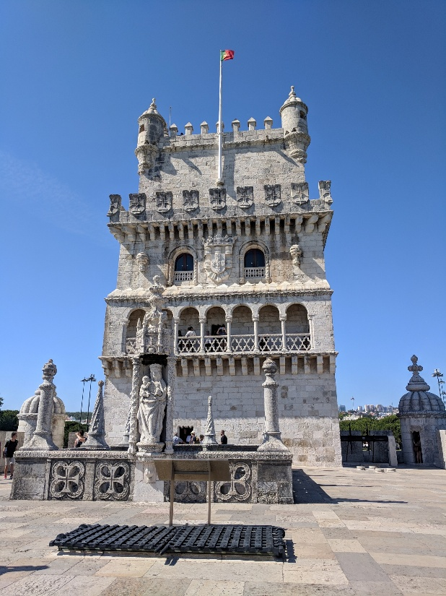
Tentative schedule
Thursday, January 1, 2026:
Go to your airport and depart the for Lisbon, PT

Slide 7

Tentative schedule:
Friday, January 2, 2026:
Arrive in Lisbon and be greeted by Laurie and Worldstrides
Arrive at hotel-store luggage if check-in is unavailable
Health and Safety Orientation
In the afternoon, enjoy a city tour
Welcome Dinner

Slide 8

Tentative schedule
Saturday, January 3, 2026:
Breakfast at the hotel
Lunch-Portuguese Cooking Class
Dinner on your own*
*students will be directed to local suggestions for meals that are "on your own" but will pay for these meals out of pocket

Slide 9

Tentative schedule:
Sunday, January 4, 2026:
Breakfast at the hotel
Sintra City Tour (Guided)
Sunset River Cruise (Guided)
Lunch and Dinner on your own

Slide 10

Tentative schedule:
Monday, January 5, 2026:
Breakfast at the hotel
Business Visit #1:
Lunch on your own
Dinner on your own

Slide 11
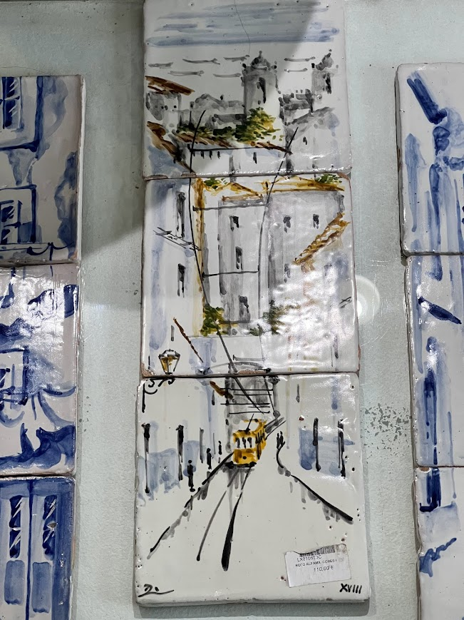
Tentative schedule:
Tuesday, January 6, 2026:
Breakfast at the hotel
Business Visit #2
Dinner on your own

Slide 12

Tentative schedule:
Wednesday, January 7, 2026:
Breakfast at the hotel
Museum of Communications (Guided)
Lunch On your own in seaside town
Visit Jeronimo’s Monastery and Belem Tower
Dinner and Fado Show

Slide 13

Tentative schedule:
Thursday, January 8, 2026:
Breakfast at the hotel
Coach to a UNESCO world heritage site-Evora
Olive Oil and/or Wine Production
Dinner on your own

Slide 14
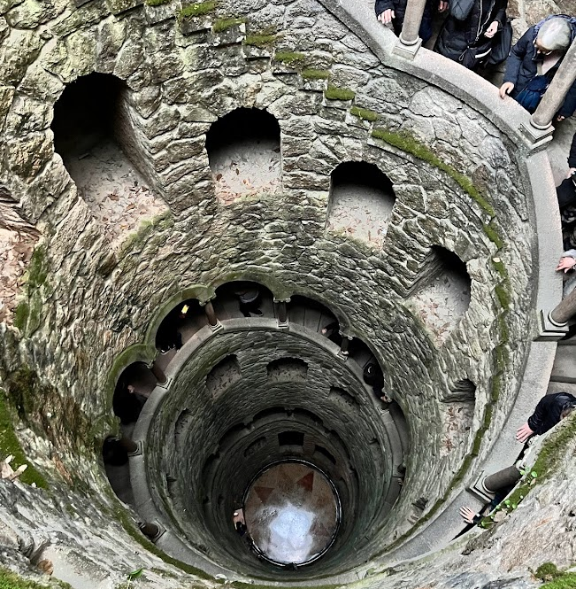
Tentative schedule:
Friday, January 9, 2026:
Breakfast at the hotel
LX Factory Neighborhood Tour-Alcântara
Transportation back to Loyola campus
Lunch and Dinner on your own

Slide 15
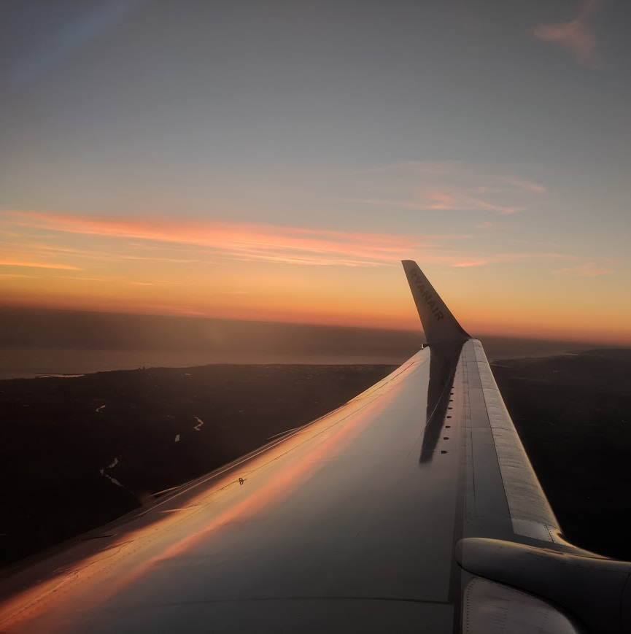
Tentative schedule:
Saturday, January 10, 2026:
Breakfast at the hotel
Students return flight home

Slide 16
Who should apply?
Students who:
Juniors and Seniors preferred but could consider Sophomores with good academic standing
MG 419 and IB 370 is cross listed to provide a management and global context

Slide 17
The application process
Apply online now through 11:59pm on Wednesday, October 8.
Deposit due Wednesday October 15th 11:59pm
Talk to Laurie Magnino about the course connection- MG419/IB370

Slide 18

The application process
Laurie will provide a link for a Microsoft forms. Students will also submit information to the OIP
This program has a maximum capacity of 20 participants
Priority will be given based on students taking the course MG419/IB370 and then to those in the Sellinger majors.
Students outside this major are welcome to apply as well!

Slide 19

Passports
Students in this program must have a passport that does not expire before July 11, 2026.!

Slide 20

Passports
The US state department is currently quoting passport processing times of 4-6 weeks for routine processing ($130, plus $35 acceptance fee) and 2-3 weeks for expedited processing (additional fee of $60). All students must have valid passports by November 21st.
Visit the US State Department website for more information on how to apply for a passport

Slide 21
Program fees
$3,250 per student paid directly to Loyola University
      Hotel accommodations
      Entrance & activity fees
      Private transportation during the program
      Local guides for duration of the program
      Some group meals
      *Does not include flights
      *solo room request incur additional fees

Slide 22
Scholarship opportunities
Higher Ed Traveler Scholarship – We understand the value of global travel and the positive
impact it can have on a student’s future success, so we created this merit-based scholarship
program in 2017 to allow more students the opportunity to make education abroad a reality.
Diversity & Inclusion Scholarship – This scholarship is intended for students with identities
underrepresented in education abroad, as we believe in extending the opportunity to learn
through experience to all students.
Natalie Shea Memorial Scholarship – Natalie Shea was a beloved colleague at WorldStrides,
and after her passing in the Fall 2020, we wanted to celebrate her enthusiasm for travel by
offering a scholarship in her name. Through Natalie’s legacy, we hope to inspire deserving
students to explore the world through a new lens for years to come.

Slide 23
Accepted Student requirements
Participate in all workshops and pre-departure meetings
(at least one/month starting in late October).
Remain in good academic and disciplinary standing. Conduct violations may result in dismissal from the program and student liability for any un-recoverable costs paid on their behalf.
.

Slide 24
FAQs
Q. What are the different types of housing available during the program?
A. Students will share a double occupancy hotel room during the program.
Q. How would this program impact my courses?
A. This program is over the winter break; you will be back on campus before the start of the spring semester.
Q. Are there any costs we should expect that are not covered by the program fee?
A. Students will be responsible for the cost of lunches and some dinners on this program, in addition to any personal spending money for shopping or free-time activities.
Q. Are there any pre-requisites to be considered for this program?
A. Students who will be taking the course should have all pre-recs completed prior to Spring ‘26 semester
Q. Will this itinerary change at all?
A. WorldStrides reserves the flexibility to make changes to an itinerary if necessary. In the case of removing an activity, alternate activities will be substituted.

Slide 25

Questions

