Slide 1
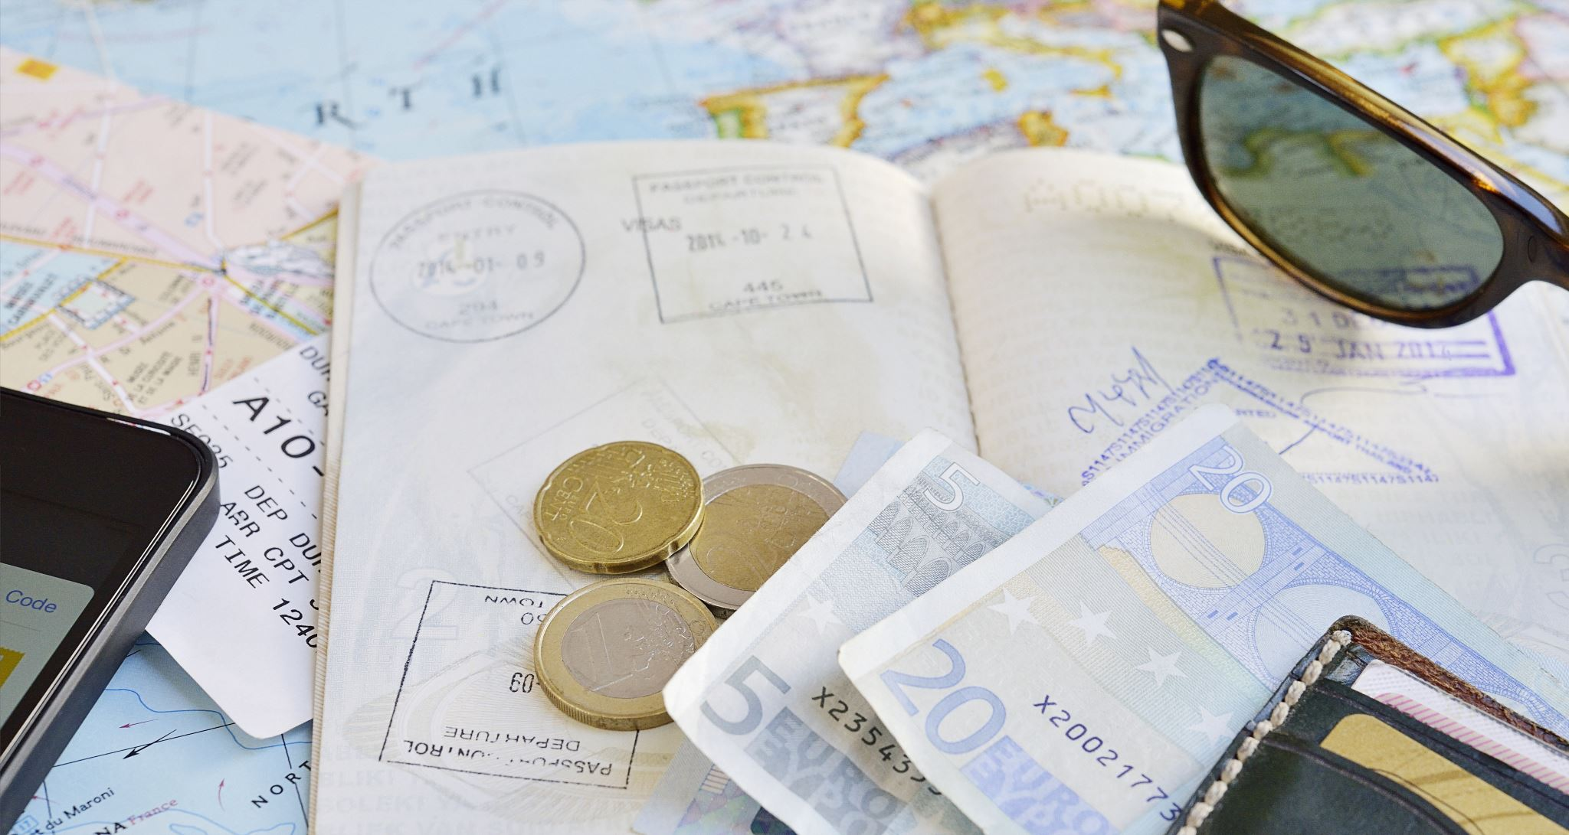
Passports
And everything you need to know about them!

Slide 2
First, the Basics!
What is a passport? Officially, it's a request for foreign governments to allow you access into their territories to travel/temporarily reside while having access to any lawful aid and protection while there.
Who needs a passport? If you plan on entering a foreign country/territory/principality that is NOT under the protection umbrella of the United States of America, then that means you, buckaroo!
Why a passport? Good question! Seems silly to need a permission slip to see members of our own species, huh? But that’s how the cookie crumbles and it is a requirement for international travel at Loyola.

Slide 3
Second, how to get your passport
Now that we know what a passport is, how do we get one? To apply for a new US passport, you must first be a.) A US citizen by birth or naturalization, or b.) An eligible US non-citizen.
If you meet those requirements, then you must apply IN PERSON at a passport acceptance facility. You CANNOT apply online, through the mail, by carrier pigeon, or through your Aunt Fanny. It must be YOU.
Passport acceptance facilities vary from post-offices to libraries to courthouses. https://iafdb.travel.state.gov/ lets you search based on zip code and can filter results to include those with on-site photo services.
Be sure to make an appointment with your facility as some keep odd hours or do not accept walk-ins. Now, as to whether you’ll be SEEN at the time of your appointment…¯\_(ツ)_/¯

Slide 4
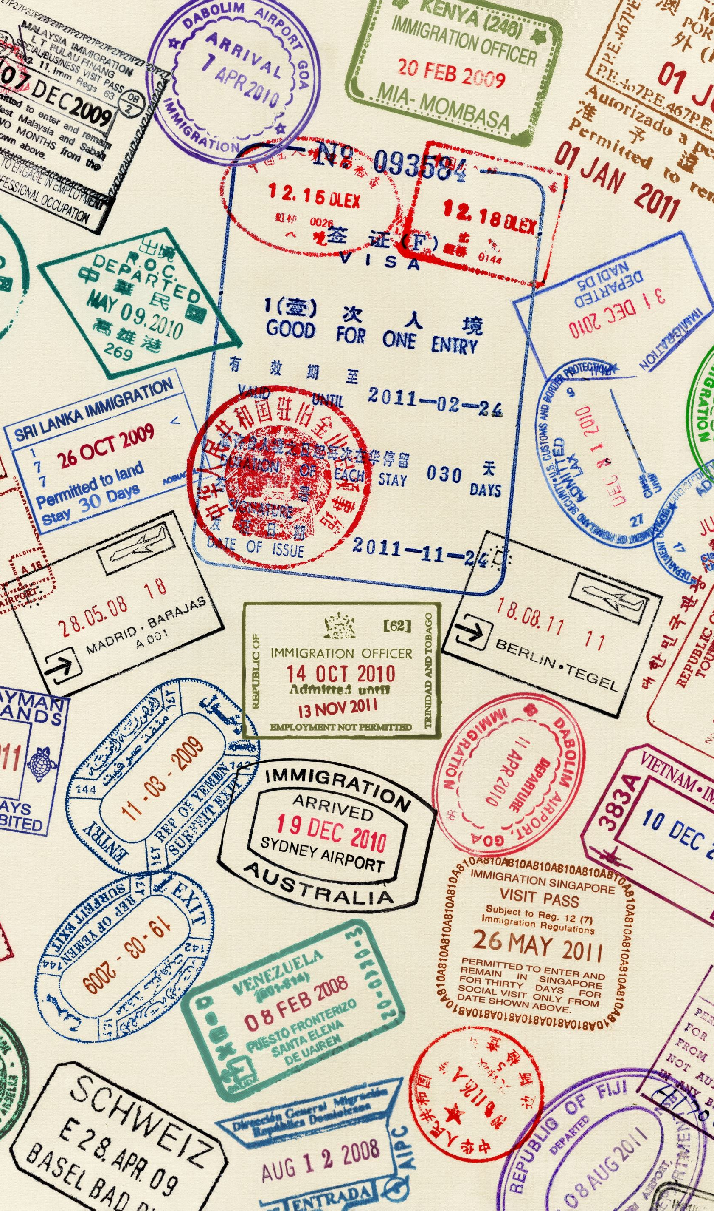
Okay, you’re at the facility; now what?
You will need Form DS-11. You can fill this form in online and print it, complete it by hand, or pick it up at your facility and finish it while you’re there. DO NOT sign Form DS-11 until the passport acceptance official tells you to, or you’ll be sent to the back of the line with a new DS-11 to fill out.
You. Must. Bring. Evidence of citizenship with you when you go to your facility. No, they cannot look you up in a database. No, they wouldn’t even if they could.
For those born in the US, your birth certificate is your best bet and listed first on travel.state.gov. You will need the ORIGINAL document with raised seal to meet the requirement. You will also need a photocopy of your birth certificate, and this will be taken with your application. Electronic or mobile copies are NOT accepted in any way, shape, or form.
For those born outside the US (you lucky ducks), you must submit a US passport that was valid for 10 years, your Certificate of Naturalization, your Certificate of Citizenship, and this Certification of Birth.
If you were born in the US but your birth certificate has ventured to lands unknown, other documents you may bring are a delayed birth certificate, a Letter of No Record, and early public or private documents. The parameters for eligibility for these options can be found here.
If you were born outside the US but became a US citizen at birth, you will need your foreign birth certificate, your parents evidence of citizenship, your parents marriage certificate(if applicable), and a statement from your US citizen parents detailing all periods and places of their residence or physical presence in the US and abroad before your birth. If you became a citizen through your parent who naturalized or though the Child Citizenship Act, the hoops you’ll have to jump through are extensive. To be sure nothing is missed, please read the requirements here.

Slide 5
You must also bring a physical, government-issued ID which includes your photo and a photocopy of its front and back. Again, anything that must be displayed on a phone screen will not be accepted.
If your facility does not take pictures on site, you must bring a passport photo with you. Think less Instagram, more mugshot. The requirements are specific, and we advise you read them carefully here. Word to the wise, the Department of State is a stickler for details and can and will deny your application if your passport photo isn’t up to snuff.
If you have all your ducks in a row and your paperwork in order to the satisfaction of the passport acceptance official, it is now time to pay up; Uncle Sam isn’t letting you leave these fair shores for free. For a passport book, the application fee is $130, the acceptance fee is $35, and both may be submitted by check or money order and payable to “US Department of State.” Credit cards, debit cards, cash, Venmo, or your first-born are not acceptable forms of payment.

Slide 6
And now, we wait
The State Department operates on a time-table beyond mortal comprehension, but their website says that routine processing takes 10-13 weeks. Experience from our office says make that 12-15 weeks. Bear that in mind when booking your appointments….
Theoretically, for an additional fee, you can have the process expedited to a lightning fast 7-9 weeks. You know, in theory. Supposedly. So legend tells us.
If you have decided to see if the odds truly are ever in your favor and wait until the last minute, there is an urgent travel option. Within 14 days of your travel date, you must call your local facility and see if there are any appointment times available and you must provide proof of travel. We highly, highly recommend(aka we are telling you) that you DO NOT do this and wait until your plane is on the tarmac to try and get your passport. In this circumstance you can never be too early, but you can be too late and run the risk of jeopardizing your time abroad.
If you would like to up to date on where your passport is and its status, you can subscribe to email updates or follow the suggestions here.

Slide 7
So, you only need to renew….
Congrats! You can avoid human interaction! Passports may be renewed by mail so long as they meet these guidelines. The form to be filled out for this process is DS-82 and can be found under those guidelines. This form, your old passport, a new passport photo, and a check or money order for the $130 application fee must be sent via USPS only to National Passport Processing Center, Post Office Box 90155, Philadelphia, PA 19190-0155.
Your passport does not have to be expired to be renewed and its expiration date MUST BE valid through 6 months from your time of travel. For example, if your plane leaves for Denmark on 8/26 and your passport ONLY has validity for the next 5 months and 29 days, regardless of when your semester ends, that passport must be RENEWED. This point is non-negotiable and must be done if you want to get on a plane out of here.

Slide 8
FAQ
Where is my passport? I applied ages ago! – We feel you, but unfortunately our powers here are limited. If you have waited over 2 weeks since the date your application status was marked “Mailed” and you have not received your passport, you will need to contact the National Passport Information Center. They will be your go-to for any passport concerns or questions while still in the processing stage.
How will my passport arrive? – USPS First class, normally with your passport arriving first and your citizenship documents coming later in a second mailing. If you renewed, your old passport will be mailed back as well.
Do I get the passport book or the card? – For our purposes, get the book.
My passport was lost or stolen! Help! – We won’t coddle you and say this isn’t a big deal, but there are steps to take for this situation. If this happens outside of the US, you must contact the nearest US embassy or consulate to have it replaced. In the US, you can report your passport lost or stolen here and then you will be prompted to complete the DS-11 and follow the instructions from there.
Should I keep my passport on me as ID while I’m abroad? – Keep a photocopy of your passport with you while you’re abroad. As for the book itself, once you’re through customs and tucked away in your host university, hide it in your socks.

