Slide 1
Loyola Exchange: Montpellier

Slide 2
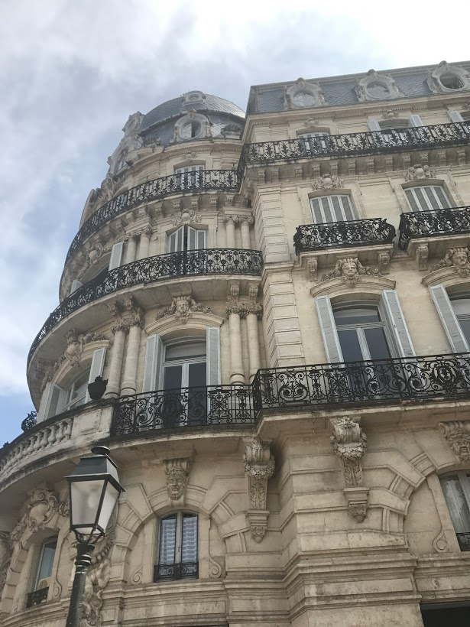
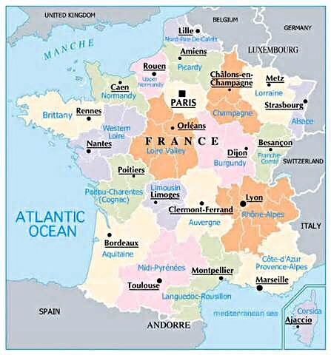
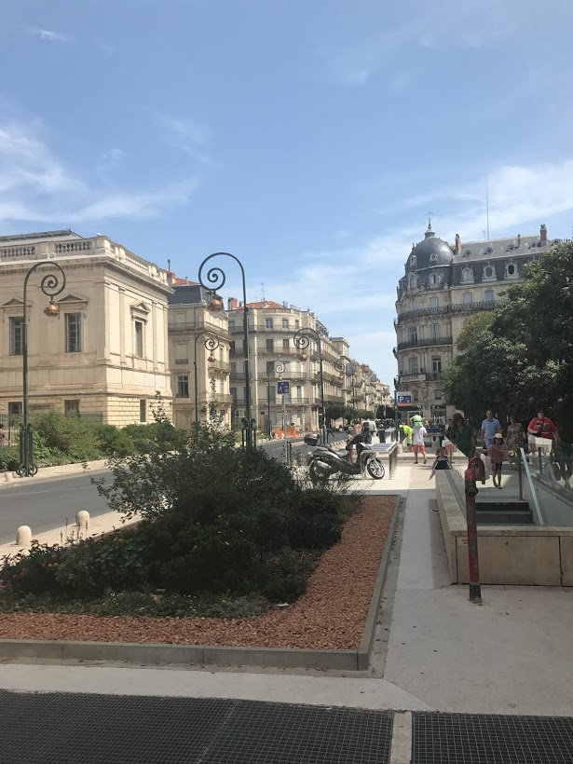
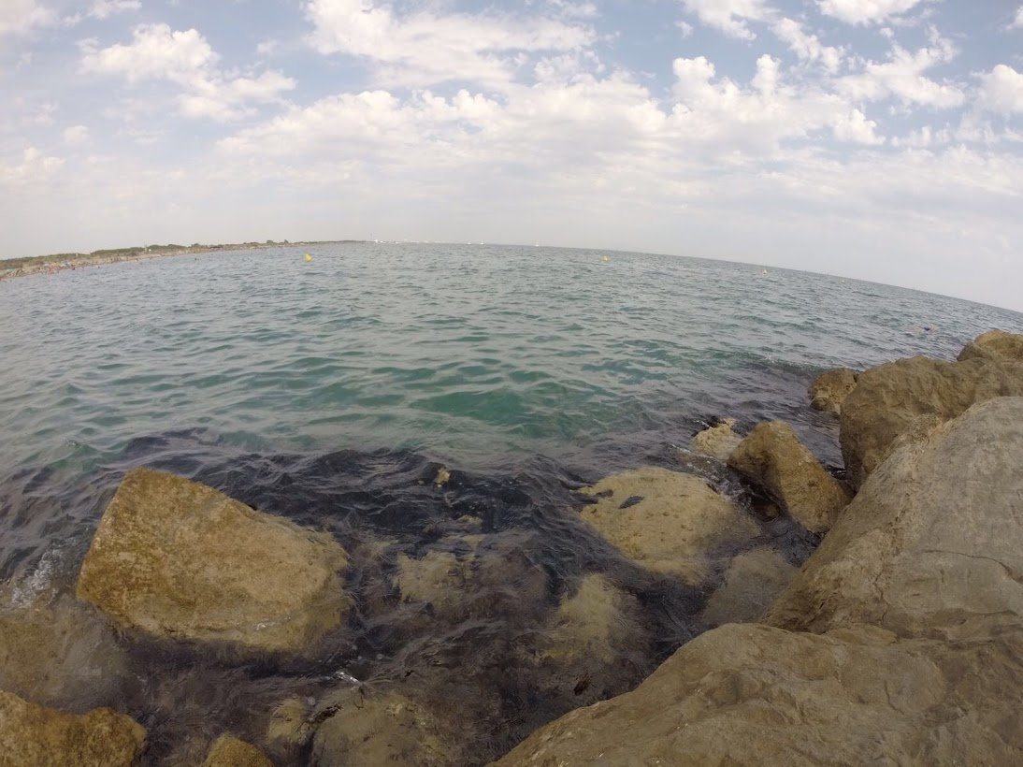
Montpellier
Population: ~275,000 (8th biggest city in France)
Location: South of France
10km from the Mediterranean Sea
Region: Languedoc-Roussillon

Slide 3
Montpellier cont.
Downtown area of Montpellier, La Place de la Comédie, features cafés, shopping centers, markets, Mediterranean architecture, and nightlife options
Montpellier has multiple art and history museums that offer free or reduced admission to students
The city has multiple gardens and outdoor landscapes, including the Esplenade (large park just behind la Place de la Comédie) and a botanical garden that are free to the public
Montpellier boasts beautiful and historically rich structures, such as an Arc de Triomphe, multiple historic statues, churches and cathedrals, an opera house, and a Roman aqueduct

Slide 4
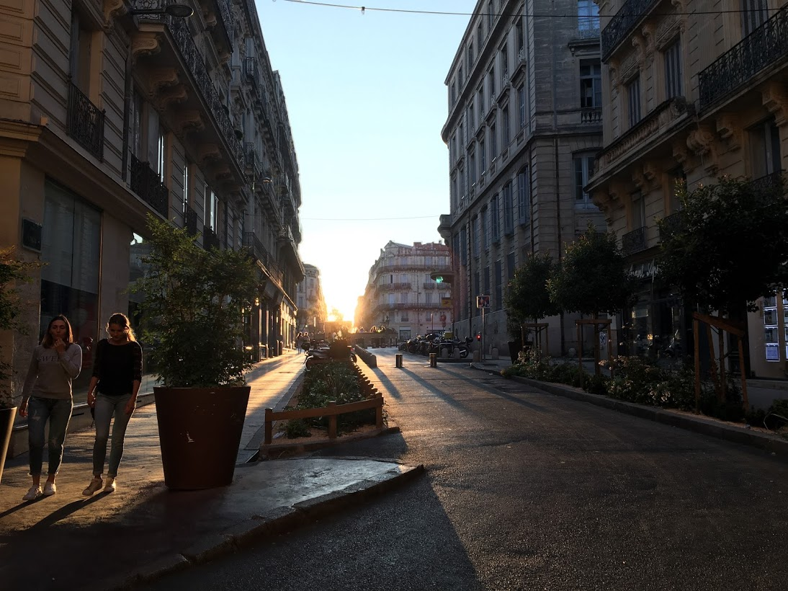
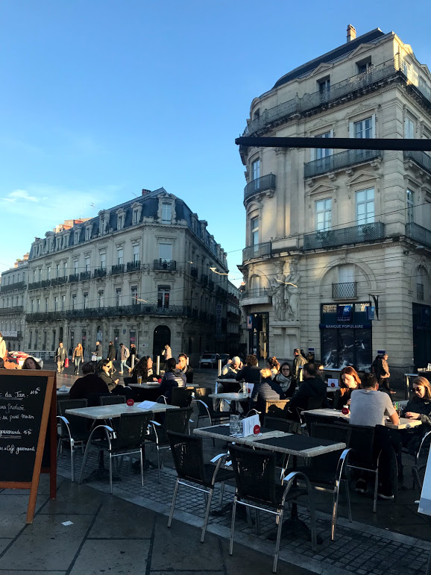
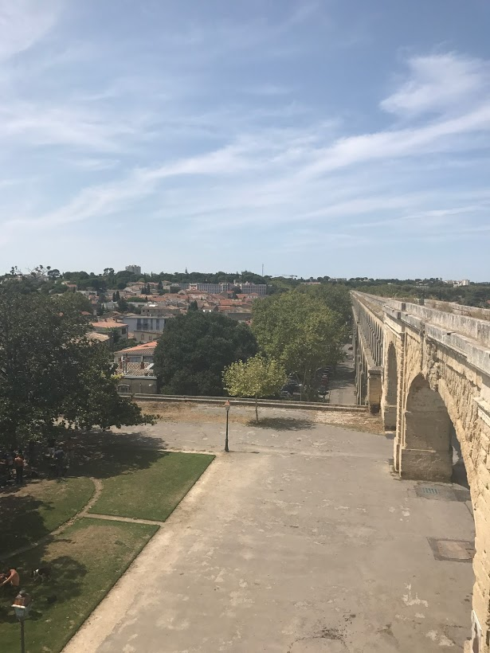
Loyola Exchange
Housing
Home stay (with host family)
Breakfast and dinner provided each day
Cité universitaire (dorm-style living)
Tuition/costs
Tuition is paid to Loyola (financial aid/scholarships
apply)
Students do not pay room and board or for meal plans
Housing costs paid directly to host family/institution
Students pay their own airfare to Montpellier and their own travel costs in France

Slide 5
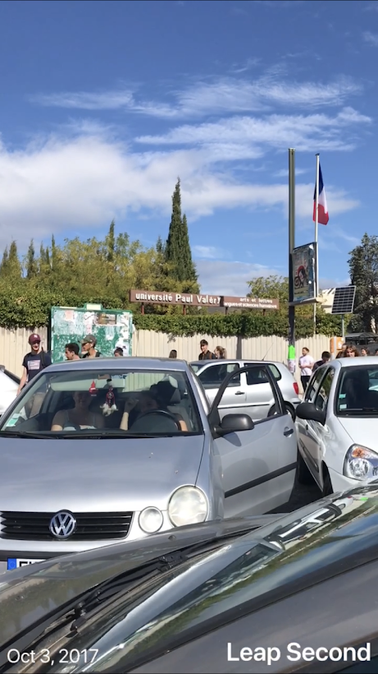
L’Université Paul Valérie
University of arts, languages, social sciences, and human sciences
RI Classes: Intended for English-speaking study-abroad students; taught in French
Courses vary by semester
Ex: Phonetics, Grammar and Methodology, French Civilization, Political Science, Practice of Writing, Cinema
Integrated Classes: General university classes intended for French students at UPV (all classes except for English are taught in French)
Art, history, economics, literature, sociology, political science
Core course equivalencies: Upper-level History and English
Fall semester: 3-week, 3-credit French immersion pre-fall course

Slide 6
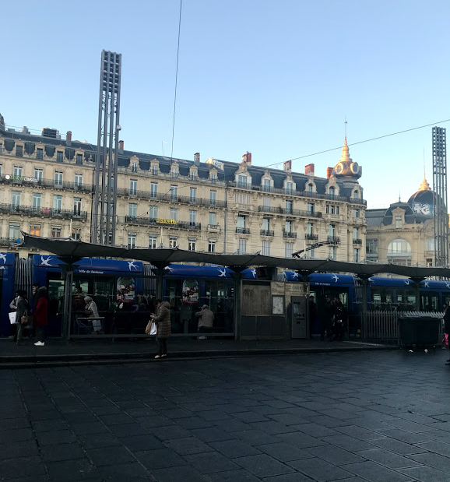
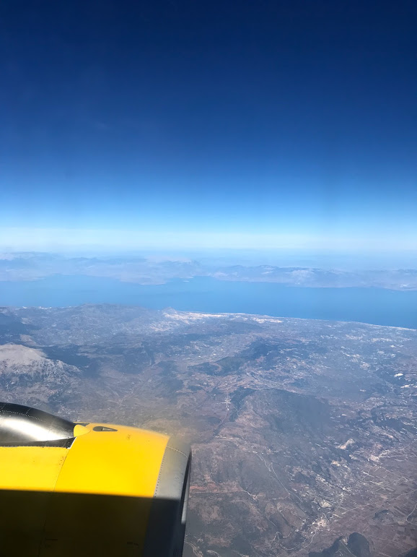
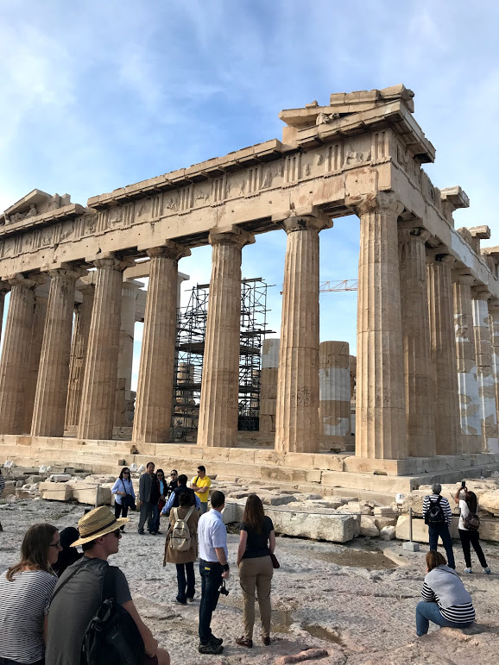
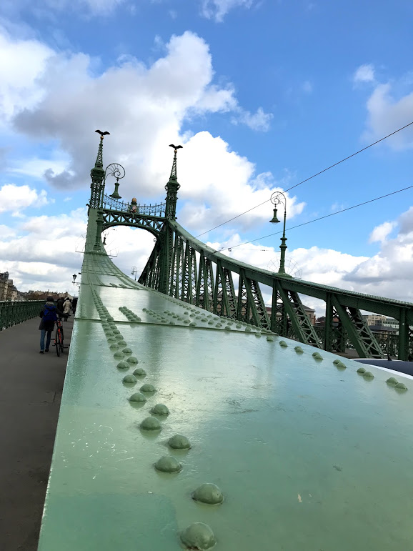
Travel
Within Montpellier, the tram system allows for easy commute and travel
A train stop at Place de la Comédie connects Montpellier to other French cities and cities in surrounding European countries
Montpellier is also located just a few hours from other major French cities (Marseille (2h), Nice (5h), Toulouse (2h30), Lyon (2h), Paris (3h30)
From Montpellier, it’s also possible to travel by train to surrounding European countries (Barcelona (3h), Monaco (6h))
An airport in Montpellier offers flights to some locations within and outside of France
Buses can also be effective, inexpensive ways of travelling around France or to surrounding countries

Slide 7
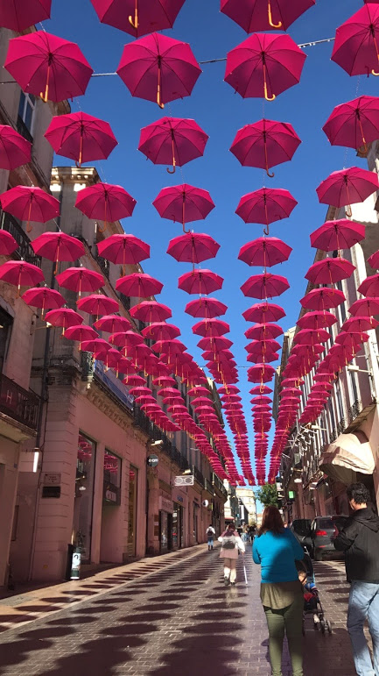
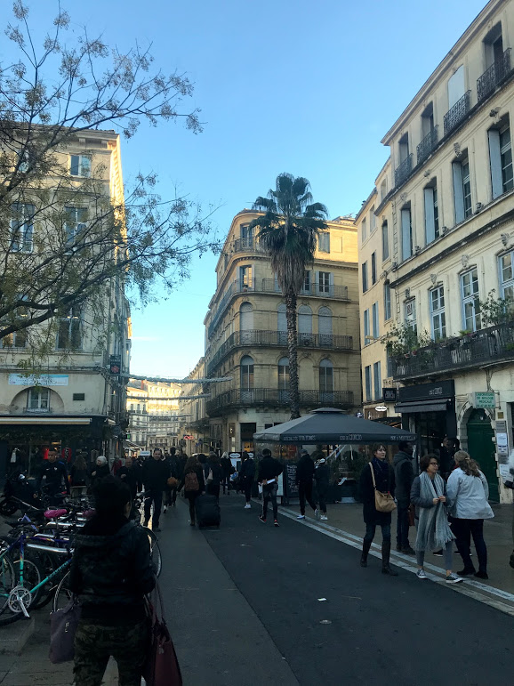
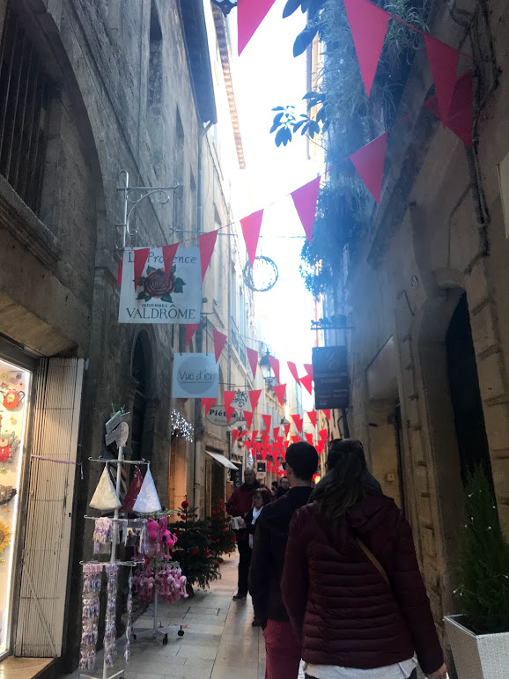
Know before you go…
Classes (with the exception of English courses) are taught in French for American students (students can also take integrated courses with French native speakers if they wish).
The exchange is intended for French majors and minors because of the many French credits earned during the exchange
It is therefore recommended that students save electives to be used abroad
The upper-level English and history cores can be taken at Montpellier.

Slide 8
Why Montpellier?
Opportunity to improve French language skills
Research has shown that foreign language skills are highly valued both for the effects that they have on the language learner’s cognition and by potential employers
Size: Montpellier is one of the 10 largest cities in France, but has a manageable, small-town feel
Location: Located just above the Mediterranean Sea, Montpellier has a strong Mediterranean feel in terms of architecture, climate, and atmosphere.
Personal growth: The Montpellier exchange allows for much freedom and choice on the student’s part of where to travel, what classes to take, etc. The full immersion component also requires students to embrace the French language and culture.
Students therefore come away from Montpellier with a greater worldview and a greater awareness of their personal capabilities.

