Slide 1
MORE THAN READY.
LOYOLA READY.

Slide 2

Office of Financial aid
Knott Humanities Center, Room 211
Email: financialaid@loyola.edu
Phone: 800-221-9107
410-617-2576
Fax: 410-617-5149
www.loyola.edu/financialaid

Slide 3
2023-24 Financial Aid Application Procedures www.loyola.edu/department/financialaid
2023-24 Free Application for Federal Student Aid (FAFSA)
  College Code Number 002078
  Student SSN required
      Use the Data Retrieval Tool (DRT) when completing the FAFSA.
You will be notified by the Office of Financial Aid if/when we need additional documentation to verify financial information.

Slide 4
Verification
The Loyola Office of Financial Aid compares information reported on the FAFSA with your income documents
Some students will be selected for verification by the Federal Government or Loyola
Students selected for verification will be notified through their Loyola email account with instructions for submitting required documents through Self-Service
Need-based aid will remain in a hold status until verification is complete
www.loyola.edu/department/financial-aid

Slide 5
William D. Ford
Direct loans
Subsidized Loan
Eligibility is based on demonstrated need
$3,500 (year 1), $4,500 (year 2), $5,500 (years 3 & 4)
Fixed interest rate set every July 1st (5.5 percent)
Interest benefit – Federal Government pays
interest while in school
Repayment begins after graduation
Unsubsidized Loan
Eligibility is not based on financial need
$2,000 each year
Fixed interest rate set every July 1st (5.5 percent)
No interest benefit – interest accrues while the
student is in school
Repayment begins after graduation

Slide 6
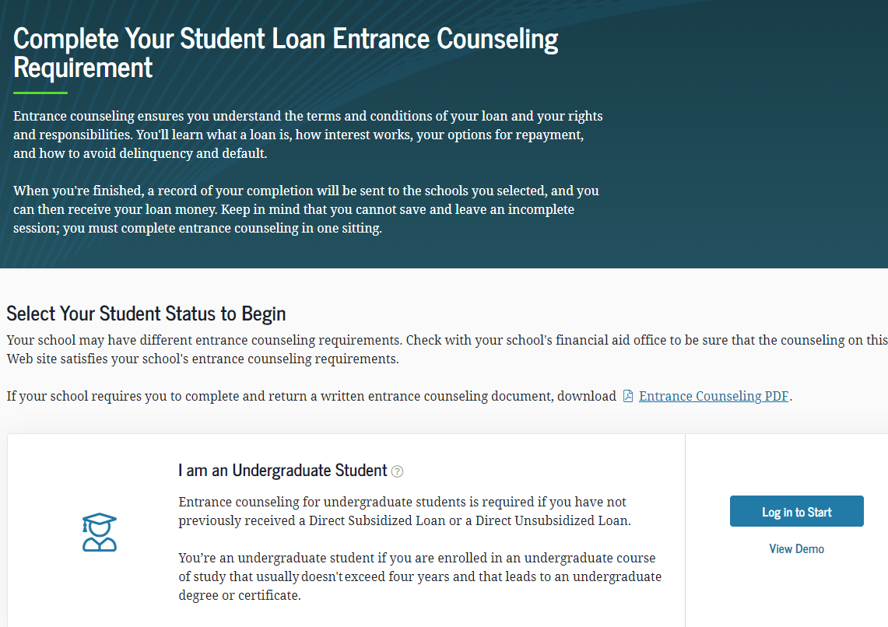
William D. Ford
Direct loans
Entrance Counseling
https://studentaid.gov/entrance-counseling/
Master Promissory Note (MPN)
https://studentaid.gov/mpn/

Slide 7
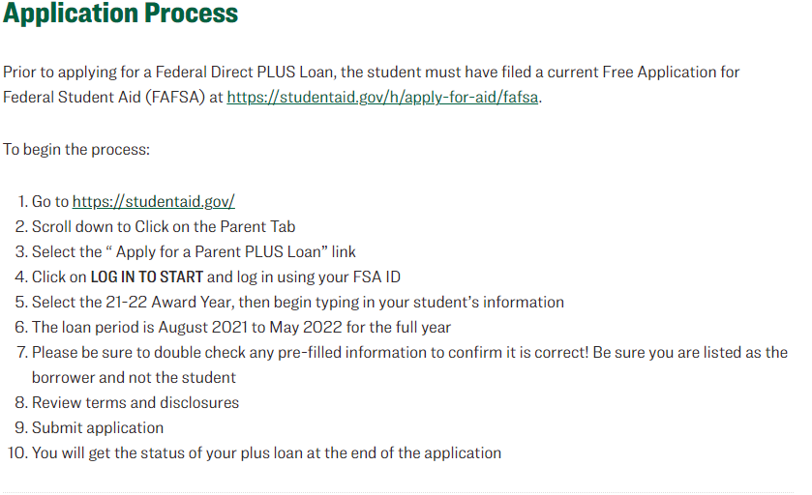
Federal Parent Direct PLUS Loan
Available to parents of dependent undergraduate students
Student must file 2023-24 FAFSA
Parent must have good credit history
4.228% origination fee
8.05% interest rate (disbursed between 7/1/23 - 6/30/24)
Interest accrual begins on the date of the first disbursement
Repayment begins 60 days after the second disbursement; repayment deferral option available
https://www.loyola.edu/department/financial-aid/undergraduate/programs/loans/direct-plus
Notes:
Due to the Bipartisan Student Loan Certainty Act of 2013, Direct Loans interest rates will be tied to the financial market. Under the new interest rate structure, rates will be determined each June for new loans and will be fixed for the life of the loan. The rates are calculated using a 10-year Treasury Note Index plus an add-on amount for each loan program and include interest rate caps.

Slide 8
Private Student Loans
aka Alternative Student Loans
Non-federal education loans
Made by banks, credit unions, etc.
Interest rates, fees and other terms set by the lender, not the federal government
May require a cosigner
Will probably have to be school certified – the lender will confirm with Loyola the student is enrolled and eligible to receive a private student loan

Slide 9
Federal work-study
Provides on-campus employment in administrative and academic departments
  Up to 20 hours per week
Minimum hourly wage rate currently $13.25 per hour (Maryland minimum wage)
FWS Employment Information (August via email)
  Job listings, payroll procedures and FWS manual
  Search job listing through Handshake
Detailed information available on Loyola’s Human Resources and Office of Financial Aid websites

Slide 10
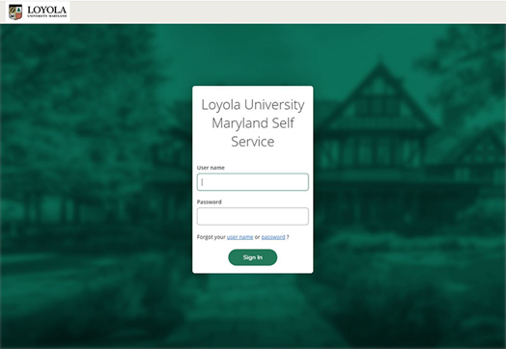
Financial aid self-service
https://www.loyola.edu/selfservice
Check financial aid status
View financial aid checklist
View financial aid award notification
Accept or decline federal work-study and/or federal student loans (if included in aid package)
Access helpful links
Parent Portal / Proxy Access Information

Slide 11
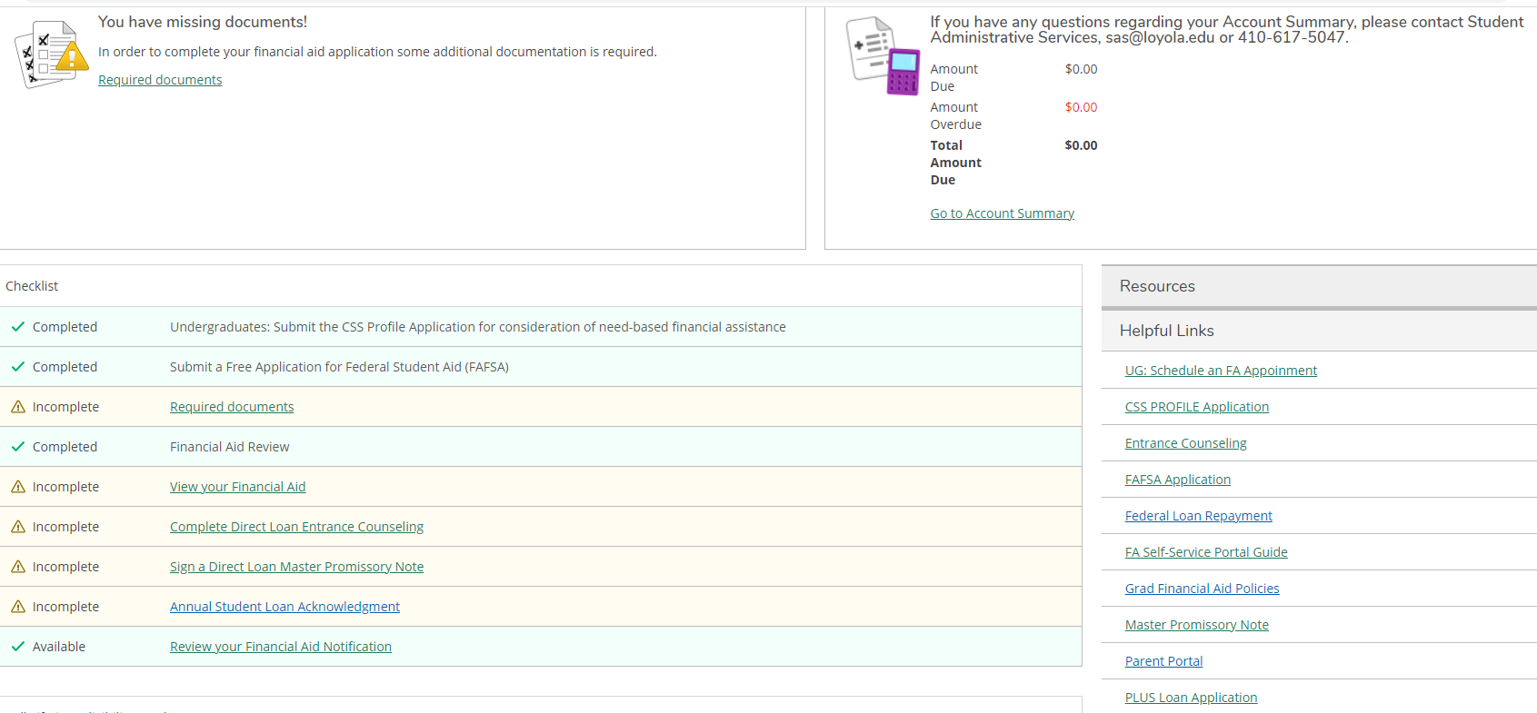
self-service financial aid homepage

Slide 12
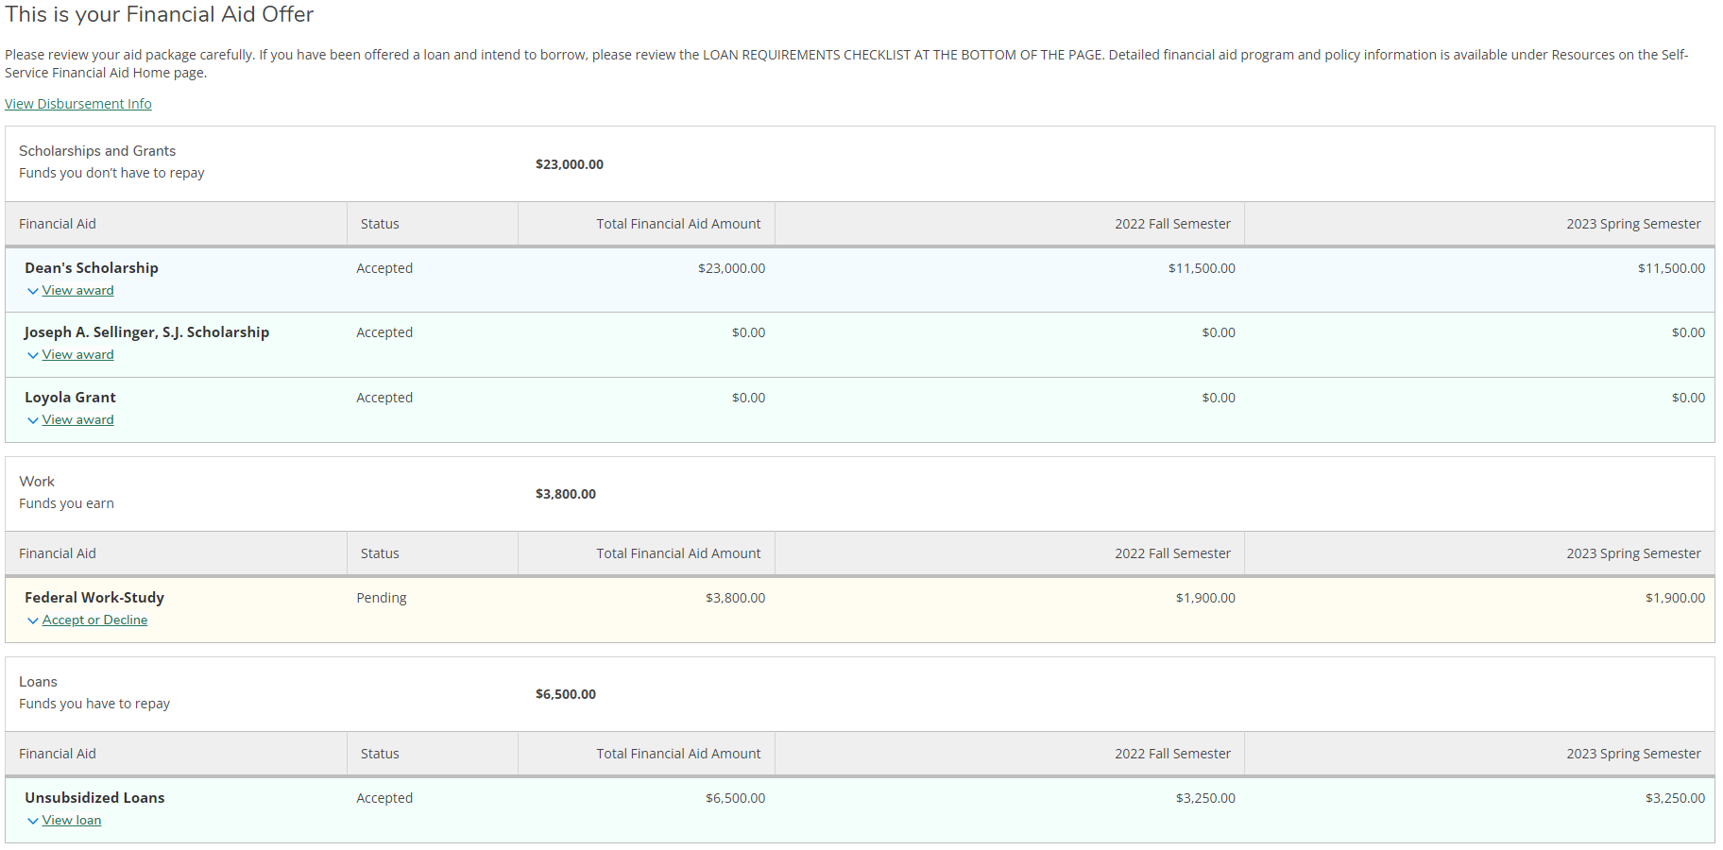
self-service “my financial aid” page

Slide 13
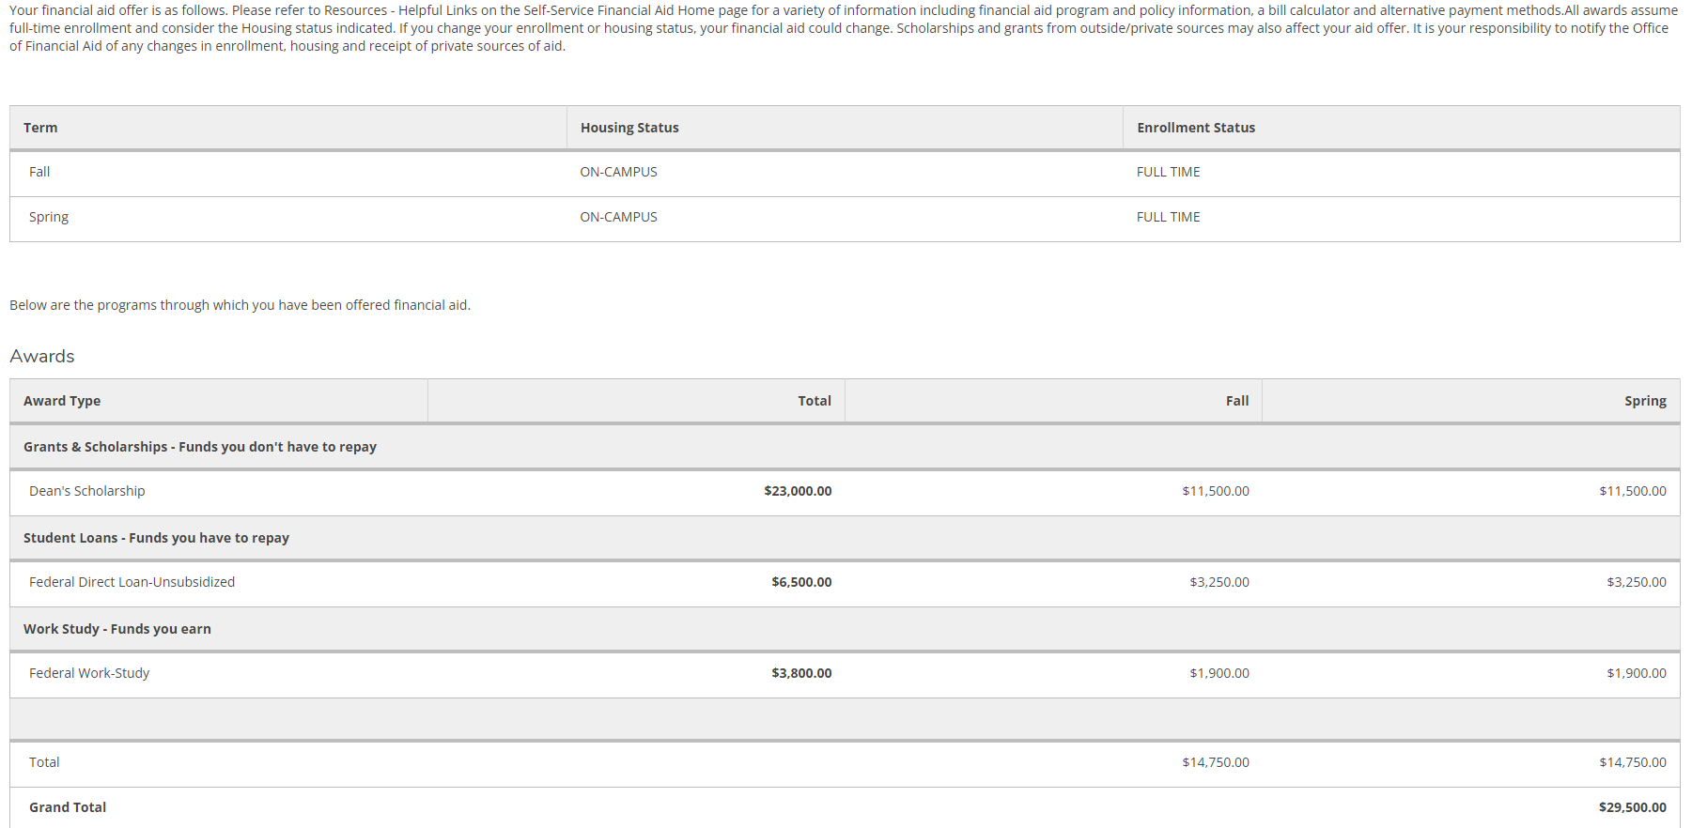
self-service financial aid offer page

Slide 14
Bill & PLUS Loan Calculators
Bill Calculator
https://www.loyola.edu/department/financial-aid/billcalculator
Parent Direct PLUS Loan Calculator
https://www.loyola.edu/department/financial-aid/paymentresources

Slide 15
Retention criteria
Loyola Merit-Based Scholarships
Presidential – Dean’s – Loyola - Loyola Transfer
Full-time enrollment
Minimum cumulative GPA – 2.0
Loyola Non-Need-Based Grants
Baltimore Diocesan – Community College – Evergreen & Evergreen Community – Family – Legacy – Magis – Phi Theta Kappa – Charm City Promise
Full-time enrollment
Minimum cumulative GPA – 2.0
Federal, State, Loyola Need-Based Aid (Grants, Loans, Work-Study)
Satisfactory Academic Progress (SAP)
Minimum cumulative GPA – 1.8 after first year at Loyola, 2.0 each year thereafter
Complete at least 67% of attempted credits
Complete bachelor’s degree within 150% of the stated number of credit hours for an academic program (6 years)
Loyola Undergraduate Sap Policy
https://www.loyola.edu/department/financial-aid/undergraduate/policies/sap

Slide 16

2024-25 Financial Aid
Application Procedures
2024-25 FAFSA
Based on student and parent 2022 income

