Slide 1
Being Your Best Self: Caring for Yourself while Supporting Students
Self-Guided Faculty/Staff Presentation Mode
Counseling Center
Loyola University Maryland
Notes:
Initiate introduction with the others in the room if you are engaging in this presentation with others. Introductions ideally would include:
Name and pronouns
Role and years at Loyola
One thing you hope to receive from today’s presentation
Depending on how many people in the room, this is likely to take between 5-10 minutes

Slide 2
Self-Guided Presentation Tips
While many of the activities will be identified within the slides, please reference the Notes section as some activities or examples of activities will be written out there.
If engaging as a group, please allow space for pauses for others to comment, engage in reflection, or ask questions.
Resources are provided at the end of this presentation for ways you can seek addition support around self-care strategies as well as seeking mental health services.
Notes:
All content in slide

Slide 3
Objectives
Understand the why’s and how’s for caring for yourself when supporting students.
Identify basic strategies for improving mental health.
Share resources and explore how to seek support.
Notes:
All content in slide

Slide 4
Setting Context:
The Why’s
“Why are we talking about this topic?” “Why do you need support when helping students?”
To prioritize your mental health and well-being
To be a better support person
Airplane metaphor (you must put your mask on first in a crises situation)
Thinking sustainably (to better create a system of support where the same practices for health we espouse to others we also engage in ourselves)
To create a ripple effect of community care
If our system is burnt out, so are we → if we are burnt out, so is our system
Notes:
Offer space for thoughts/reactions from group prior to moving to next slide

Slide 5
Brainstorming Icebreaker* Think about for a few minutes individually and then report out as a group. See notes section for examples to each question if you feel stumped.*
What’s one way you prioritize your mental health?
What’s an example of a way you supported a student recently?
How do you find community?
Notes:
Depending on the size of the group try to garner up to three answers per question:
#1 What’s one way you prioritize your mental health?: : 1-3 answers. Give an example if necessary – e.g., journaling at night; meditation/yoga/some other form of activity weekly; etc.
#2 What’s an example of a way you supported a student recently?: 1-3 answers. Give an example if necessary – e.g., sat with a student who felt overwhelmed about a project and helped them come up with an actionable plan to make more manageable; referred a student to the Counseling Center/SSWP; connected a study with DAS for accommodations)
#3 How do you find community?: 1-3 answers. Give an example if necessary – e.g., book clubs, place of religious or spiritual worship, friends, etc.
Depending on how many people in the room, this is likely to take between 5-10 minutes

Slide 6
Faculty/ STAFF Burnout
The majority of burnout is a systems-level issue
We work in imperfect systems:
Lack of societal resources for childcare or eldercare
Cultural attitudes toward productivity and work/life balance
Constant connectivity & expectations of immediate response
Notes:
Questions to offer for folks to reflect on to identify whether they are experiencing job related burnout (please name they DO NOT need to share out about these experiences to the group – this is for their internal reflection):
Do you question the value of your work?
Do you have to force yourself to go to work/ do you have trouble getting the workday started?
Do you feel removed from your work and the people you work with?
Have you lost patience with colleagues or students?
Do you lack the energy to do your job well?
Is it hard to focus on your job?
Do you feel little satisfaction from what you get done?
Do you doubt your skills and abilities?
Do you have headaches, stomach or bowel problems, or other physical complaints with no known cause?
Have you noticed any significant behavioral, medical, or routine changes?
After reading off the questions, please allow 1-2 minutes for folks to reflect silently

Slide 7
Notes:
Introduction to conversation:
If we try to imagine the sector of burnout which we have control over, there are some ways in which we can intervene personally and ways we can seek community on campus to intervene at more systemic levels.
Discuss ways you can address burnout at a personal level and within community on campus either in pairs or as a group depending on the number of participants.
Time for conversation should be approximately 10 minutes. If meeting in pairs, allow 5-7 minutes for pairs to discuss and then 3 minutes for sharing out Potential ways to address at personal level: time management, making sure you have a balance of experiences in life focused on achievement (e.g. work) and focused on pleasure, engaging intentionally with support systems and families (bio and chosen), therapy, self-care, engaging in values-driven experiences outside of work (e.g. volunteering, church, hobbies, exercise/fitness, etc)
Potential ways to address at community (systemic) level: request support to attend professional development opportunities and conferences, join mentorship and support spaces for faculty and staff offered, participate in campus events that are major points of feedback and questions, such as town halls, participate in or start spaces for representation and advocacy (e.g. Out Loyola, The Collective), participate in training, wellness, and education focused offerings such as brown bag series, find points of contact in the areas where you’d like to collaborate and identify ways to combine resources around shared missions to increase person power and voice , request to join groups tasked with evaluating needs and implementing action (e.g. steering groups, task forces), find community orgs or social groups in your neighborhood/city that meet your values and needs for connection

Slide 8
Barriers to Supporting Others and Ourselves* Think about for a few minutes individually and then report out as a group. See notes section for examples to each question if you feel stumped.*
What do you think are some factors that make it difficult to imagine holding emotional space for students while maintaining a sense of wellness for yourself?
This Photo by Unknown Author is licensed under CC BY
Notes:
Examples:
Lack of time/other duties than your primary roles
The number of students experiencing difficulties
Lack of awareness on ways to best express support
Difficulty containing one’s own emotional response

Slide 9
Secondary & Vicarious Trauma
Secondary trauma and vicarious trauma both result from bearing witness to the traumatizing experience of others, causing significant distress in oneself
Secondary trauma is more likely to present suddenly after being exposed to someone’s traumatic experience
Vicarious trauma is more likely to present over time and represent a broad change in attitude or worldview
Symptoms Include:
Difficulty concentrating or persisting in tasks
Feelings of numbness, hopelessness, of being overwhelmed
Experiencing trauma imagery – not just media or memories, but visualizations of described events
Physical and emotional hyper vigilance for threats or danger
Physically or emotionally withdrawing from others particularly salient for vicarious trauma among community/family/friend “rocks” or helpers and may be harder to detect
Spiritual doubt and worry
Fundamental shifts in beliefs about the world, people, and the future
Notes:
Presenter, please read out to group and encourage people to reflect on for 1-2 minutes)

Slide 10
ABC’s of Preventing and Managing Secondary Trauma
Awareness: increasing insight, knowledge, and reflection of yourself and your needs
Balance: Preventative measures to create sustainability and recognition of varied needs
Connection: support seeking and community engagement
Adapted from Saakvitne, K. & Pearlman, L. (1996). Transforming the Pain: A Workbook on Vicarious Traumatization for Helping Professionals who Work with Traumatized Clients. New York, New York: W.W. Norton and Company.
Notes:
Read and brainstorm a few ways to do each of these (to be shared with group when discussing next several slides)

Slide 11
Awareness
Identify what activates and/or triggers you
Example: If somebody talks about the death of a loved one and you recently had a death in your family
Be aware how your triggers/activating events can affect how you view and do this work
Review lifestyle choices and recognize whether you need to make adjustments/additions
Examples: Do you get enough sleep? Do you allow yourself downtime? Do you exercise regularly?
Know your limits and what boundaries you need to create
Can inform how and when you delegate & refer to other offices (such as academic deans, SSWP, Counseling Center, the Study, etc.)
Notes:
Questions in slide – please encourage sharing of ideas (get 1-3 people to respond out to group

Slide 12
Awareness: Empathy vs. Sympathy
Sympathy is going down with the ship
It is always okay to feel sad on behalf of somebody else, but if you find your emotions taking over and impacting the support you provide, you might be feeling sympathy
Empathy is helping others to their life rafts, yourself included
Sympathy opens a door of the supported person having to support you
If you can look at somebody from a balcony level view and help people help themselves, you are more likely feeling empathy
Notes:
Read out to group. Invite thoughts/reactions

Slide 13
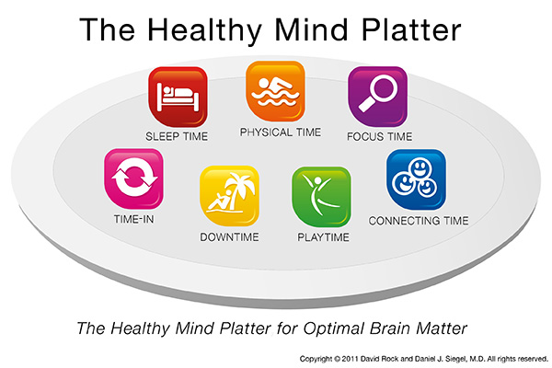
Awareness: Lifestyle Choices
Can you identify examples?*
Notes:
Please read: Dr. Dan Siegel and David Rock define the Healthy Mind Platter as containing “seven daily essential mental activities necessary for optimum mental health” and the promotion of an integrated and balanced life strengthened by the brain’s internal connections and the connections within your environment and interpersonal interactions.
*Have people identify at least one example for each component of the healthy mind platter

Slide 14
Balance
Allow yourself to experience authentic emotional reactions
Set and maintain clear work boundaries and expectations
Engage with your limits and boundaries: Refer & Delegate
Practice time management skills
Avoid maladaptive coping (e.g., alcohol misuse)
Try something you haven’t tried before
What’s something new you’ve been wanting to add to your leisure list?
Notes:
Questions in slide – please encourage sharing of ideas (get 1-3 people to respond out to group)

Slide 15
Balance: Leisure Activities
Yoga
Planning trips or vacations
Meditating
Being with Animals
Creative writing or journaling
Exploring a new place
Being in nature
Spending time with friends or family
See the full DBT list of Pleasant Activities Examples!
Notes:
Share ideas (click on link in slide to pull up list for folks to see other options if stuck/no responses initially) If presenter, please send this list out after via email or print hardcopies for in person gatherings

Slide 16
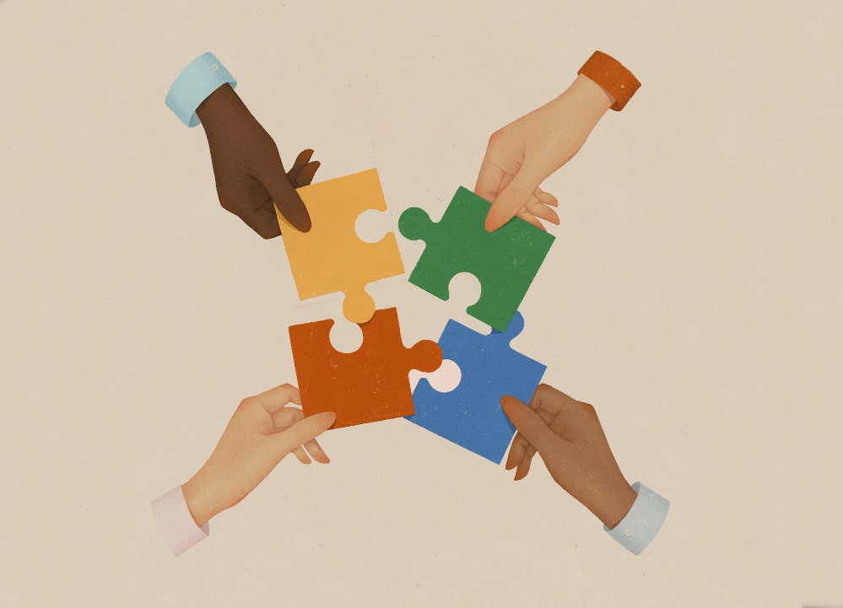
Connection
Avoid professional isolation
Enhance and increase external support
Family, friends, partners, pets
Seek mentorship/be a mentor
Seek spiritual support
Notes:
please encourage sharing of ideas (get 1-3 people to respond out to group)

Slide 17
Connection: Role of Identity
Shared identity as beneficial; Over identification as a barrier
Sharing an identity with someone you are supporting can increase rapport, mutual understanding, trust, and knowledge of solutions
Over identification can cause you to feel overinvolved
In supporting yourself, consider how you find community
Spiritual/Religious Centers
Race and Ethnicity
Sexual and Gender Identity
Ability
Notes:
Please offer time to reflect on this notion

Slide 18
Resources
Apps
Loyola Specific
In the Community
Notes:
Please introduce shift in focus to now being providing resources – encourage folks who don’t have access to the slides to take pictures or let them know you will send them out later so they can access this information at their own pace

Slide 19
Mental well-being apps
Calm: Calm produces meditation products, including guided meditations, a book, narrated Sleep Stories, and health and meditation videos. Their primary product is the meditation app, available on iPhone and Android devices. They offer resources specifically for teachers (including faculty).
Headspace: Meditations, exercises, inspiring wake-up stories, sleepcasts, music, audio experiences and courses. Available on iPhone and Android devices.
How We Feel: Mood tracker. Includes the impact of sleep, exercise, and weather. Provides analytics to better understand your mood patterns. Available on iPhone and Android devices.
Notes:
Read through slides - Encourage folks to take photos

Slide 20
Loyola Specific resources
Employee Assistance Program (EAP)
Mental Health Task Force
SAFE-TY Notices
RecWell – FAC Membership
Human Resources Wellness Page
Counseling Center
Secondary and Vicarious Trauma
Faculty and Campus Partner Resources
Notes:
Read through slides - Encourage folks to take photos

Slide 21
Therapy Resources*
EAP through LUM
Psychology Today
Inclusive Therapists
Neurodivergent Therapists
Open Path Collective
*Therapy is not always necessary even if everyone can benefit from therapy
Notes:
Read through slides - Encourage folks to take photos

Slide 22
Notes:
If you have time, click on the image for an example of the resources on the counseling center’s relaxation page. This is a 9-minute guided meditation you can engage in as a group or individually.

Slide 23
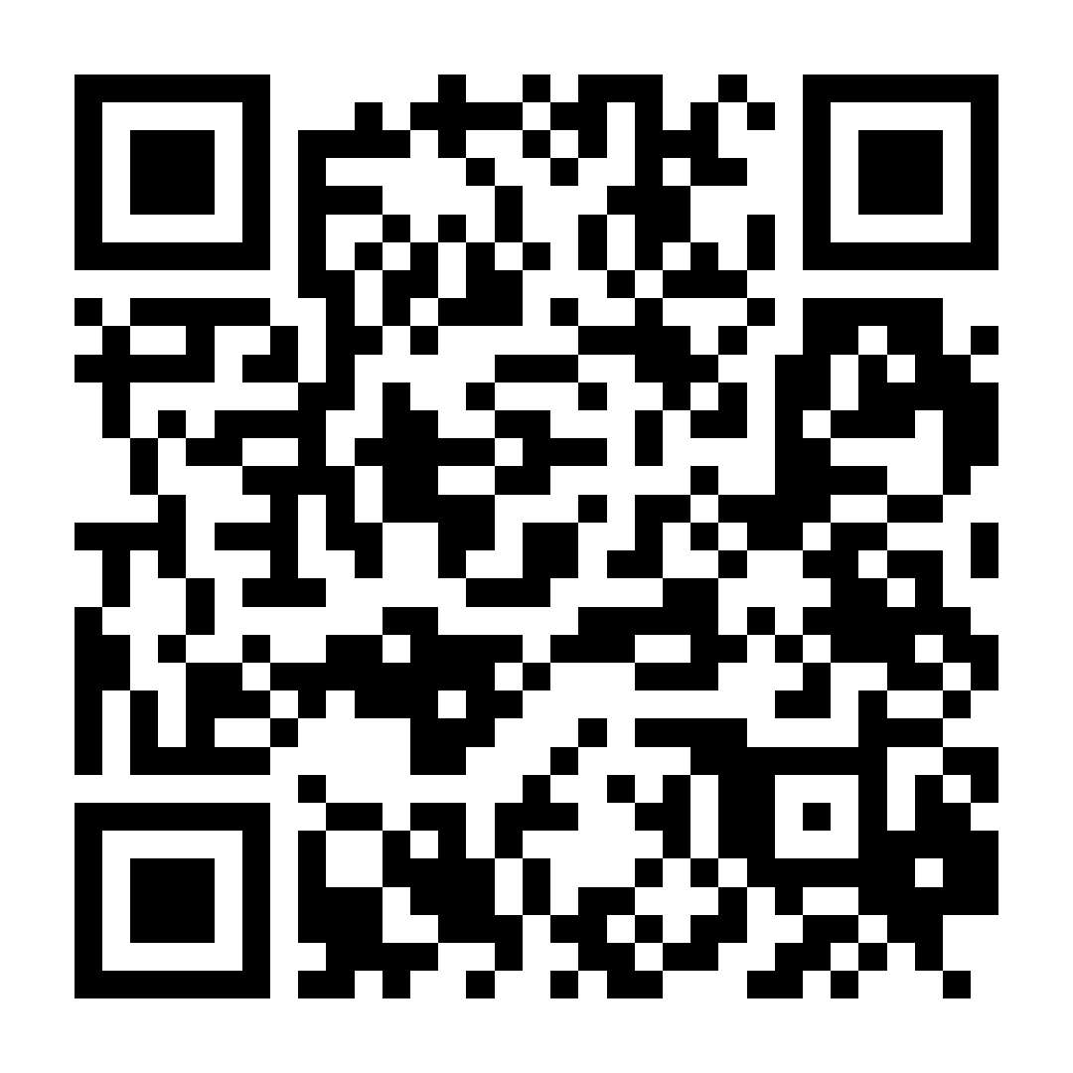
Questions?
Scan the qr code to fill out the evaluation survey!
Email the Counseling Center at counselingcenter@loyola.edu
Notes:
NOTE: Please inform folks that in the Evaluation Survey where it mentions “the facilitator” they should answer it as though they are referring to the Counseling Center as the creators of the material and not an evaluation of the faculty/staff presenter.

